Slide 1
The Good, the Bad, and the Ugly
Politicians in U.S. History

Slide 2
Not Perfect
“The Bible has little to say in praise of men. Little space is given to recounting the virtues of even the best men who have ever lived. This silence is not without purpose; it is not without a lesson. All the good qualities that men possess are the gift of God; their good deeds are performed by the grace of God through Christ. Since they owe all to God the glory of whatever they are or do belongs to Him alone; they are but instruments in His hands. More than this--as all the lessons of Bible history teach--it is a perilous thing to praise or exalt men; for if one comes to lose sight of his entire dependence on God, and to trust to his own strength, he is sure to fall. Man is contending with foes who are stronger than he. "We wrestle not against flesh and blood, but against principalities, against powers, against the rulers of the darkness of this world, against wicked spirits in high places." Ephesians 6:12, margin. It is impossible for us in our own strength to maintain the conflict; and whatever diverts the mind from God, whatever leads to self-exaltation or to self-dependence, is surely preparing the way for our overthrow. The tenor of the Bible is to inculcate distrust of human power and to encourage trust in divine power.” PP 717

Slide 3
Some good things
Men are not to be praised, ‘for all have sinned and come short of the glory of God’ (Rom. 3:23),but some men in America have stood up against the evils perpetrated by Rome/Jesuits and have suffered for their bravery. We salute them for their right actions!!
From the very inception of this great nation, a battle has raged against her. A powerful, united country, offering Protestant freedom, government of, by, and for the people, with the accompanying blessing of economic prosperity in a middle class could not and would not be tolerated by the powers of Rome/Jesuits. If allowed, all nations of the earth would embrace these Protestant advantages and would oust the papacy from their shores.

Slide 4
The Battle Has Raged
“The sovereigns of the ‘Holy Alliance’ had massed large armies, and soon entered into a pledge to devote them to the suppression of all uprisings of the people in favor of free government; and he [Pope Pius VII] desired to devote the Jesuits, supported by his pontifical power, to the accomplishment of that end. He knew how faithfully they would apply themselves to that work, and hence he counseled them, in his decree of restoration, to strictly observe the ‘useful advices and salutary counsels’ whereby Loyola had made absolution the cornerstone of the society.” — R.W. Thompson, The Footprints of the Jesuits, Hunt and Eaton, 1894, p. 251.
“The author undertakes to show that a conspiracy against the liberties of this Republic is now in full action, under the direction of the wily Prince Metternich of Austria, who knowing the impossibility of obliterating this troublesome example of a great and free nation by force of arms, is attempting to accomplish his object through the agency of an army of Jesuits. The array of facts and arguments going to prove the existence of such a conspiracy, will astonish any man who opens the book with the same incredulity as we did. — Samuel B. Morse, Foreign Conspiracy Against the Liberties of the United States, Crocker and Brewster, 1835, Preface.

Slide 5
Do you know?
“And do Americans need to be told what Jesuits are?… they are a secret society, a sort of Masonic order, with super added features of revolting odiousness, and a thousand times more dangerous. They are not merely priests, or of one religious creed; they are merchants, and lawyers, and editors, and men of any profession, having no outward badge by which to be recognized; they are about in all your society. They can assume any character, that of angels of light, or ministers of darkness, to accomplish their one great end… They are all educated men, prepared and sworn to start at any moment, and in any direction, and for any service, commanded by the general of their order, bound to no family, community, or country, by the ordinary ties which bind men; and sold for life to the cause of the Roman Pontiff. — J. Wayne Laurens, The Crisis in America: or the Enemies of America Unmasked, G. D. Miller, 1855, pp. 265-267.

Slide 6
How Far They would Go!
“I do further promise and declare, that I will have no opinion or will of my own, or any mental reservation whatever, even as a corpse or cadaver, but will unhesitatingly obey each and every command that I may receive from my superiors in the Militia of the Pope… I furthermore promise and declare that I will, when opportunity presents, make and wage relentless war, secretly or openly, against all heretics, Protestants and Liberals, as I am directed to do, to extirpate and exterminate them from the face of the whole earth; and that I will spare neither age, sex or condition; and that I will hang, burn, waste, boil, flay, strangle and bury alive these infamous heretics, rip up the stomachs and the wombs of their women and crush their infants heads against the walls, in order to annihilate forever their execrable race. That when the same cannot be done openly, I will secretly use the poisoned cup, the strangulating cord, the steel of the poniard or the leaden bullet, regardless of the honor, rank, dignity, or authority of the person or persons, whatever may be their condition in life, either public or private, as I at any time may be directed so to do by any agent of the Pope or Superior of the Brotherhood of the Holy Faith, of the Society of Jesus. — Edwin A. Sherman, The Engineer Corps of Hell; or Rome’s Sapper’s and Miners, Private Subscription, 1883, pp. 118-124.

Slide 7
Andrew Jackson
The right of the people of a single State to absolve themselves at will, and without the consent of the other states, from their most solemn obligations, and hazard the liberties and happiness of millions comprising this nation, cannot be acknowledged. Such authority is believed to be wholly repugnant, both to the principles upon which the General Government is constituted, and the objects which it is expressly formed to obtain. — John Smith Dye, The Adder’s Den, p. 25.
Is there no danger to our liberty and independence in a bank that in its nature has so little to bind it to our country? Is there not cause to tremble for the purity of our elections in peace and for the independence of our country in war? Controlling our currency, receiving our public monies, and holding thousands of our citizens in dependence, it would be more formidable and dangerous than a naval and military power of the enemy. — Herman E. Kross, Documentary History of Banking and Currency in the United States, Chelsea House, pp. 26, 27.

Slide 8
‘Old Hickory’
“The Jesuits’ scheming for a central bank in America was temporarily stopped during Andrew Jackson’s presidency. He had opposed Calhoun’s States Rights doctrine, and he stopped Biddle’s attempt to continue the Central Bank. When other things fail, the Jesuit Oath declares that it is commendable to murder someone who stands in their way.” Secret Terrorists, pg. 18
The President had earned the undying hatred of monetary scientists, both in America and abroad. [The Jesuits were furious.] It is not surprising, therefore, that on January 30,1835, an assassination attempt was made against him.
Miraculously, both pistols of the assailant misfired, and Jackson was spared by a quirk of fate. It was the first such attempt to be made against the life of a President of the United States. The would-be assassin was Richard
Lawrence who either was truly insane or who pretended to be insane to escape harsh punishment. At any rate, Lawrence was found not guilty due to insanity. Later, he boasted to friends that he had been in touch with powerful
people in Europe who had promised to protect him from punishment should he be caught. — Ibid. p. 357.

Slide 9
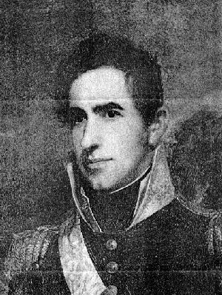
William Henry Harrison ‘Old Tippecanoe’ 1841
“William Henry Harrison had also refused to go along with the Jesuits’ goals for America. In his inaugural address he made these comments: ‘We admit of no government by divine right, believing that so far as power is concerned, the beneficent Creator has made
no distinction among men; that all are upon an equality, and that the only legitimate right to govern, is upon the
expressed grant of power from the governed.’ — Burke
McCarty, The Suppressed Truth About the Assassination of Abraham Lincoln, Arya Varta Publishing, p. 44.

Slide 10
No Divine Right
“General Harrison did not die of natural disease — no failure of health or strength existed — but something sudden and fatal. He did not die of Apoplexy; that is a disease. But arsenic would produce a sudden effect, and it would also be fatal from the commencement. This is the chief weapon of the medical assassin. Oxalic acid, prucic acid, or salts of strychnine, would be almost instant death, and would give but little advantage for escape to the murderer. Therefore his was not a case of acute poisoning, when death takes place almost instantaneously, but of chronic, where the patient dies slowly. He lived about six days after he received the drug.” — John Smith Dye, The Adder’s Den, p. 37.
By that statement, President Harrison had just incurred the deadly wrath of the Jesuits. With these unmistakable words President Harrison made his
position clear; he hurled defiance to the Divine Right
enemies of our Popular Government. [Burke McCarty is
talking about Rome when she says that.] Aye, he did more — for those were the words that signed his death warrant. Just one month and five days from that day, President Harrison lay a corpse in the White House. He died from arsenic poisoning, administered by the tools of Rome.” ST pg. 19,20

Slide 11
The Letter
From Oliver H. P. Parker to Abraham Lincoln, September 1860
Mr. Lincoln, will please read the accompanying document, which is not an application for office, but is on the subject of the preservation of his life and health, and future welfare. Although you may have had warnings of the same nature, the writer thinks perhaps there are certain facts therein contained that cannot be otherwise obtained,
No. 310 New Street Philadelphia, September 7th 1860.

Slide 12
Continued
“After Harrison's death his remains was placed in a sarcophagus to be conveyed to North Bend, its final resting place, and a committee of Congress was appointed to accompany the funeral cortège to North Bend:—The Chairman of that Committee was the Hon Thos. Ewing Senator from Ohio, and when they arrived at the place of destination the Sarcophagus was opened and to the Surprise of all, the head and chest of the corpse was very much swollen, and the face and breast was as black as though the blood had been drawn to the skin by bruises:—The matter was talked over by the Committee and I am informed it was declared by a Doctor who was present, that nothing but Poison would produce that result, and suggested an investigation, when Mr. Ewing, replied, close up the sarcophagus, and deposit it in its final resting place, for said he, if on investigation it should be found that Poison was the cause of his death, it would involve the country in a civil war.:—Thus his body was consigned to the grave without investigation, and the People left in ignorance as to the real cause of Harrisons Death, which, was by Poison beyond a possibility of doubt:” CT Wilcox, Transformation of the Republic.

Slide 13
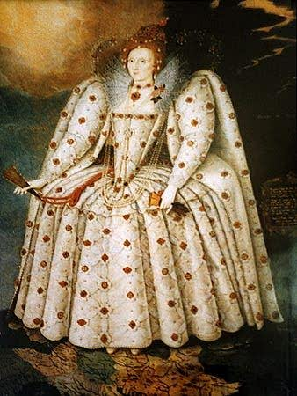
Queen Elizabeth of England
Because she refused to give England to Rome, there were many attempts made on her life. When all attempts failed, Rome summoned her beloved Spain to destroy England with the Spanish Armada.

Slide 14
Papacy Wanted Her Head on a Platter
“After her accession, Elizabeth wrote to Sir Richard Crane, the English ambassador in Rome, to notify the people of her accession. But she was informed by ‘His Holiness’ that England was a fief [servant or slave] of the ‘Holy See,’ that Elizabeth had no right to assume the crown without his permission, that she was not born in lawful wedlock, and could not therefore reign over England; that her safest course was to renounce all claims to the throne, and submit herself entirely to his will; then he would treat her as tenderly as possible. But, if she refused his ‘advice,’ he would not spare her! She declined the pope’s advice, and the hatred of Pius and his successors was assured. — J.E.C. Shepherd, The Babington Plot, Wittenburg Publications, p. 46.

Slide 15
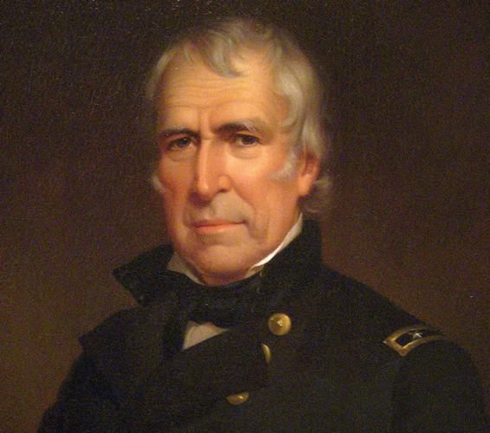
‘Old Rough and Ready’
“Attachment to the Union of States should be fostered in every American heart. For more than half a century during which kingdoms and empires have fallen, this Union has stood unshaken.... In my judgment its dissolution would be the greatest of calamities and to avert that should be the steady aim of every American. Upon its preservation must depend our own happiness and that of generations to come. Whatever dangers may threaten it, I shall stand by it and maintain it in its integrity to the full extent of the obligations imposed, and power conferred upon me by the Constitution. — John Smith Dye, The Adder’s Den, pp. 51, 52.

Slide 16
Zachary Taylor
“There was no quibbling in this. The pro slavery leaders had nothing to count on in Taylor, therefore they decided on his assassination… The arch-plotters, fearing that suspicion might be aroused by the death of the President early in his administration, as in the case of President Harrison, permitted him to serve one year and four months, when on the fourth of July, arsenic was administered to him during a celebration in Washington at which he was invited to deliver the address. He went in perfect health in the morning and was taken ill in the afternoon about five o’clock and died on the Monday following, having been sick the same number of days and with precisely the same symptoms as was his predecessor, President Harrison. — Burke McCarty, The Suppressed Truth About the Assassination of Abraham Lincoln, Arya Varta Publishing, p. 48.

Slide 17
He Died Too!
“He was decidedly opposed to the further extension of slavery into territory north of 36.30 and desired, and was using the whole force, and power of his administration to bring New Mexico into the Union as a free state;—He also believed that the Missouri compromise was Strictly constitutional, and one of the most Sacred compromises of the Slave question, and I am credibly informed that five days before his sudden death, he had high and angry words with some of his prominent Southern friends, on the subject of extending Slavery into New Mexico, and that he Said to them, he was the President of the Whole United States, and that he had found certain States and territories free, and he would never with his consent, agree to force or extend that damnable curse into any territory that is now free, or north of 36.30, and would use all of his power against it; consequently he did not Suit the Slave oligarchy, and on the 9th of July, one year four months and five days after his inauguration he died suddenly, as did Harrison, and with the same apparent disease, which caused the Nation to mourn again for the loss of that good old chieftain President:—His death was attributed to his eating a cherry pie the day before his death:—I have no doubt but the pie was the cause of his death, but in the pie was poison—for I cannot believe that an old Soldier who had been used to the hardships of a camp life for thirty years could be killed by eating a simple cherry pie; if there had been no poison in it,…” CT Wilcox, Transformation of the Republic. Letter.

Slide 18
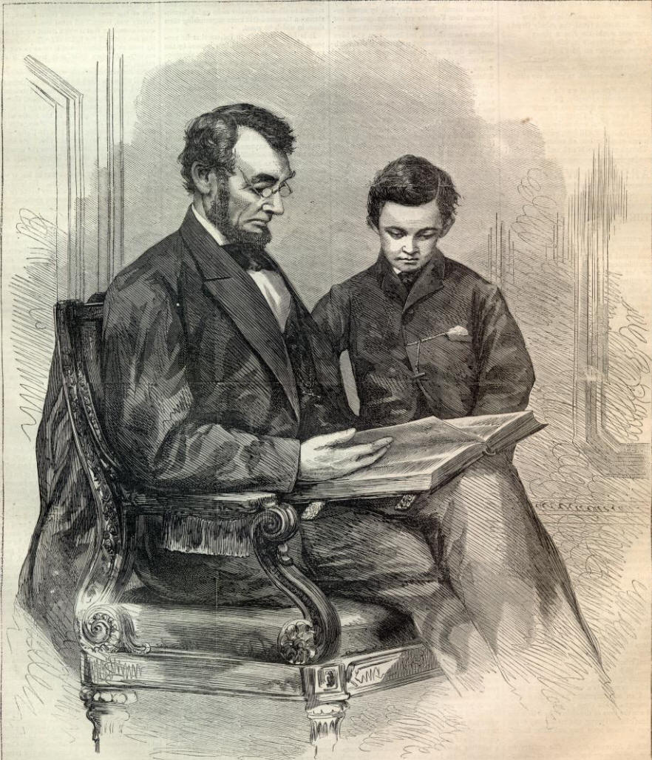
The Best of the Good

