Slide 1
Jesus' Life, pt. 1 ‘Unlikely Heralds’

Slide 2
Organized Religion Passed By
‘The angels had wondered at the glorious plan of redemption. They watched to see how the people of God would receive His Son, clothed in the garb of humanity. Angels came to the land of the chosen people. Other nations were dealing in fables and worshiping false gods. To the land where the glory of God had been revealed, and the light of prophecy had shone, the angels came. They came unseen to Jerusalem, to the appointed expositors of the Sacred Oracles, and the ministers of God's house. Already to Zacharias the priest, as he ministered before the altar, the nearness of Christ's coming had been announced. Already the forerunner was born, his mission attested by miracle and prophecy. The tidings of his birth and the wonderful significance of his mission had been spread abroad. Yet Jerusalem was not preparing to welcome her Redeemer…..

Slide 3
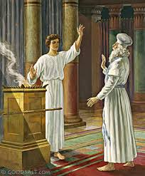
Everyone Knew!
“And he asked for a writing table, and wrote, saying, His name is John. And they marvelled all. And his mouth was opened immediately, and his tongue loosed, and he spake, and praised God. And fear came on all that dwelt round about them: and all these sayings were noised abroad throughout all the hill country of Judaea. And all they that heard them laid them up in their hearts, saying, What manner of child shall this be! And the hand of the Lord was with him.” Luke 1:63-66

Slide 4
‘…With amazement the heavenly messengers beheld the indifference of that people whom God had called to communicate to the world the light of sacred truth. The Jewish nation had been preserved as a witness that Christ was to be born of the seed of Abraham and of David's line; yet they knew not that His coming was now at hand. In the temple the morning and the evening sacrifice daily pointed to the Lamb of God; yet even here was no preparation to receive Him. The priests and teachers of the nation knew not that the greatest event of the ages was about to take place. They rehearsed their meaningless prayers, and performed the rites of worship to be seen by men, but in their strife for riches and worldly honor they were not prepared for the revelation of the Messiah. The same indifference pervaded the land of Israel. Hearts selfish and world-engrossed were untouched by the joy that thrilled all heaven. Only a few were longing to behold the Unseen. To these heaven's embassy was sent.” DA, pgs. 43,44

Slide 5
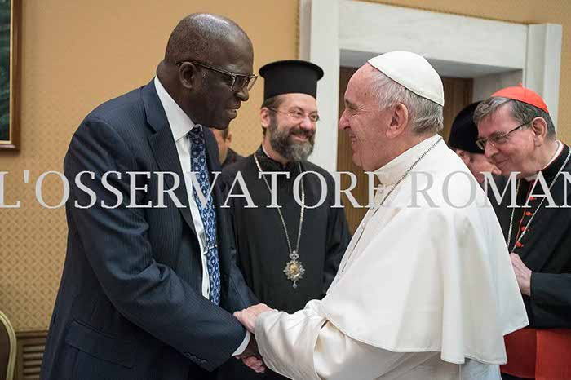
Worldly Acceptance
His first encounter with the pope took place on October 12, 2016 in Rome, Italy and his second meeting was on October 31, 2016 in Lund, Sweden. This news was actually reported by Diop’s Public Affairs and Religious Liberty department. Notice what they published back in 2016:
“Dr. Diop, in his capacity as secretary of the group, attended a meeting this past October in Rome. The following week, also as CS/CWC secretary, he attended the commemoration of the 500-year anniversary of the Reformation in Lund, Sweden, which was co-organized by the Lutherans and the Roman Catholics.” [1]

Slide 6
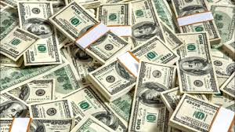
Money Reigns Supreme in Adventism Today
How many people in Adventism are given high positions because they have deep pockets?
How many people in Adventism have flagrant sins excused because they have deep pockets?
How often do people with deep pockets have faithful men deposed because they do not like what the man is saying?
How many times has money won and truth has been destroyed?

Slide 7

John the Baptist was already Born
The news of John’s birth was spread abroad. The ancient Seventh day Adventist Church knew of John’s birth. Zacharias was a priest and his visit from an angel was very well known. The nearness of the Messiah’s coming was well known. BUT, the desire for money and acceptance by the worldly churches had blinded their eyes. Organized religion was passed by in heralding the Messiah’s coming. Who would the Lord get to proclaim His coming?

Slide 8
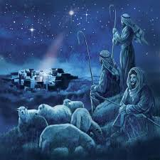
Who?
“And she brought forth her firstborn son, and wrapped him in swaddling clothes, and laid him in a manger; because there was no room for them in the inn. And there were in the same country shepherds abiding in the field, keeping watch over their flock by night. And, lo, the angel of the Lord came upon them, and the glory of the Lord shone round about them: and they were sore afraid. And the angel said unto them, Fear not: for, behold, I bring you good tidings of great joy, which shall be to all people. For unto you is born this day in the city of David a Saviour, which is Christ the Lord. And this shall be a sign unto you; Ye shall find the babe wrapped in swaddling clothes, lying in a manger.” Luke 2:7-12

Slide 9
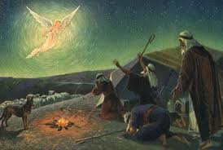
Talked and Prayed
“Above the hills of Bethlehem are gathered an innumerable throng of angels. They wait the signal to declare the glad news to the world. Had the leaders in Israel been true to their trust, they might have shared the joy of heralding the birth of Jesus. But now they are passed by. God declares, “I will pour water upon him that is thirsty, and floods upon the dry ground.” “Unto the upright there ariseth light in the darkness.” Isaiah 44:3; Psalm 112:4. To those who are seeking for light, and who accept it with gladness, the bright rays from the throne of God will shine. In the fields where the boy David had led his flock, shepherds were still keeping watch by night. Through the silent hours they talked together of the promised Saviour, and prayed for the coming of the King to David's throne. “And, lo, the angel of the Lord came upon them, and the glory of the Lord shone round about them: and they were sore afraid. And the angel said unto them, Fear not: for, behold, I bring you good tidings of great joy, which shall be to all people. For unto you is born this day in the city of David a Saviour, which is Christ the Lord.” DA, pg. 47

Slide 10

Spread the Angel’s Message
“And they came with haste, and found Mary, and Joseph, and the babe lying in a manger. And when they had seen it, they made known abroad the saying which was told them concerning this child. And all they that heard it wondered at those things which were told them by the shepherds. But Mary kept all these things, and pondered them in her heart.” Luke 2:16-19

Slide 11

Would They Let Other Things Distract Them?
In this day, God has called His church, as He called ancient Israel, to stand as a light in the earth. By the mighty cleaver of truth,--the messages of the first, second, and third angels,--He has separated a people from the churches and from the world, to bring them into a sacred nearness to Himself. He has made them the depositories of His law, and has committed to them the great truths of prophecy for this time. Like the holy oracles committed to ancient Israel, these are a sacred trust to be communicated to the world.” ST, January 25, 1910

Slide 12
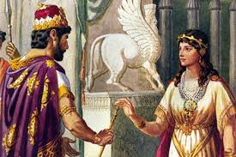
Spread THE Truth!
“For if thou altogether holdest thy peace at this time, then shall there enlargement and deliverance arise to the Jews from another place; but thou and thy father's house shall be destroyed: and who knoweth whether thou art come to the kingdom for such a time as this?” Esther 4:14

Slide 13
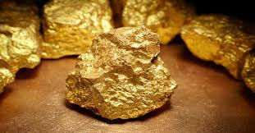
Days of Elisha
“And when these lepers came to the uttermost part of the camp, they went into one tent, and did eat and drink, and carried thence silver, and gold, and raiment, and went and hid it; and came again, and entered into another tent, and carried thence also, and went and hid it. Then they said one to another, We do not well: this day is a day of good tidings, and we hold our peace: if we tarry till the morning light, some mischief will come upon us: now therefore come, that we may go and tell the king's household.” 2 Kings 7:8,9

Slide 14
How Far Was it Spread?
“The priests and elders of Jerusalem were not as ignorant concerning the birth of Christ as they pretended. The report of the angels’ visit to the shepherds had been brought to Jerusalem, but the rabbis had treated it as unworthy of their notice. They themselves might have found Jesus, and might have been ready to lead the magi to His birthplace; but instead of this, the wise men came to call their attention to the birth of the Messiah. “Where is He that is born King of the Jews?” they said; “for we have seen His star in the East, and are come to worship Him.”
Now pride and envy closed the door against the light. If the reports brought by the shepherds and the wise men were credited, they would place the priests and rabbis in a most unenviable position, disproving their claim to be the exponents of the truth of God. These learned teachers would not stoop to be instructed by those whom they termed heathen. It could not be, they said, that God had passed them by, to communicate with ignorant shepherds or uncircumcised Gentiles. They determined to show their contempt for the reports that were exciting King Herod and all Jerusalem. They would not even go to Bethlehem to see whether these things were so. And they led the people to regard the interest in Jesus as a fanatical excitement. Here began the rejection of Christ by the priests and rabbis. From this point their pride and stubbornness grew into a settled hatred of the Saviour. While God was opening the door to the Gentiles, the Jewish leaders were closing the door to themselves.” DA, pg. 62

Slide 15
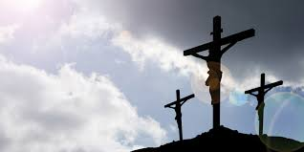
Heard it, Rejected it, Hated it, Fanatical Excitement
The work of the shepherds was well known in Jerusalem, at headquarters, but it was unworthy of the notice of the bigshots! If acknowledgment was given to the shepherds, that their message was from God, it would put leadership in a most uncomfortable position. Their claim to be the religious leaders of God’s people would be shown to be false! They had refused to do the work God gave them to do and He passed them by!!

Slide 16
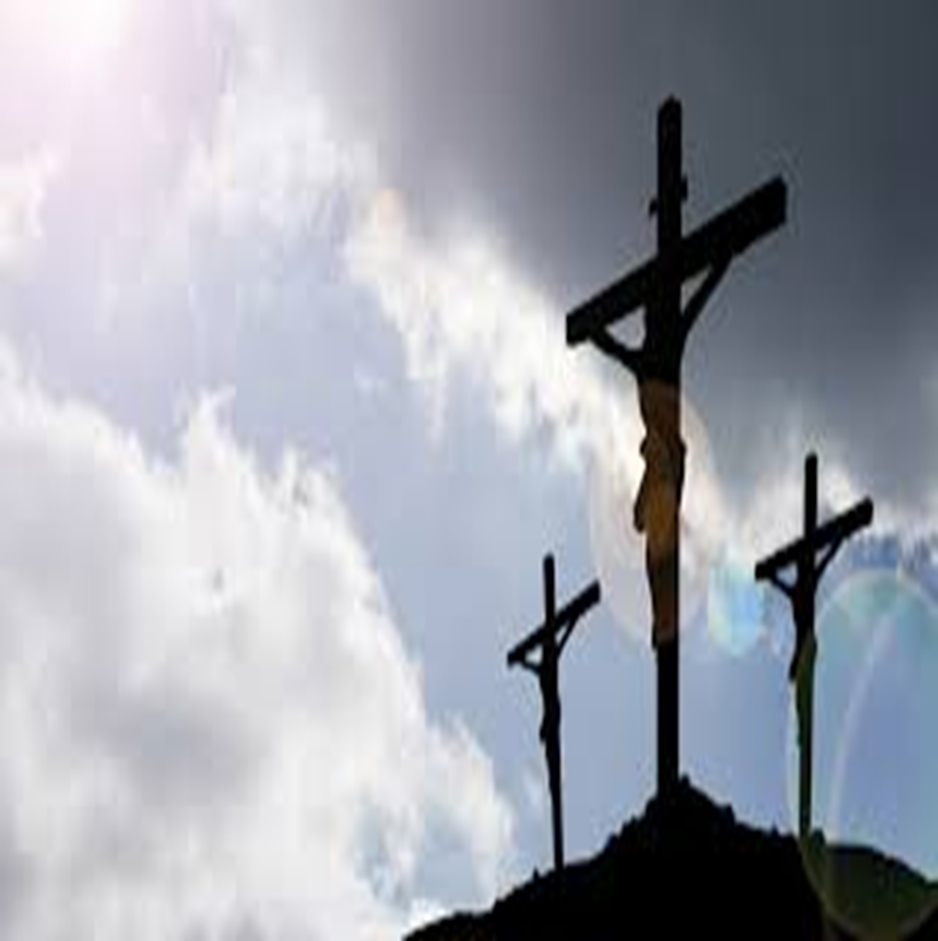
This Was the Beginning!
“They would not even go to Bethlehem to see whether these things were so. And they led the people to regard the interest in Jesus as a fanatical excitement. Here began the rejection of Christ by the priests and rabbis. From this point their pride and stubbornness grew into a settled hatred of the Saviour.” DA, pg. 62

Slide 17
Human Pride Crushed
“The story of Bethlehem is an exhaustless theme. In it is hidden “the depth of the riches both of the wisdom and knowledge of God.” Romans 11:33. We marvel at the Saviour's sacrifice in exchanging the throne of heaven for the manger, and the companionship of adoring angels for the beasts of the stall. Human pride and self-sufficiency stand rebuked in His presence. Yet this was but the beginning of His wonderful condescension. It would have been an almost infinite humiliation for the Son of God to take man's nature, even when Adam stood in his innocence in Eden. But Jesus accepted humanity when the race had been weakened by four thousand years of sin. Like every child of Adam He accepted the results of the working of the great law of heredity. What these results were is shown in the history of His earthly ancestors. He came with such a heredity to share our sorrows and temptations, and to give us the example of a sinless life….

Slide 18
“Satan in heaven had hated Christ for His position in the courts of God. He hated Him the more when he himself was dethroned. He hated Him who pledged Himself to redeem a race of sinners. Yet into the world where Satan claimed dominion God permitted His Son to come, a helpless babe, subject to the weakness of humanity. He permitted Him to meet life's peril in common with every human soul, to fight the battle as every child of humanity must fight it, at the risk of failure and eternal loss. The heart of the human father yearns over his son. He looks into the face of his little child, and trembles at the thought of life's peril. He longs to shield his dear one from Satan's power, to hold him back from temptation and conflict. To meet a bitterer conflict and a more fearful risk, God gave His only-begotten Son, that the path of life might be made sure for our little ones. “Herein is love.” Wonder, O heavens! and be astonished, O earth!

