Slide 1
Final Scenes, pt. 24 “Jesus, the Crucified”
Love’s Ultimate Test

Slide 2
How Far?
How far would Love go to demonstrate what God thinks of us?
What would Love do in order to clarify God’s plan for us?
How much would Love give up to reveal mankind’s value in Heaven’s eyes?

Slide 3
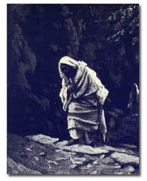
Nears Gethsemane
Something started changing for Christ as He neared Gethsemane. He declared, “My soul is exceeding sorrowful, even unto death: tarry ye here, and watch with me.“ Matthew 26:38 He is sensing death very near. No one is whipping Him; He hasn’t been arrested. Inside Him, Jesus is having some deep, mental issues.

Slide 4
Tasting Eternal Death
“Jesus had been earnestly conversing with His disciples and instructing them; but as He neared Gethsemane, He became strangely silent… Throughout His life on earth He had walked in the light of God's presence…But now He seemed to be shut out from the light of God's sustaining presence. Now He was numbered with the transgressors. The guilt of fallen humanity He must bear. Upon Him who knew no sin must be laid the iniquity of us all. So dreadful does sin appear to Him, so great is the weight of guilt which He must bear, that He is tempted to fear it will shut Him out forever from His Father's love…

Slide 5
No Hope!
…Feeling how terrible is the wrath of God against transgression, He exclaims, "My soul is exceeding sorrowful, even unto death.“ As they approached the garden, the disciples had marked the change that came over their Master. Never before had they seen Him so utterly sad and silent. As He proceeded, this strange sadness deepened; yet they dared not question Him as to the cause. His form swayed as if He were about to fall.” DA, pgs. 685, 686

Slide 6
Separation
“He felt that by sin He was being separated from His Father. The gulf was so broad, so black, so deep, that His spirit shuddered before it. This agony He must not exert His divine power to escape. As man He must suffer the consequences of man's sin. As man He must endure the wrath of God against transgression.
Christ was now standing in a different attitude from that in which He had ever stood before…As Christ felt His unity with the Father broken up, He feared that in His human nature He would be unable to endure the coming conflict with the powers of darkness.” DA, pg. 686

Slide 7
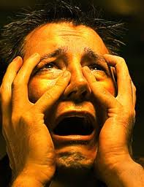
Explanation
When we sin and feel bad about it, knowing we have hurt God and ourselves, there is still a part of our mind that says there is hope. Whether it be a Bible promise, or an encouraging voice in our mind, there is hope. In the mind of Jesus, there was no hope. Everything appeared utterly hopeless and discouraging. There was no relief for Christ. This same hopelessness will be felt by those who finally reject Christ and suffer the mind anguish during the 7 last plagues.

Slide 8
Lost Man Will Feel
”He feared that sin was so offensive to God that Their separation was to be eternal. Christ felt the anguish which the sinner will feel when mercy shall no longer plead for the guilty race. It was the sense of sin, bringing the Father's wrath upon Him as man's substitute, that made the cup He drank so bitter, and broke the heart of the Son of God.” DA, pg. 753

Slide 9
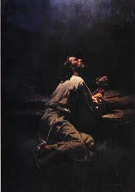
Christ Sweat Blood
“And being in an agony he prayed more earnestly: and his sweat was as it were great drops of blood falling down to the ground.” Luke 22:44
“They saw His face marked with the bloody sweat of agony, and they were filled with fear. His anguish of mind they could not understand. "His visage was so marred more than any man, and His form more than the sons of men." Isa. 52:14.” DA, pg. 690

Slide 10
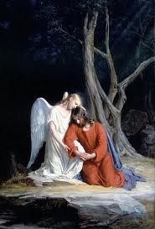
An Angel Appears
“The angel came not to take the cup from Christ's hand, but to strengthen Him to drink it, with the assurance of the Father's love. He came to give power to the divine-human suppliant. He pointed Him to the open heavens, telling Him of the souls that would be saved as the result of His sufferings. He assured Him that His Father is greater and more powerful than Satan, that His death would result in the utter discomfiture of Satan, and that the kingdom of this world would be given to the saints of the Most High.” …He had borne that which no human being could ever bear; for He had tasted the sufferings of death for every man.” .” DA, pg. 693, 694

Slide 11
Gloom, Shut Out!
“And now the Lord of glory was dying, a ransom for the race. In yielding up His precious life, Christ was not upheld by triumphant joy. All was oppressive gloom. It was not the dread of death that weighed upon Him. It was not the pain and ignominy of the cross that caused His inexpressible agony. Christ was the prince of sufferers; but His suffering was from a sense of the malignity of sin, a knowledge that through familiarity with evil, man had become blinded to its enormity. Christ saw how deep is the hold of sin upon the human heart, how few would be willing to break from its power. He knew that without help from God, humanity must perish, and He saw multitudes perishing within reach of abundant help.” DA, pgs. 752,753

Slide 12
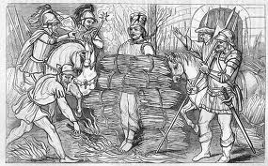
Not Like Martyrs
Christ had no hope of coming forth from the grave. He felt that if He took our sins, the separation from His Father would be eternal. Yet, Christ continued on down the path, doing it to place eternal hope and life in our path!!!!!!!!!!!!

Slide 13
No Hope
“Satan with his fierce temptations wrung the heart of Jesus. The Saviour could not see through the portals of the tomb. Hope did not present to Him His coming forth from the grave a conqueror, or tell Him of the Father's acceptance of the sacrifice. He feared that sin was so offensive to God that Their separation was to be eternal. Christ felt the anguish which the sinner will feel when mercy shall no longer plead for the guilty race. It was the sense of sin, bringing the Father's wrath upon Him as man's substitute, that made the cup He drank so bitter, and broke the heart of the Son of God.” DA, pg. 753

Slide 14
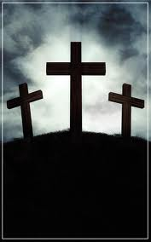
Everything Changed
Up until Gethsemane, Christ had told the disciples, that He would be killed, but would rise again in 3 days. “For thou wilt not leave my soul in hell; neither wilt thou suffer thine Holy One to see corruption.” Ps. 16:10 Based on this Scripture and the feast of unleavened bread, Christ knew He would rise. But since Gethsemane and the burden of sin being laid upon Him, Christ could no longer see the other side of the grave!!

Slide 15
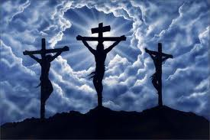
Forsaken
”Now from the sixth hour there was darkness over all the land unto the ninth hour. And about the ninth hour Jesus cried with a loud voice, saying, Eli, Eli, lama sabachthani? that is to say, My God, my God, why hast thou forsaken me?” Matthew 27:45,46

Slide 16
Wonder
“The guilt of every descendant of Adam was pressing upon His heart. The wrath of God against sin, the terrible manifestation of His displeasure because of iniquity, filled the soul of His Son with consternation. All His life Christ had been publishing to a fallen world the good news of the Father's mercy and pardoning love. Salvation for the chief of sinners was His theme. But now with the terrible weight of guilt He bears, He cannot see the Father's reconciling face. The withdrawal of the divine countenance from the Saviour in this hour of supreme anguish pierced His heart with a sorrow that can never be fully understood by man. So great was this agony that His physical pain was hardly felt.” DA, pg. 753

Slide 17
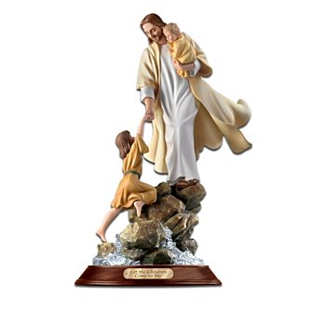
Grace that Empowers
“ For the grace of God that bringeth salvation hath appeared to all men, Teaching us that, denying ungodliness and worldly lusts, we should live soberly, righteously, and godly, in this present world;
Looking for that blessed hope, and the glorious appearing of the great God and our Saviour Jesus Christ;
Who gave himself for us, that he might redeem us from all iniquity, and purify unto himself a peculiar people, zealous of good works.” Titus 2:11-14

Slide 18
Behold
“The spotless Son of God hung upon the cross, His flesh lacerated with stripes; those hands so often reached out in blessing, nailed to the wooden bars; those feet so tireless on ministries of love, spiked to the tree; that royal head pierced by the crown of thorns; those quivering lips shaped to the cry of woe. And all that He endured--the blood drops that flowed from His head, His hands, His feet, the agony that racked His frame, and the unutterable anguish that filled His soul at the hiding of His Father's face--speaks to each child of humanity, declaring, It is for thee that the Son of God consents to bear this burden of guilt; for thee He spoils the domain of death, and opens the gates of Paradise. He who stilled the angry waves and walked the foam-capped billows, who made devils tremble and disease flee, who opened blind eyes and called forth the dead to life,--offers Himself upon the cross as a sacrifice, and this from love to thee.” DA, pg. 755

