Slide 1
Hard Thrusts?
Or
Dumb Dogs?

Slide 2
Counsel
Unkind Thrusts and Personal Allusions.-- Let not those who write for our papers make unkind thrusts and allusions that will certainly do harm, and that will hedge up the way and hinder us from doing the work that we should do in order to reach all classes, the Catholics included. It is our work to speak the truth in love, and not to mix in with the truth the unsanctified elements of the natural heart, and speak things that savor of the same spirit possessed by our enemies. All sharp thrusts will come back upon us in double measure when the power is in the hands of those who can exercise it for our injury. Over and over the message has been given to me that we are not to say one word, not to publish one sentence, especially by way of personalities, unless positively essential in vindicating the truth, that will stir up our enemies against us, and arouse their passions to a white heat. Our work will soon be
closed up, and soon the time of trouble, such as never was, will come upon us, of which we have but little idea. {CW 60.1}

Slide 3
Many Faithful Catholics
Thrusts at the Catholics.--It is true that we are commanded to "cry aloud, spare not, lift up thy voice like a trumpet, and show My people their transgression, and the house of Jacob their sins." Isa. 58:1. This message must be given, but while it must be given, we should be careful not to thrust and crowd and condemn those who have not the light that we have. We should not go out of our way to make hard thrusts at the Catholics. Among the Catholics there are many who are most conscientious Christians, and who walk in all the light that shines upon them, and God will work in their behalf. Those who have had great privileges and opportunities, and who have failed to improve their physical, mental, and moral powers, but who have lived to please themselves, and have refused to bear their responsibility, are in greater danger and in greater condemnation before God than those who are in error upon doctrinal points, yet who seek to live to do good to others. Do not censure others; do not condemn them. {CW 63.2}

Slide 4
Summary
Summary
1. Hard Thrusts should not be made in our `periodicals and books against anyone, including the Catholics.’
2. Unless absolutely necessary, persons shouldn’t be mentioned in a derogatory light.
3. We must maintain the truth.

Slide 5
The Position of Some
"Although it is true that there was a period in the life of the Seventh-day Adventist Church when the denomination took a distinctly anti-Roman Catholic viewpoint...that attitude on the church's part was nothing more than a manifestation of widespread anti-popery among conservative Protestant denominations in the early part of this century and the latter part of the last, and which has now been consigned to the historical trash heap so far as the Seventh-day Adventist Church is concerned." (Neal C. Wilson, past president of the Seventh-day Adventist General Conference, Court Transcript of United States vs the Seventh-day Adventist Church, Equal Employment Opportunity Commission vs the Pacific Press Publishing Association and the General Conference, Reply Brief for Defendants, p 4, Civil Case #74-2025 CBR, presided over by Judge Charles B. Renfrew, U.S. District Court, San Francisco, California, 1974-1975.)

Slide 6
Amazing
George Vandeman “These were dark ages for the church. How could Christians be so intolerant of their brothers and sisters in Christ? Jesus had predicted that those who killed His followers would sincerely think they were serving God…It is not for us to question our medieval ancestors…Nor must we overlook the good done by the church. Throughout the world, monasteries provided care for orphans, widows, and the sick. And all of us owe appreciation to the church of the Middle Ages for preserving the Scriptures.” Vandeman, The Rise and Fall of Christ, pages 54,55

Slide 7
Vandeman’s Vomit
“But they also have erred through wine, and through strong drink are out of the way; the priest and the prophet have erred through strong drink, they are swallowed up of wine, they are out of the way through strong drink; they err in vision, they stumble in judgment. For all tables are full of vomit and filthiness, so that there is no place clean.’ Isa. 28:7,8

Slide 8
Shocking
Associate Editor of the Review, Myron Widmer “I was surprised and delighted to learn that the Bible is the sole textbook during the pope’s visit and the World Youth Day activities. What a wonderful opportunity fro so many young people to hear the gospel message straight from God’s Word…Or might a better understanding be that God is working through this pope to open doors for Catholics to the great truths of Scripture concerning salvation by faith in Christ?”…I can only wonder if in these last days He is using some very unexpected sources to encourage many individuals (especially Catholics) in search for truth.” Review and Herald, September 9,23,and 30, 1993

Slide 9
Did EGW mean?
William Johnson-Editor-Adventist Review-1994,1995 ‘Saints Victory in the End-time’ “To interpret the sea monster of Revelation 13 as the papacy seems somewhat out of keeping with the spirit of the times. In an age when Christianity in general faces the onslaughts of secularism and when among Christians ecumenism has become popular, the interpretation smacks of narrowness and bigotry.” Shocking………………………………………

Slide 10
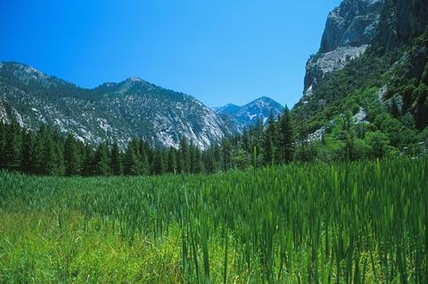
Is The Bible Guilty?
2 Thessalonians 2:3,4,8-10
“Let no man deceive you by any means: for that day shall not come, except there come a falling away first, and that man of sin be revealed, the son of perdition; Who opposeth and exalteth himself above all that is called God, or that is worshipped; so that he as God sitteth in the temple of God, shewing himself that he is God.”

Slide 11

Guilty!
“And then shall that Wicked be revealed, whom the Lord shall consume with the spirit of his mouth, and shall destroy with the brightness of his coming: Even him, whose coming is after the working of Satan with all power and signs and lying wonders, And with all deceivableness of unrighteousness in them that perish; because they received not the love of the truth, that they might be saved.” 2 Thessalonians 2:8-10

Slide 12
Does it get Better?
Revelation 13:1-7 “And I stood upon the sand of the sea, and saw a beast rise up out of the sea, having seven heads and ten horns, and upon his horns ten crowns, and upon his heads the name of blasphemy. And the beast which I saw was like unto a leopard, and his feet were as the feet of a bear, and his mouth as the mouth of a lion: and the dragon gave him his power, and his seat, and great authority. And I saw one of his heads as it were wounded to death; and his deadly wound was healed: and all the world wondered after the beast. And they worshipped the dragon which gave power unto the beast: and they worshipped the beast, saying, Who is like unto the beast? who is able to make war with him? And there was given unto him a mouth speaking great things and blasphemies; and power was given unto him to continue forty and two months. And he opened his mouth in blasphemy against God, to blaspheme his name, and his tabernacle, and them that dwell in heaven. And it was given unto him to make war with the saints, and to overcome them: and power was given him over all kindreds, and tongues, and nations.”

Slide 13
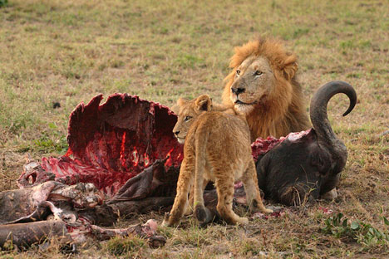
The Bible Says
1. The papacy is an animal.
2. The papacy is a blasphemer.
3. The papacy is controlled by the devil.
4. The papacy tries to destroy the temple in heaven.
5. The papacy is a cold blooded killer of humanity.
6. Do we have any hard thrusts yet?

Slide 14
How about Revelation 17?
“And there came one of the seven angels which had the seven vials, and talked with me, saying unto me, Come hither; I will shew unto thee the judgment of the great whore that sitteth upon many waters: With whom the kings of the earth have committed fornication, and the inhabitants of the earth have been made drunk with the wine of her fornication. So he carried me away in the spirit into the wilderness: and I saw a woman sit upon a scarlet coloured beast, full of names of blasphemy, having seven heads and ten horns. And the woman was arrayed in purple and scarlet colour, and decked with gold and precious stones and pearls, having a golden cup in her hand full of abominations and filthiness of her fornication: And upon her forehead was a name written, MYSTERY, BABYLON THE GREAT, THE MOTHER OF HARLOTS AND ABOMINATIONS OF THE EARTH. And I saw the woman drunken with the blood of the saints, and with the blood of the martyrs of Jesus: and when I saw her, I wondered with great admiration.” (verses 1-6)

Slide 15
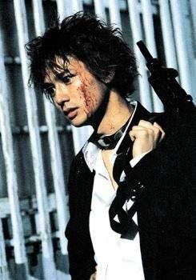
Shocking!
1. The papacy is a whore.
2. The papacy is committing immorality with the leaders of the world.
3. The papacy has intoxicated the people of the world. She has made the world drunk.
4. The papacy is full of filthiness and abominable things.
5. The papacy is a ruthless killer.

Slide 16
Revelation 18
“And he cried mightily with a strong voice, saying, Babylon the great is fallen, is fallen, and is become the habitation of devils, and the hold of every foul spirit, and a cage of every unclean and hateful bird. For all nations have drunk of the wine of the wrath of her fornication, and the kings of the earth have committed fornication with her, and the merchants of the earth are waxed rich through the abundance of her delicacies. And I heard another voice from heaven, saying, Come out of her, my people, that ye be not partakers of her sins, and that ye receive not of her plagues. For her sins have reached unto heaven, and God hath remembered her iniquities. Reward her even as she rewarded you, and double unto her double according to her works: in the cup which she hath filled fill to her double. How much she hath glorified herself, and lived deliciously, so much torment and sorrow give her: for she saith in her heart, I sit a queen, and am no widow, and shall see no sorrow. Therefore shall her plagues come in one day, death, and mourning, and famine; and she shall be utterly burned with fire: for strong is the Lord God who judgeth her.” (verses 1-8)

Slide 17
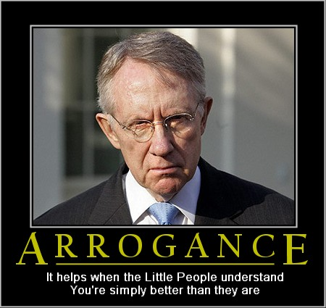
Is the Bible Guilty?
1. The papacy is possessed by devils.
2. The papacy makes the world drunk.
3. The papacy commits sexual impurity with the leaders of the world.
4. The papacy is so arrogant.

Slide 18
Do the Bible and SOP harmonize?
The Bible makes some absolutely stunning expose’s of the papacy’s wickedness. If we say that ‘hard thrusts’ are made when exposing what Rome is, then we are saying that the Bible and Ellen White are at odds. Since the same Spirit inspired both, then obviously, Ellen White’s statement has nothing to do with declaring the evils of Rome!!

Slide 19
What does Ellen White’s Statement Mean?
“Let not those who write for our papers make unkind thrusts and allusions that will certainly do harm, and that will hedge up the way and hinder us from doing the work that we should do in order to reach all classes, the Catholics included… Over and over the message has been given to me that we are not to say one word, not to publish one sentence, especially by way of personalities, unless positively essential in vindicating the truth, that will stir up our enemies against us, and arouse their passions to a white heat.”
When writing or giving a public meeting where the community is involved, all facts and points must be brought to bear on a subject. Once all the facts are made clear, then the conclusion is drawn. We should do all we can not to point out personalities and make shots at individuals unless absolutely critical to the message.

Slide 20
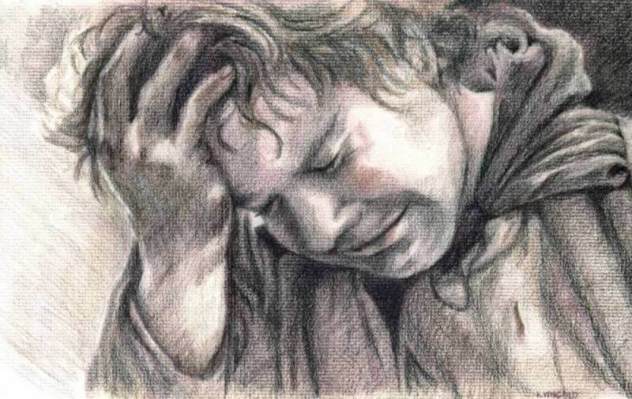
The Tragedy of it all
As SDA’s, we have taken a pitiful turn. We have abused Ellen White’s comment to mean that we should no longer preach, teach, or write in explanation the message of Rev. 13, Rev. 14, and Rev. 17and 18. This is insanity! We must arise and proclaim the messages we have been given to every nation, kindred, tongue, and people!

Slide 21
Hellish Torch of False Prophecy
“Unsanctified ministers are arraying themselves against God. They are praising Christ and the god of this world in the same breath. While professedly they receive Christ, they embrace Barabbas, and by their actions say, "Not this Man, but Barabbas." Let all who read these lines, take heed. Satan has made his boast of what he can do. He thinks to dissolve the unity which Christ prayed might exist in His Church. He says, "I will go forth and be a lying spirit to deceive those that I can, to criticize, and condemn, and falsify." Let the sin of deceit and false witness be entertained by a church that has had great light, great evidence, and that church will discard the message the Lord has sent, and receive the most unreasonable assertions and false suppositions and false theories. Satan laughs at their folly, for he knows what truth is. Many will stand in our pulpits with the torch of false prophecy in their hands, kindled from the hellish torch of Satan. If doubts and unbelief are cherished, the faithful ministers will be removed from the people who think they know so much. "If thou hadst known," said Christ, "even thou, at least in this thy day, the things which belong unto thy peace! but now they are hid from thine eyes." TM 409,410

Slide 22
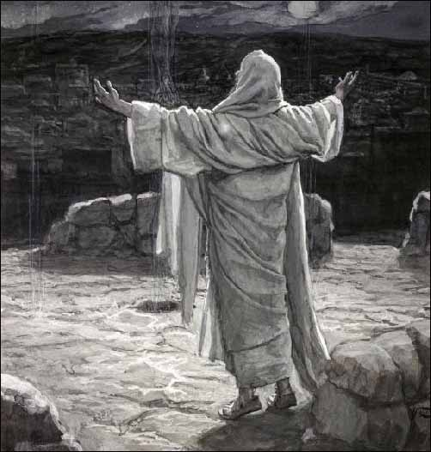
Will We Stand?
How long will we listen to the torch of false prophecy in our midst?
How long will we hear ‘Peace, peace, when there is no peace’?
How long will we listen to ‘dumb dogs that will not bark’?
Erelong, the words of Christ will be said about Adventism “If thou hadst known, even thou, at least in this thy day, the things which belong unto thy peace! but now they are hid from thine eyes. For the days shall come upon thee, that thine enemies shall cast a trench about thee, and compass thee round, and keep thee in on every side, And shall lay thee even with the ground, and thy children within thee; and they shall not leave in thee one stone upon another; because thou knewest not the time of thy visitation.” Luke 19:42-44

Slide 23
“In the closing work of God in the earth, the standard of His law will be again exalted. False religion may prevail, iniquity may abound, the love of many may wax cold, the cross of Calvary may be lost sight of, and darkness, like the pall of death, may spread over the world; the whole force of the popular current may be turned against the truth; plot after plot may be formed to overthrow the people of God; but in the hour of greatest peril the God of Elijah will raise up human instrumentalities to bear a message that will not be silenced. In the populous cities of the land, and in the places where men have gone to the greatest lengths in speaking against the Most High, the voice of stern rebuke will be heard. Boldly will men of God's appointment denounce the union of the church with the world. Earnestly will they call upon men and women to turn from the observance of a man-made institution to the observance of the true Sabbath. "Fear God, and give glory to Him," they will proclaim to every nation; "for the hour of His judgment is come: and worship Him that made heaven, and earth, and the sea, and the fountains of waters. . . . If any man worship the beast and his image, and receive his mark in his forehead, or in his hand, the same shall drink of the wine of the wrath of God, which is poured out without mixture into the cup of His indignation." Revelation 14:7-10. God will not break His covenant, nor alter the thing that has gone out of His lips. His word will stand fast forever as unalterable as His throne. At the judgment this covenant will be brought forth, plainly written with the finger of God, and the world will be arraigned before the bar of Infinite Justice to receive sentence.

Slide 24
Today, as in the days of Elijah, the line of demarcation between God's commandment-keeping people and the worshipers of false gods is clearly drawn. "How long halt ye between two opinions?" Elijah cried; "if the Lord be God, follow Him: but if Baal, then follow him." 1 Kings 18:21. And the message for today is: "Babylon the great is fallen, is fallen. . . . Come out of her, My people, that ye be not partakers of her sins, and that ye receive not of her plagues. For her sins have reached unto heaven, and God hath remembered her iniquities." Revelation 18:2, 4, 5. The time is not far distant when the test will come to every soul. The observance of the false sabbath will be urged upon us. The contest will be between the commandments of God and the commandments of men. Those who have yielded step by step to worldly demands and conformed to worldly customs will then yield to the powers that be, rather than subject themselves to derision, insult, threatened imprisonment, and death. At that time the gold will be separated from the dross. True godliness will be clearly distinguished from the appearance and tinsel of it. Many a star that we have admired for its brilliance will then go out in darkness. Those who have assumed the ornaments of the sanctuary, but are not clothed with Christ's righteousness, will then appear in the shame of their own nakedness.

Slide 25
Truth Is Heard
Among earth's inhabitants, scattered in every land, there are those who have not bowed the knee to Baal. Like the stars of heaven, which appear only at night, these faithful ones will shine forth when darkness covers the earth and gross darkness the people. In heathen Africa, in the Catholic lands of Europe and of South America, in China, in India, and in the islands of the sea, and in all the dark corners of the earth, God has in reserve a firmament of chosen ones that will yet shine forth amidst the darkness, revealing clearly to an apostate world the transforming power of obedience to His law. Even now they are appearing in every nation, among every tongue and people; and in the hour of deepest apostasy, when Satan's supreme effort is made to cause "all, both small and great, rich and poor, free and bond," to receive, under penalty of death, the sign of allegiance to a false rest day, these faithful ones, "blameless and harmless, the sons of God, without rebuke," will "shine as lights in the world." Revelation 13:16; Philippians 2:15. The darker the night, the more brilliantly will they shine.” PK, pgs. 187-189

