Slide 1
“I furthermore promise and declare that I will, when opportunity present, make and wage relentless war, secretly or openly, against all heretics, Protestants and Liberals, as I am directed to do, to extirpate and exterminate them from the face of the whole earth”—Carlos Didier, Subterranean Rome, 1843
“I do further declare that I will help, assist, and advise all or any of His Holiness agents in any place wherever I shall be; and to do my utmost to extirpate [exterminate] the heretical Protestant doctrine, and to destroy all their pretended power.”—Political and Economic Handbook, Thomas Edward Watson, 1916, p. 437

Slide 2
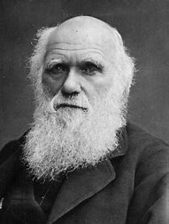
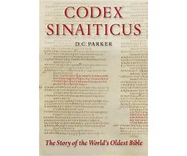
Evolution a “higher criticism”?
Starting in the 1600s, the Jesuits infiltrated the secular universities and began to introduce doubt about the Bible—later called “higher criticism”. By the 1800s, the Jesuits infiltrated many liberal seminaries introducing doubt as to the validity of Scripture—Did the Catholic Church Give Us the Bible, David Daniels, p. 129-131
Long Shot???
Today Wikipedia lists 380 secondary schools and 190 colleges that are directly Jesuit affiliated

Slide 3
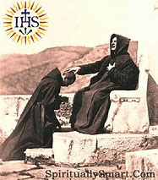
A Conspiracy Against Our Schools???
“The Protestants of both the North and South would surely unite to exterminate the priests and the Jesuits, if they could learn how the priests, the nuns, and the monks, which daily land on our shores, under the pretext of preaching their religion...are nothing else but the emissaries of the Pope, of Napoleon III, and the other despots of Europe, to undermine our institutions, alienate the hearts of our people from our constitution, and our laws, destroy our schools, and prepare a reign of anarchy here as they have done in Ireland, in Mexico, in Spain, and wherever there are any people who want to be free”—Abraham Lincoln, as quoted in Charles Chiniquy, Fifty Years in the Church of Rome(Grand Rapids, Michigan: Baker Book House, 1968): 499.

Slide 4
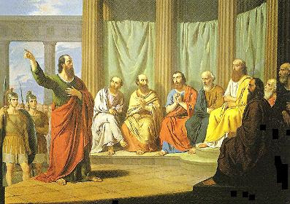
Paul, a Conspiracy Message???
Acts 20:29-31 “For I know this, that after my departing shall grievous wolves enter in among you, not sparing the flock. Also of your own selves shall men arise, speaking perverse things, to draw away disciples after them. Therefore watch, and remember, that by the space of three years I ceased not to warn every one night and day with tears.”

Slide 5
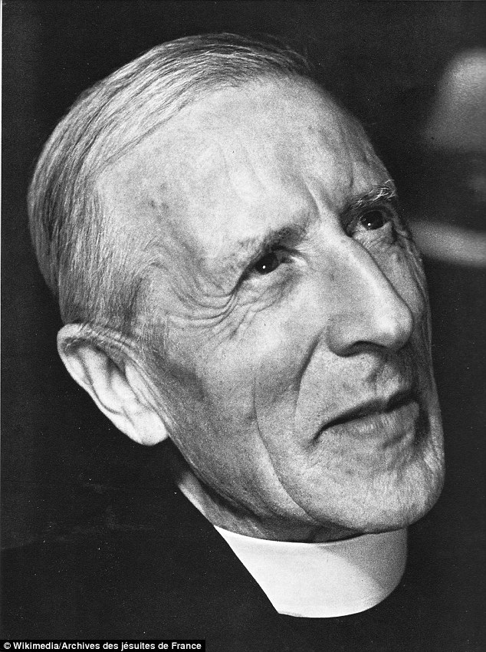
Deliberate Lies From Catholic-Evolutionist Priests
“In 1912 it was announced that some remains of 'the earliest Englishman' had been found in a gravel pit. This 'hominid', Eoanthropus dawsoni, became known as the Piltdown Man. About 50 years later, South African anatomist Joseph Weiner exposed the Piltdown Man as a hoax. He revealed that a human skull and a modern orangutan jaw, both stained brown, had been deposited together in the gravel pit. . . . Pierre Teilhard de Chardin (pictured) was a French Jesuit based at Ore Place, a theological seminary nears Hastings in Sussex. Correspondence from him to a friend convinces researchers that he knew from the very beginning that Piltdown Man was not genuine”—Daily Mail.uk, Frances Thackary, September 2016, “Was a French PRIEST really behind the Piltdown Man hoax?” https://www.dailymail.co.uk/sciencetech/article-3814608/Was-French-PRIEST-really-Piltdown-Man-hoax.html

Slide 6
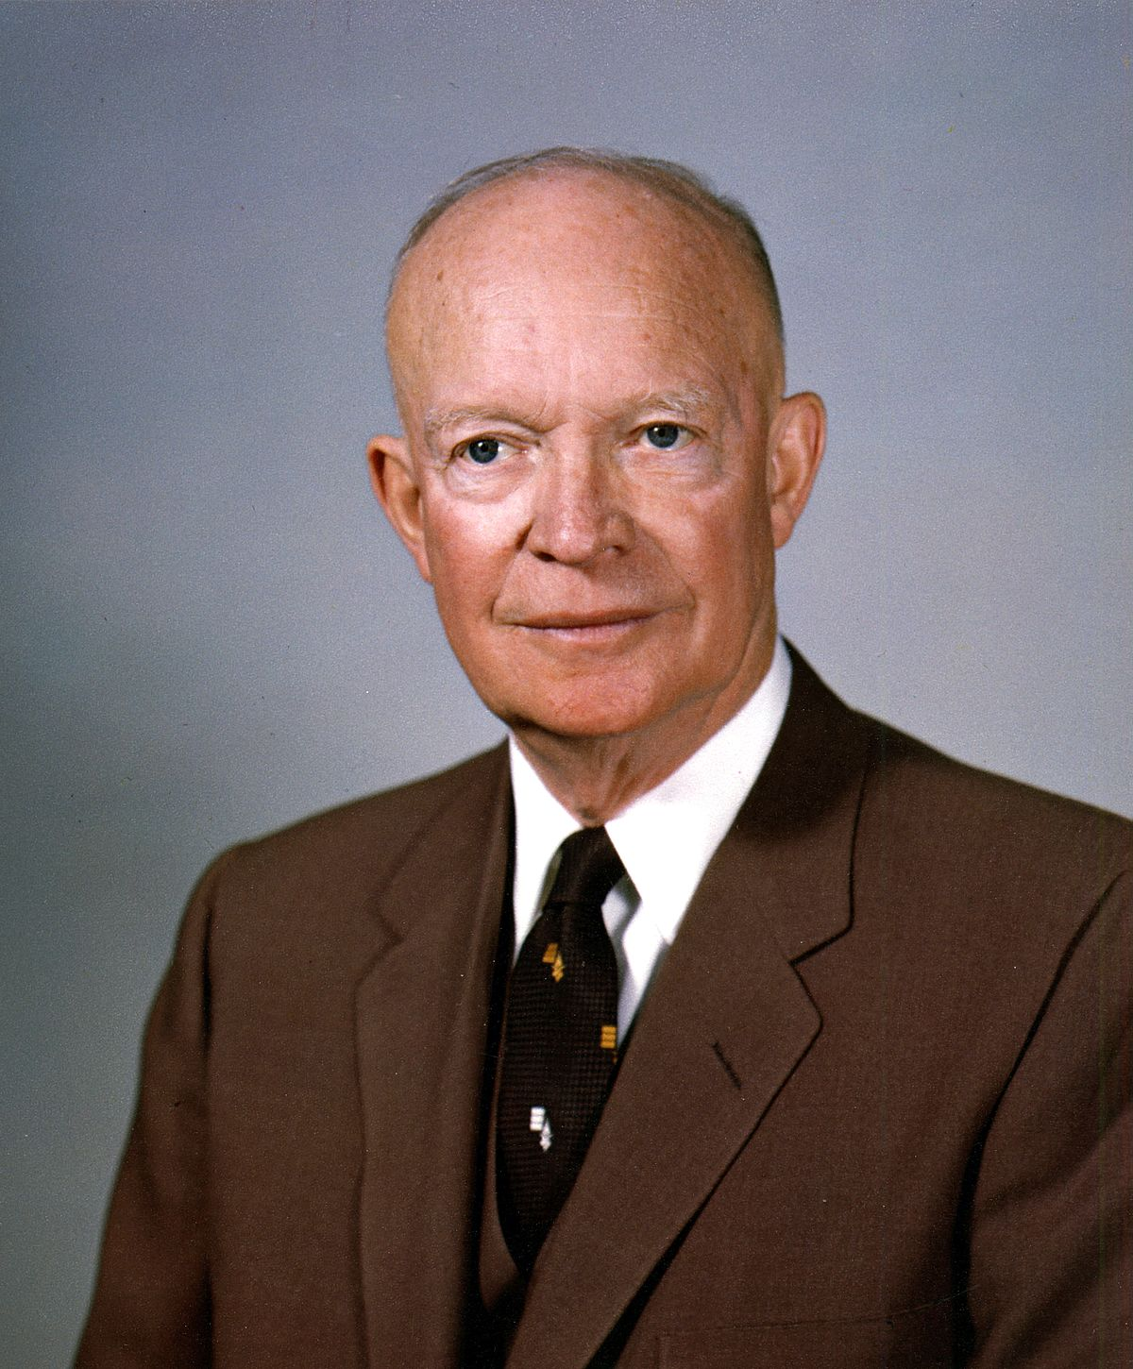
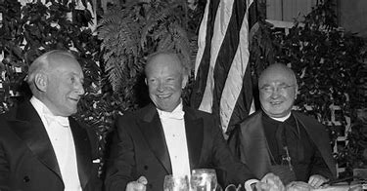
In 1959, President Eisenhower requested 1 billion dollars from congress to implement more evolution for the American Education Fund and Department of Health Education and Welfare—Scientists In The Classroom, John Rudolph, p. 107, 109

Slide 7
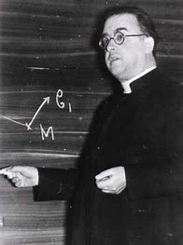
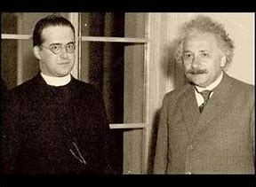
The Big Bang Theory…
“In 1927 a Roman Catholic priest and scientist Georges Lemaitre proposed what later became known as the Big Bang theory of the origin of the Universe, based on work by Edwin Hubble who theorized and then proved that the Universe was getting bigger and bigger. Many scientists have discovered other evidence that confirms that the theory might be correct. They think that the Big Bang happened 13 to 15 billion years ago.”—Unitarian Universalist Association, The Big Bang Theory, https://www.uua.org/re/tapestry/multigenerational/miracles/session-1/big-bang
Georges Lemaitre was initially educated at a Jesuit school located in Charleroi named College du Sacre-Couer.—Georges Lemaître, Biography, https://www.thefamouspeople.com/profiles/georges-lematre-6929.php

Slide 8
What is the Result?
“And so the sons betrayed the sacrifice of the fathers…”

Slide 9
Psalm 11:2-3 “For, lo, the wicked bend their bow, they make ready their arrow upon the string, that they may privily shoot at the upright in heart. If the foundations be destroyed, what can the righteous do?”
Rev. 18:3 “For all nations have drunk of the wine of the wrath of her fornication, and the kings of the earth have committed fornication with her, and the merchants of the earth are waxed rich through the abundance of her delicacies.”

Slide 10
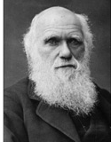
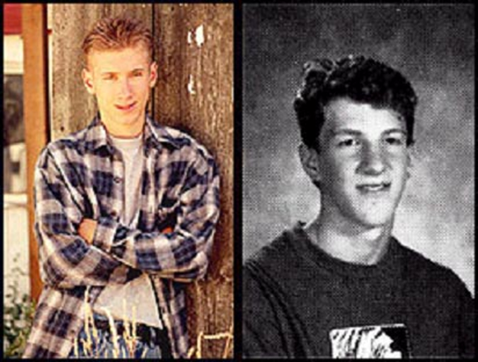
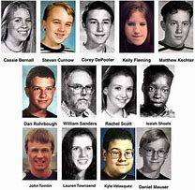
What do they have in common…
Dylan Kleboid and Eric Harris took part in the Columbine shooting, wearing t-shirts that said “wrath” and “natural selection”. They committed the atrocity on Hitler’s birthday. before the act, the two boys created a video talking about a football player, saying: “He doesn’t deserve the jaw evolution gave him. Look for his jaw. It won’t be on his body.”

Slide 11
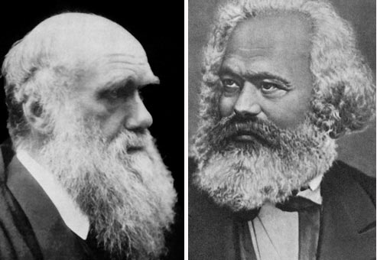
Religious Sect of the NWO
“Bismark complained in his North German Gazette, that I was in league with Father Beck [Superior General of the Jesuit Order], the leader of the Jesuit movement, and that we were keeping the socialist movement in such a condition that he could do nothing with it"--Interview with Karl Marx, January 5, 1879, Chicago Tribune
Fascism???
National Socialist German Workers Party

Slide 12
What Can We Do???
“The author cannot send forth this little volume without reiterating once more, most humbly, yet most earnestly, his immovable conviction that the Government of Britain [U.S.] and the Government of God are, at this hour, proceeding on lines directly antagonistic, and that either we must change our course or the Most High must change His if a great catastrophe is to be avoided. . . God raised up Britain [America] and gave her greatness beyond the measure of all former empires. For what end? That she might subserve the interests of the Gospel, as embodied in Protestantism. This is our first duty as a nation. The neglect of it is our first sin, no matter what other duties we make ourselves busy about. The laws of God’s providence being what they are, we cannot retain our supremacy, or , it may be, our existence, and neglect our great mission. But let be what may, the fate of our empire, whether it part in twain or dissolve in ruin, one thing is certain, Protestantism shall survive and triumph.”—JA Wylie, The Jesuits: Their Moral Maxims and Plots, 1881, p. vi

