Slide 1
Ezekiel, pt. 20
Valley of Dry Bones

Slide 2
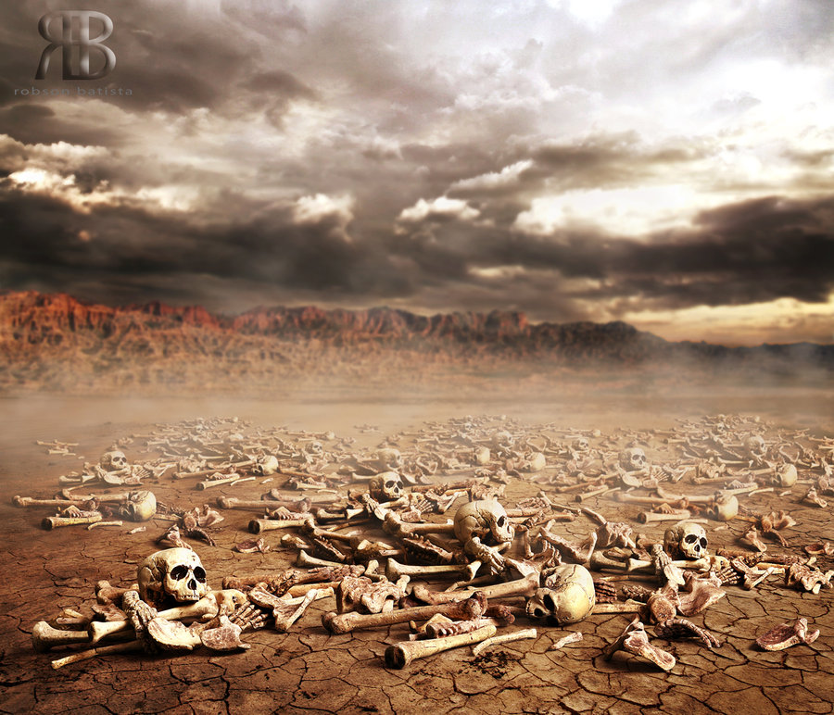
Very Promising!

Slide 3
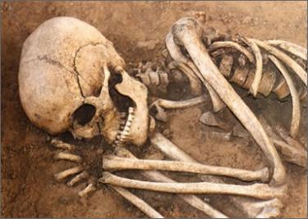
Hopeless!
Lifeless, incapable of doing anything , totally unaware of anything around them, and utterly pitiful is this valley of dry bones!
Our obvious response is, “I’m sure glad I’m not like them!”
Well, we had better think again…………………….!!!!!!!!!!

Slide 4
Ezekiel 37: 1,2,
The hand of the LORD was upon me, and carried me out in the spirit of the LORD, and set me down in the midst of the valley which was full of bones, And caused me to pass by them round about: and, behold, there were very many in the open valley; and, lo, they were very dry...... Then he said unto me, Son of man, these bones are the whole house of Israel: behold, they say, Our bones are dried, and our hope is lost: we are cut off for our parts.”

Slide 5
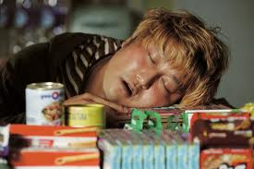
Kind of Like the Virgins
Then shall the kingdom of heaven be likened unto ten virgins, which took their lamps, and went forth to meet the bridegroom. And five of them were wise, and five were foolish. They that were foolish took their lamps, and took no oil with them: But the wise took oil in their vessels with their lamps. While the bridegroom tarried, they all slumbered and slept.” Matthew 25:1-5

Slide 6
What a Fitting Symbol!!
Conference versus independent! One heresy after another, picking off people by the scores! People bickering over the 2520, feast days, what name to call God, is the Holy Spirit a person?, is Ted Wilson following God, can he be trusted? How about the king of the north?, Uriah Smith should be listened to like the spirit of prophecy, will we be saved in sin?, Can I just love Jesus? And the beat goes on………. Truly, we are a valley of dry bones, as were Ancient Adventists!

Slide 7
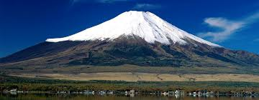
Is there any Hope?
“And he said unto me, Son of man, can these bones live? And I answered, O Lord GOD, thou knowest. Again he said unto me, Prophesy upon these bones, and say unto them, O ye dry bones, hear the word of the LORD.” Ezekiel 37:3,4
“It is the spirit that quickeneth; the flesh profiteth nothing: the words that I speak unto you, they are spirit, and they are life.” JN. 6:63

Slide 8
Life Only
“The life of Christ that gives life to the world is in His word. It was by His word that Jesus healed disease and cast out demons; by His word He stilled the sea, and raised the dead; and the people bore witness that His word was with power. He spoke the word of God, as He had spoken through all the prophets and teachers of the Old Testament. The whole Bible is a manifestation of Christ, and the Saviour desired to fix the faith of His followers on the word. When His visible presence should be withdrawn, the word must be their source of power. Like their Master, they were to live "by every word that proceedeth out of the mouth of God." Matt. 4:4.” DA, pg. 390

Slide 9
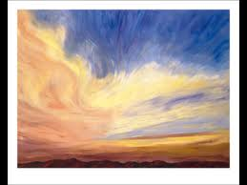
Breath of God
“Thus saith the Lord GOD unto these bones; Behold, I will cause breath to enter into you, and ye shall live: And I will lay sinews upon you, and will bring up flesh upon you, and cover you with skin, and put breath in you, and ye shall live; and ye shall know that I am the LORD.” Ezekiel 37:5,6

Slide 10
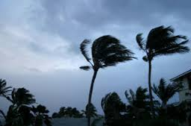
Clarification
“ So I prophesied as I was commanded: and as I prophesied, there was a noise, and behold a shaking, and the bones came together, bone to his bone. And when I beheld, lo, the sinews and the flesh came up upon them, and the skin covered them above: but there was no breath in them. Then said he unto me, Prophesy unto the wind, prophesy, son of man, and say to the wind, Thus saith the Lord GOD; Come from the four winds, O breath, and breathe upon these slain, that they may live.” Ezekiel 37:7-9

Slide 11
The Holy Spirit
“The wind is heard among the branches of the trees, rustling the leaves and flowers; yet it is invisible, and no man knows whence it comes or whither it goes. So with the work of the Holy Spirit upon the heart. It can no more be explained than can the movements of the wind. A person may not be able to tell the exact time or place, or to trace all the circumstances in the process of conversion; but this does not prove him to be unconverted. By an agency as unseen as the wind, Christ is constantly working upon the heart. Little by little, perhaps unconsciously to the receiver, impressions are made that tend to draw the soul to Christ. These may be received through meditating upon Him, through reading the Scriptures, or through hearing the word from the living preacher. Suddenly, as the Spirit comes with more direct appeal, the soul gladly surrenders itself to Jesus. By many this is called sudden conversion; but it is the result of long wooing by the Spirit of God,--a patient, protracted process. “ DA, pg. 172

Slide 12
Like Pentecost
“And when the day of Pentecost was fully come, they were all with one accord in one place. And suddenly there came a sound from heaven as of a rushing mighty wind, and it filled all the house where they were sitting. And there appeared unto them cloven tongues like as of fire, and it sat upon each of them.” Acts 2:1-3

Slide 13
Coming Again!
“I saw the latter rain is coming suddenly, as the midnight cry and with ten times the power.” Ellen White letter, Spalding-Megan Collection, pages 3,4
How powerful was the midnight cry?
“In the parable of Matthew 25 the time of waiting and slumber is followed by the coming of the bridegroom. This was in accordance with the arguments just presented, both from prophecy and from the types. They carried strong conviction of their truthfulness; and the "midnight cry" was heralded by thousands of believers.
Like a tidal wave the movement swept over the land.

Slide 14
Unstoppable Army
“So I prophesied as he commanded me, and the breath came into them, and they lived, and stood up upon their feet, an exceeding great army.” Ezekiel 37:10
“Who is she that looketh forth as the morning, fair as the moon, clear as the sun, and terrible as an army with banners?” S of S, 6:10

Slide 15
Bohemians 15th Century
“The pope now proclaimed a crusade against the Hussites, and again an immense force was precipitated upon Bohemia, but only to suffer terrible defeat. Another crusade was proclaimed. In all the papal countries of Europe, men, money, and munitions of war were raised. Multitudes flocked to the papal standard, assured that at last an end would be made of the Hussite heretics. Confident of victory, the vast force entered Bohemia. The people rallied to repel them. The two armies approached each other until only a river lay between them. "The crusaders were in greatly superior force, but instead of dashing across the stream, and closing in battle with the Hussites whom they had come so far to meet, they stood gazing in silence at those warriors."--Wylie, b. 3, ch. 17. Then suddenly a mysterious terror fell upon the host. Without striking a blow, that mighty force broke and scattered as if dispelled by an unseen power. Great numbers were slaughtered by the Hussite army, which pursued the fugitives, and an immense booty fell into the hands of the victors, so that the war, instead of impoverishing, enriched the Bohemians.” GC, pg. 116

Slide 16
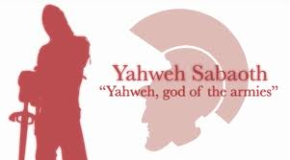
Yahweh Sabaoth
Throughout Scripture, the phrase ‘LORD of Hosts’ means Commander of the armies of the universe. Awesome name to describe the One who will fight the battles of His lowly children!!!

Slide 17
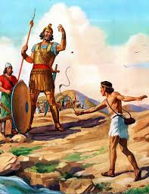
Luther, David, Zerubbabel
In the song, ‘A Mighty Fortress’, Luther invoked Yahweh Sabaoth. So did David before Goliath- 1 Samuel 17:45 and so did Zerubbabel in Zech. 4:6. The Lord shall fight for you and you shall hold your peace!!

Slide 18
The Holy Spirit
“Then he said unto me, Son of man, these bones are the whole house of Israel: behold, they say, Our bones are dried, and our hope is lost: we are cut off for our parts. Therefore prophesy and say unto them, Thus saith the Lord GOD; Behold, O my people, I will open your graves, and cause you to come up out of your graves, and bring you into the land of Israel. And ye shall know that I am the LORD, when I have opened your graves, O my people, and brought you up out of your graves, And shall put my spirit in you, and ye shall live, and I shall place you in your own land: then shall ye know that I the LORD have spoken it, and performed it, saith the LORD.” Ezekiel 37:11-14

Slide 19
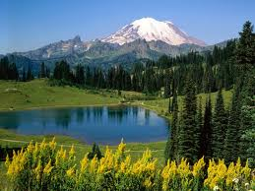
Power to do Right!!!
“And I will put my spirit within you, and cause you to walk in my statutes, and ye shall keep my judgments, and do them.” Ezekiel 36:26,27

