Slide 1
Church and state, pt. 4
Unknown Stepchildren

Slide 2
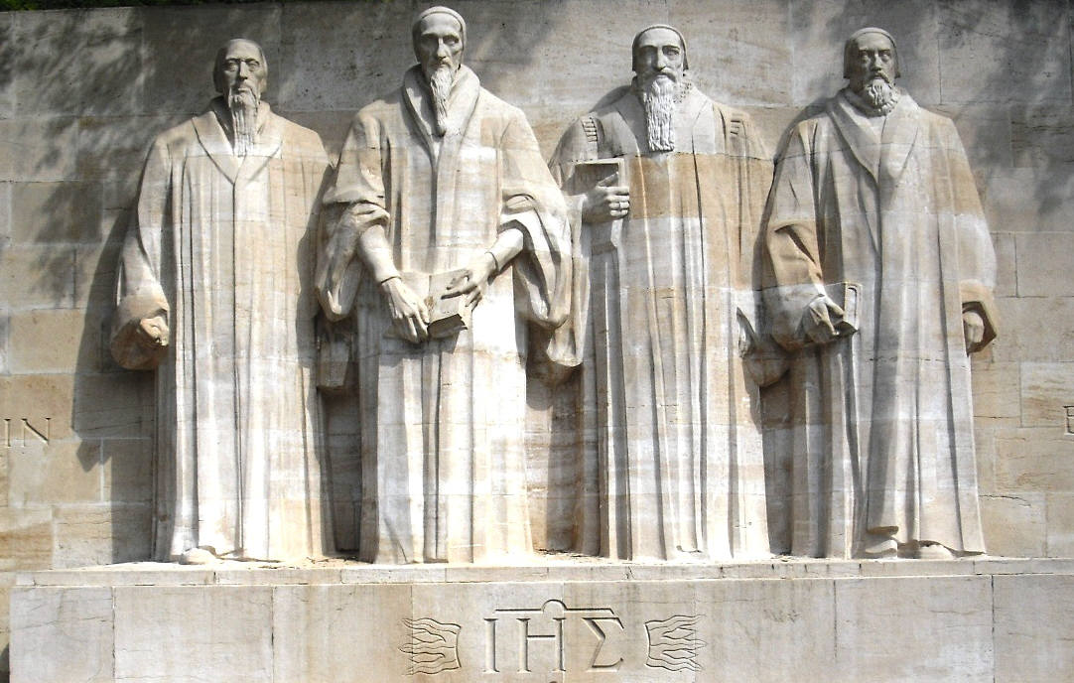
Halfway Men
To discuss Martin Luther, Philip Melanchthon, Ulrich Zwingli, and John Calvin in the same context as ‘halfway men’ is difficult. God used these men in a mighty way as they stood for His Word. ‘Sola Scriptura’ was their cry. In some things, however, they only went halfway and thus were called ‘halfway men’. We will examine these things today.

Slide 3
The Second Front
“Before the Reformation was ten years along it had become evident that not all who were rebelling against the medieval order were of one mind and heart. It had become apparent that within the camp of the dissenters there were deep-seated differences, tensions of such dimensions that a parting of the ways was in the making. It had become plain that the Reformers would as a result be obliged to deploy some of their forces to a second front; they would have to divide their energies between two opponents, Rome and the Radicals. From the outset the Reformers realized that the opposition that was shaping up on the Second Front was going to be formidable--at least as formidable as the opposition from the side of the Catholics. As early as May 28, 1525, Zwingli, in a letter to Vadian, expressed the opinion that the struggle with the Catholic party was "but child's play" when compared with the struggle that was erupting at the Second Front. The opening of the Second Front affected the course of the Reformation very significantly. By way of reaction to it the Reformers backed into a corner where they would not otherwise have retreated. The opening of the Second Front caused the Reformers to go back on their own former selves;” Verduin, intro.

Slide 4
The Difference
“The Stepchildren believed that the Church of Christ is by definition an element in society, not society as such. Their opponents, the Reformers as well as the Catholics, were unwilling to go along with this; they continued to look upon the Church as coextensive with society. It has been said of late that Luther was faced with a dilemma, the dilemma of wanting both a confessional Church based on personal faith and a regional Church including all in a given locality. It was this dilemma that gave rise to the Second Front.
This dilemma was a cruel one. He who thinks of the Church as a community of experiential believers is bound to oppose him who thinks of it as a fellowship embracing all in a given territory; he who operates with the concept of the Church as a society embracing all in a given geographic area must of necessity look askance at him who restricts the Church to the believing ones. The two views cannot be combined; one cancels out the other. In the one view the Church is Corpus Christi, the body of Christ, which consists of believing folk and of them solely; in the other view the Church is Corpus Christianum, the body of a "christened" society. As we shall see, attempts have been made to combine these two, but without success.
Upon the horns of this dilemma Luther was impaled. And not only Luther-all the rest of the Reformers were torn between the same two alternatives. They one and all halted between two opinions. They one and all tried to avoid an outright choice. All tried to ride the fence.” Verduin, introduction

Slide 5
Where They Stumbled
The great reformers struggled in several Biblical areas that were very prevalent at that time.
1. They were all sacra lists. They believed that everyone was to be part of the Christian society in which they lived. There could be no deviation.
2. Infant baptism was crucial because this made a child at birth a part of the ‘Christian’ community and one with everyone else.
3. They believed that when someone didn’t go along with the whole, they could be persecuted to death.
4. The reformer became the final word; ‘Sola Scriptura’ was replaced with ‘Sola Reforma’.
5. This resulted in failure to see other Biblical doctrines like the Sabbath, state of the dead, communion ,others.

Slide 6
The Great Protest
One of the noblest testimonies ever uttered for the Reformation was the Protest offered by the Christian princes of Germany at the Diet of Spires in 1529. The courage, faith, and firmness of those men of God gained for succeeding ages liberty of thought and of conscience. Their Protest gave to the reformed church the name of Protestant; its principles are "the very essence of Protestantism."--D'Aubigne, b. 13, ch. 6.

Slide 7
4 Days Later
On April 23, 1529 the Catholic and Protestant Princes gathered at the second Diet of Speyer and one of their decrees was: "every Anabaptist and rebapitized man and woman of the age of reason shall be condemned and brought from natural life into death by fire, sword, and the like, according to the person, without proceeding by the inquisition of the spiritual judges."
Speaking for Luther and himself, Melanchthon, making no distinction between the quiet reformers who believed in baptism and the radicals who had used mob action (peasant's revolt)to war against papal oppression, wrote (February, 1530) "The government is under obligation to kill them:" A year later, Luther himself wrote: "I approve, ...although it is terrible to view."

Slide 8
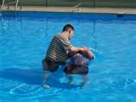
The Anabaptists: Killed for This!
The Anabaptists, at this time, were simply trying to go by the Protestant battle cry ‘Sola Scriptura’. They saw nothing in the Bible that said infants should be baptized. They saw that people should be baptized only when there is understanding of what the ordinance means and if the person is desirous of submitting their life to Christ.

Slide 9
Let Us Meet Some of Them!
Karlstadt- During the reformer's stay at the Wartburg, in 1521/1522, he introduced important changes in Wittenberg, among others, in the order of the Mass; he was against the veneration of images. As an opponent of priestly celibacy he became a married man on January 19, 1522. Until 1523 or 1524 he was a professor at Wittenberg University, but he then became a pastor in Orlamünde. His theology became ever more radical; for instance, he rejected the Real Presence, which distanced him from Luther. He was banished from Saxony in 1524, returned in 1525, but had to flee again in 1529.”… At his new post Karlstadt proceeded head-on with his radical programme: the Mass in German, the celebrant without the ritual garments, the Eucharist sub utraque specie, the statues and images removed. And also something brand new: he forbade infant baptism. Karlstadt was highly influential, so alterations were introduced in many villages around Orlamünde. The same happened in the city of Jena. This region became the first with non-Catholic religious services.” The Light and the Dark, chapter 5

Slide 10
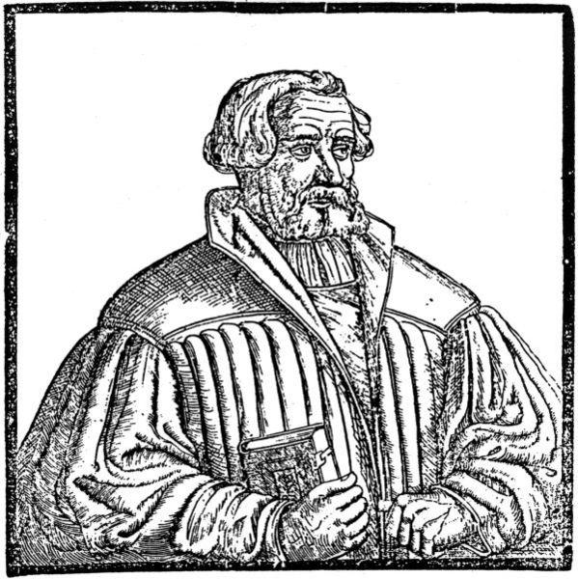
Karlstadt
“It is interesting that Andreas Karlstadt, one of Luther’s first theological opponents, already in 1524 published Von dem Sabbat un gebotten feyertagen at Jena, reflecting his pastoral concerns at Orlamuende, tr. E. J. Furcha, tr., The Essential Karlstadt, Scottdale PA, 1995, pp. 317-333. In section 9, pp. 333-4, Karlstadt says, “It is no secret that human beings instituted Sunday. As for Saturday, the matter is still being debated. But it is clear that you must celebrate on the seventh day and allow your servants to celebrate whenever they have worked six days.”[3]
The first polemical appearance of Sabbatarianism in the Reformation coincides with Luther’s knowledge of it and his refutation of the Silesian movement in this work.”

Slide 11
Felix Mantz/Conrad Grebel
Mantz became a follower of Ulrich Zwingli after he came to Zürich in 1519. When Conrad Grebel joined the group in 1521, he and Mantz became friends. They questioned the mass, the nature of church and state connections, and infant baptism. Around 1523, they became dissatisfied with the Reformation, believing that Zwingli's plans for reform had been compromised with the city council. Grebel, Mantz, Reublin and others made several attempts to plead their position. Several parents refused to have their children baptized. A public disputation was held with Zwingli on January 17,1525, whereby the council declared Zwingli the victor. These Radical Reformers, as they were now called, were banished from the region and were considered outlaws. After the final rebuff by the city council on January 18, in which they were ordered to desist from arguing and submit to the decision of the council, and have their children baptized within eight days, the brethren gathered at the home of Felix Mantz and his mother on January 21. Conrad Grebel baptized George Blaurock, and in turn Blaurock baptized the others….

Slide 12
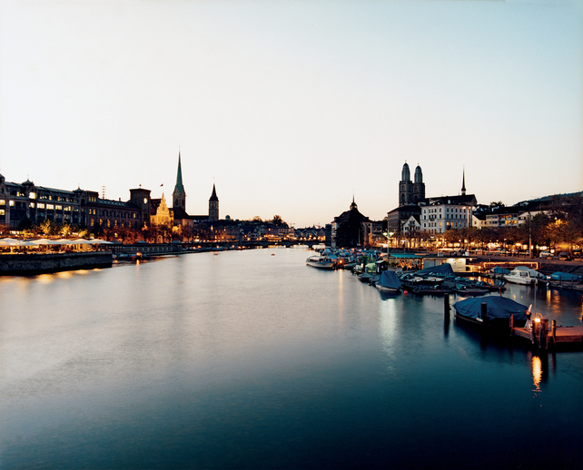
Mantz’ 3rd Baptism
This made the break complete with Zwingli and the council, as they formed the first church of the Radical Reformation. The movement spread rapidly, and Mantz was very active in it. He used his language skills to translate his texts into the language of the people, and worked enthusiastically as an evangelist. Mantz was arrested on a number of occasions between 1525 and 1527. While he was preaching with George Blaurock in the Grüningen region, they were taken by surprise, arrested and imprisoned in Zürich at the Wellenburg prison. On March 7,1526, the Zürich council had passed an edict that made adult rebaptism punishable by drowning. On January 5,1527, Felix Mantz became the first casualty of the edict, and the first Swiss Anabaptist to be martyred at the hands of other Protestants.”
http://theradicalsmovie.com/felixmantz.htm

Slide 13
Conrad Grebel
“Grebel and Zwingli broke over abolishing the Mass. Zwingli argued before the council for abolishing the Mass and removing images from the church. But when he saw that the city council was not ready for such radical changes, he chose not to break with the council, and even continued to officiate at the Mass until it was abolished in May of 1525. Grebel saw this as an issue of obeying God rather than men, and, with others, could not conscientiously continue in that which they had condemned as unscriptural. These young radicals felt betrayed by Zwingli, while Zwingli looked on them as irresponsible…The final question to completely sever ties between the radicals and Zwingli was the question of infant baptism. A public debate was held on January 17, 1525. Zwingli argued against Grebel, Mantz and George Blaurock. The city council decided in favor of Zwingli and infant baptism, ordered the Grebel group to cease their activities, and ordered that any unbaptized infants must be submitted for baptism within 8 days. Failure to comply with the council's order would result in exile from the canton. Grebel had an infant daughter,Issabella, who had not been baptized, and he resolutely stood his ground. He did not intend for her to be baptized.” Wikipedia

Slide 14
Oswald Glait
Little is known about Oswald Glait, a founder with Andreas Fischer, (1480-1546)[8] of Sabbatarian Anabaptism, both of whom developed the seventh-day doctrine into a major part of their faith. Glait, born at Cham in the Upper Palatinate, later came to serve a Lutheran congregation at Nikolsburg, Moravia, after 1525 under the protection of Leonhard von Liechtenstein. At first helping unite the evangelical groups at a 1526 Austerlitz synod, Glait became an Anabaptist when Balthasar Huebmaier arrived at Nikolsburg the same year. The Liechtenstein Lord also approved of Anabaptism. When Glait sided with the radical Anabaptist Hans Hut against the use of the sword one year later, they were both exiled to Vienna. Moving on to Liegnitz, Silesia, where Schwwenckfeld and Crautwald were influential, Glait (aided by Andreas Fischer) appears to have become a Sabbatarian there, where he published a lost tract “Concerning the Keeping of the Sabbath,” c. 1530. Glait taught that the seventh day Sabbath is binding on Christians just as it was on the Jews of old, because it is enjoined intheDecalogue.”http://concordiatheology.org/2010/05/luther%E2%80%99s-writing-against-emerging-sabbatarianism/

Slide 15
Menno Simons
“From one of the provinces of Holland came Menno Simons. Educated a Roman Catholic and ordained to the priesthood, he was wholly ignorant of the Bible, and he would not read it for fear of being beguiled into heresy. When a doubt concerning the doctrine of transubstantiation forced itself upon him, he regarded it as a temptation from Satan, and by prayer and confession sought to free himself from it; but in vain. By mingling in scenes of dissipation he endeavored to silence the accusing voice of conscience; but without avail. After a time he was led to the study of the New Testament, and this, with Luther's writings, caused him to accept the reformed faith. He soon after witnessed in a neighboring village the beheading of a man who was put to death for having been rebaptized. This led him to study the Bible in regard to infant baptism. He could find no evidence for it in the Scriptures, but saw that repentance and faith are everywhere required as the condition of receiving baptism.
Menno withdrew from the Roman Church and devoted his life to teaching the truths which he had received. In both Germany and the Netherlands a class of fanatics had risen, advocating absurd and seditious doctrines, outraging order and decency, and proceeding to violence and insurrection. Menno saw the horrible results to which these movements would inevitably lead, and he strenuously opposed the erroneous teachings and wild schemes of the fanatics. There were many, however, who had been misled by these fanatics, but who had renounced their pernicious doctrines; and there were still remaining many descendants of the ancient Christians, the fruits of the Waldensian teaching. Among these classes Menno labored with great zeal and success.” GC, pgs. 238,239

Slide 16
The Weirdo’s
“But Satan was not idle. He now attempted what he has attempted in every other reformatory movement--to deceive and destroy the people by palming off upon them a counterfeit in place of the true work. As there were false christs in the first century of the Christian church, so there arose false prophets in the sixteenth century.
A few men, deeply affected by the excitement in the religious world, imagined themselves to have received special revelations from Heaven, and claimed to have been divinely commissioned to carry forward to its completion the Reformation which, they declared, had been but feebly begun by Luther. In truth, they were undoing the very work which he had accomplished. They rejected the great principle which was the very foundation of the Reformation--that the word of God is the all-sufficient rule of faith and practice; and for that unerring guide they substituted the changeable, uncertain standard of their own feelings and impressions. By this act of setting aside the great detector of error and falsehood the way was opened for Satan to control minds as best pleased himself.
One of these prophets claimed to have been instructed by the angel Gabriel. A student who united with him forsook his studies, declaring that he had been endowed by God Himself with wisdom to expound His word. Others who were naturally inclined to fanaticism united with them. The proceedings of these enthusiasts created no little excitement.” GC, pg. 186

Slide 17
Thomas Munzer
“Thomas Munzer, the most active of the fanatics, was a man of considerable ability, which, rightly directed, would have enabled him to do good; but he had not learned the first principles of true religion. "He was possessed with a desire of reforming the world, and forgot, as all enthusiasts do, that the reformation should begin with himself."--Ibid., b. 9, ch. 8. He was ambitious to obtain position and influence, and was unwilling to be second, even to Luther. He declared that the Reformers, in substituting the authority of Scripture for that of the pope, were only establishing a different form of popery. He himself, he claimed, had been divinely commissioned to introduce the true reform. "He who possesses this spirit," said Munzer, "possesses the true faith, although he should never see the Scriptures in his life."--Ibid., b. 10, ch. 10.
The fanatical teachers gave themselves up to be governed by impressions, regarding every thought and impulse as the voice of God; consequently they went to great extremes. Some even burned their Bibles, exclaiming: "The letter killeth, but the Spirit giveth life." Munzer's teaching appealed to men's desire for the marvelous, while it gratified their pride by virtually placing human ideas and opinions above the word of God. His doctrines were received by thousands. He soon denounced all order in public worship, and declared that to obey princes was to attempt to serve both God and Belial. The minds of the people, already beginning to throw off the yoke of the papacy, were also becoming impatient under the restraints of civil authority. Munzer's revolutionary teachings, claiming divine sanction, led them to break away from all control and give the rein to their prejudices and passions. The most terrible scenes of sedition and strife followed, and the fields of Germany were drenched with blood.”
GC, pg. 191,192

Slide 18
The Peasants Revolt
“The agony of soul which Luther had so long before experienced at Erfurt now pressed upon him with redoubled power as he saw the results of fanaticism charged upon the Reformation. The papist princes declared..that the rebellion was the legitimate fruit of Luther's doctrines. Although this charge was without the slightest foundation, it could not but cause the Reformer great distress. That the cause of truth should be thus disgraced by being ranked with the basest fanaticism, seemed more than he could endure. On the other hand, the leaders in the revolt hated Luther because he had not only opposed their doctrines and denied their claims to divine inspiration, but had pronounced them rebels against the civil authority. He seemed to have brought upon himself the enmity of both princes and people.” GC, pg. 192
Müntzer led a group of about 8000 peasants at the battle of Frankenhausen (15 May 1525) against political and spiritual oppression, convinced that God would intervene on their side. Utterly defeated, captured, imprisoned and tortured, Müntzer recanted and accepted the Roman Catholic mass prior to his beheading in Mühlhausen in Thuringia on 27 May 1525. Under torture he confessed that he believed that omnia sunt communia, all things are in common. His head and body were displayed as a warning to all those who might again preach treasonous doctrines.”
This became known as the Peasants Revolt. Because some of Muntzer’s doctrines were similar to the antibaptists, for he didn’t believe in infant baptism, and because some of Muntzer’s ideas were like Luther’s, this revolt was charged on Luther and the Bible believing Antibaptists.

Slide 19
Parallels Today-Amazing!!
1. The denomination is in apostasy, just as Rome was in that day.
2. Some want to maintain ties to the ‘church’ and obey its dictates just as Luther, Zwingli, and the like did in the 16th century.
3. Some wanted to spread the whole truth throughout the world as the antibaptists did.
4. Some fanatics arose drawing people after them. We have that today with those who say keep the feast days, no Holy Spirit, church is Babylon.
Personally, I want to stand with the Antibaptists that had a zeal for evangelism and for the whole truth.

