Slide 1
Pilate the Coward
The Theologian too!

Slide 2
A Must!
“It would be well for us to spend a thoughtful hour each day in contemplation of the life of Christ. We should take it point by point, and let the imagination grasp each scene, especially the closing ones. As we thus dwell upon His great sacrifice for us, our confidence in Him will be more constant, our love will be quickened, and we shall be more deeply imbued with His spirit. If we would be saved at last, we must learn the lesson of penitence and humiliation at the foot of the cross.” DA, pg. 83

Slide 3
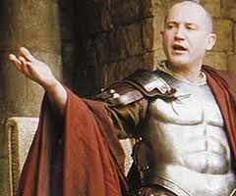
His Background
The sketchy background of this Roman governor has it that Pilate was a soldier in the Roman machine. He became famous for his valor and was given opportunity to take a high position. Pilate chose Judea, knowing that if he succeeded here, the next step could very well be Caesar’s throne. If he succeeded here………………………..

Slide 4
Don’t Get Defiled!
“After condemning Jesus, the council of the Sanhedrin had come to Pilate to have the sentence confirmed and executed. But these Jewish officials would not enter the Roman judgment hall. According to their ceremonial law they would be defiled thereby, and thus prevented from taking part in the feast of the Passover. In their blindness they did not see that murderous hatred had defiled their hearts… When the Saviour was brought into the judgment hall, Pilate looked upon Him with no friendly eyes. The Roman governor had been called from his bedchamber in haste, and he determined to do his work as quickly as possible.” DA, pg. 723
“Then led they Jesus from Caiaphas unto the hall of judgment: and it was early; and they themselves went not into the judgment hall, lest they should be defiled; but that they might eat the Passover.” Jn. 18:28

Slide 5
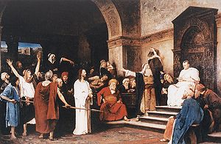
The Look
“Pilate looked at the men who had Jesus in charge, and then his gaze rested searchingly on Jesus. He had had to deal with all kinds of criminals; but never before had a man bearing marks of such goodness and nobility been brought before him. On His face he saw no sign of guilt, no expression of fear, no boldness or defiance. He saw a man of calm and dignified bearing, whose countenance bore not the marks of a criminal, but the signature of heaven.” DA., pg. 724

Slide 6
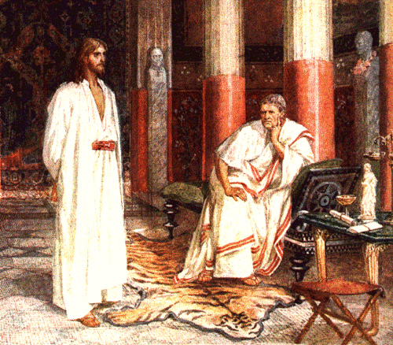
Questioning?!?
“Then Pilate said…unto him, Art thou the King of the Jews? Jesus answered him, Sayest thou this thing of thyself, or did others tell it thee of me? Pilate answered, Am I a Jew? Thine own nation and the chief priests have delivered thee unto me: what hast thou done? Jesus answered, My kingdom is not of this world: if my kingdom were of this world, then would my servants fight, that I should not be delivered to the Jews: but now is my kingdom not from hence.
Pilate therefore said unto him, Art thou a king then? Jesus answered, Thou sayest that I am a king. To this end was I born, and for this cause came I into the world, that I should bear witness unto the truth. Every one that is of the truth heareth my voice. Pilate saith unto him, What is truth?” Jn. 18:33-38

Slide 7
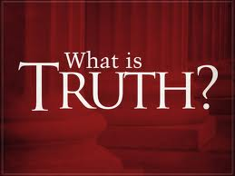
What is Truth?
“Jesus saith unto him, I am the way, the truth, and the life: no man cometh unto the Father, but by me.” Jn. 14:6
“Sanctify them through thy truth: thy word is truth.” Jn. 17:17
“Thy righteousness [is] an everlasting righteousness, and thy law [is] the truth.” Ps. 119:142

Slide 8
Too Busy
Pilate asked a great question, but was too busy to wait for an answer. A golden opportunity passed him by. It would have made all the difference!!!
“Christ affirmed that His word was in itself a key which would unlock the mystery to those who were prepared to receive it. It had a self-commending power, and this was the secret of the spread of His kingdom of truth. He desired Pilate to understand that only by receiving and appropriating truth could his ruined nature be reconstructed.” DA, pg. 727

Slide 9
Christ
“Standing behind Pilate, in view of all in the court, Christ heard the abuse; but to all the false charges against Him He answered not a word. His whole bearing gave evidence of conscious innocence. He stood unmoved by the fury of the waves that beat about Him. It was as if the heavy surges of wrath, rising higher and higher, like the waves of the boisterous ocean, broke about Him, but did not touch Him. He stood silent, but His silence was eloquence. It was as a light shining from the inner to the outer man.” DA, pg. 726

Slide 10
Pilate’s Fatal Mistake
“And Pilate, when he had called together the chief priests and the rulers and the people, Said unto them, Ye have brought this man unto me, as one that perverteth the people: and, behold, I, having examined him before you, have found no fault in this man touching those things whereof ye accuse him: No, nor yet Herod: for I sent you to him; and, lo, nothing worthy of death is done unto him. I will therefore chastise him, and release him.” Lk. 23:13-16

Slide 11
Too Obvious
Pilate knew his duty. He had declared Christ to be innocent. Pilate had to release Christ; he had to let Him go. Pilate’s fatal flaw was that he was a coward. He refused to do right and this destroyed him!
New International Perversion>we need to pray
Singing, swaying, celebrating>we need to continue to support this.
Spiritual Formation>The Lord will right the ship
The Antichrist is the devil>I just want to hear about Jesus!
Any Cowards here?

Slide 12
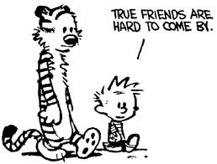
Friendship/Fellowship/Position
“By this course, Pilate thought to shift the responsibility of the trial from himself to Herod. He also thought this a good opportunity to heal an old quarrel between himself and Herod. And so it proved. The two magistrates made friends over the trial of the Saviour.” DA, pg. 728
“And as soon as he knew that he belonged unto Herod's jurisdiction, he sent him to Herod, who himself also was at Jerusalem at that time.” LK. 23:7

Slide 13
The Warning
“Even now Pilate was not left to act blindly. A message from God warned him from the deed he was about to commit. In answer to Christ's prayer, the wife of Pilate had been visited by an angel from heaven, and in a dream she had beheld the Saviour and conversed with Him. Pilate's wife was not a Jew, but as she looked upon Jesus in her dream, she had no doubt of His character or mission. She knew Him to be the Prince of God. She saw Him on trial in the judgment hall. She saw the hands tightly bound as the hands of a criminal. She saw Herod and his soldiers doing their dreadful work. She heard the priests and rulers, filled with envy and malice, madly accusing. She heard the words, "We have a law, and by our law He ought to die." She saw Pilate give Jesus to the scourging, after he had declared, "I find no fault in Him." She heard the condemnation pronounced by Pilate, and saw him give Christ up to His murderers. She saw the cross uplifted on Calvary. She saw the earth wrapped in darkness, and heard the mysterious cry, "It is finished." Still another scene met her gaze. She saw Christ seated upon the great white cloud, while the earth reeled in space, and His murderers fled from the presence of His glory. With a cry of horror she awoke, and at once wrote to Pilate words of warning…Have thou nothing to do with that just Man: for I have suffered many things this day in a dream because of Him.“ DA, pg. 732

Slide 14
Custom/Trap
“Now at that feast the governor was wont to release unto the people a prisoner, whom they would. And they had then a notable prisoner, called Barabbas. Therefore when they were gathered together, Pilate said unto them, Whom will ye that I release unto you? Barabbas, or Jesus which is called Christ? For he knew that for envy they had delivered him. When he was set down on the judgment seat, his wife sent unto him, saying, Have thou nothing to do with that just man: for I have suffered many things this day in a dream because of him. But the chief priests and elders persuaded the multitude that they should ask Barabbas, and destroy Jesus. The governor answered and said unto them, Whether of the twain will ye that I release unto you? They said, Barabbas. Pilate saith unto them, What shall I do then with Jesus which is called Christ? They all say unto him, Let him be crucified.” Matt. 27:15-21

Slide 15
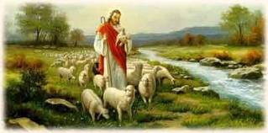
What Shall I do Then With…..
How would you answer that question from a heathen governor? What would you do with Christ? Does He get in the way of your ambition? Does He keep you from some cherished friend that you can’t live without? What shall I do then with Jesus?

Slide 16
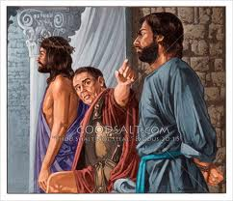
Christ or Barabbas?
Pilate was strangling himself. He had scourged an innocent Man. His wife told him to have nothing to do with Jesus. He figured the custom of releasing a prison would work, but it failed. He tried everything, but doing the right thing and letting the chips fall as they would. He knew if he crossed the Jews, he could lose his job. He was at a crossroads. The Jews put the nail in the coffin. “And from thenceforth Pilate sought to release him: but the Jews cried out, saying, If thou let this man go, thou art not Caesar's friend: whosoever maketh himself a king speaketh against Caesar.” Jn. 19:12

Slide 17
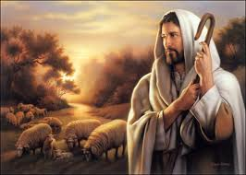
Mankind’s Solution
“Then came Jesus forth, wearing the crown of thorns, and the purple robe. And Pilate saith unto them, Behold the man!” Jn. 19:5
Will we heed the words of Pilate and ‘Behold the Man’ or will we snub Him because He keeps us from some cherished job, person, or goal? Let us crown Him now as King of our being for now and eternity!!

