Slide 1
Jesus Life, pt. 6 ‘A Voice’

Slide 2
Unlike Any Other!
“When the ministry of John began, the nation was in a state of excitement and discontent verging on revolution. At the removal of Archelaus, Judea had been brought directly under the control of Rome. The tyranny and extortion of the Roman governors, and their determined efforts to introduce the heathen symbols and customs, kindled revolt, which had been quenched in the blood of thousands of the bravest of Israel. All this intensified the national hatred against Rome, and increased the longing to be freed from her power. Amid discord and strife, a voice was heard from the wilderness, a voice startling and stern, yet full of hope.” DA, pg. 104

Slide 3
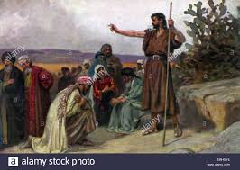
John was not so interested in the current events of his day to make them the central focus of his message. His message was to awaken a people to the fact that Messiah was coming. He sought to startle the people from their lethargy.

Slide 4
Awake!
“He saw his people deceived, self-satisfied, and asleep in their sins. He longed to rouse them to a holier life. The message that God had given him to bear was designed to startle them from their lethargy, and cause them to tremble because of their great wickedness. Before the seed of the gospel could find lodgment, the soil of the heart must be broken up. Before they would seek healing from Jesus, they must be awakened to their danger from the wounds of sin. God does not send messengers to flatter the sinner. He delivers no message of peace to lull the unsanctified into fatal security. He lays heavy burdens upon the conscience of the wrongdoer, and pierces the soul with arrows of conviction. The ministering angels present to him the fearful judgments of God to deepen the sense of need,

Slide 5
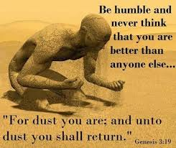
and prompt the cry, “What must I do to be saved?” Then the hand that has humbled in the dust, lifts up the penitent. The voice that has rebuked sin, and put to shame pride and ambition, inquires with tenderest sympathy, “What wilt thou that I shall do unto thee?” Da, pgs. 103, 104

Slide 6
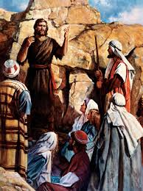
“In this fearful time, just before Christ is to come the second time, God's faithful preachers will have to bear a still more pointed testimony than was borne by John the Baptist. A responsible, important work is before them; and those who speak smooth things, God will not acknowledge as his shepherds. A fearful woe is upon them.—Testimonies for the Church, pg. 1, pg. 321

Slide 7

“And the same John had his raiment of camel's hair, and a leathern girdle about his loins; and his meat was locusts and wild honey.” Matthew 3:4

Slide 8
“John was to go forth as Jehovah's messenger, to bring to men the light of God. He must give a new direction to their thoughts. He must impress them with the holiness of God's requirements, and their need of His perfect righteousness. Such a messenger must be holy. He must be a temple for the indwelling Spirit of God. In order to fulfill his mission, he must have a sound physical constitution, and mental and spiritual strength. Therefore it would be necessary for him to control the appetites and passions. He must be able so to control all his powers that he could stand among men as unmoved by surrounding circumstances as the rocks and mountains of the wilderness. In the time of John the Baptist, greed for riches, and the love of luxury and display had become widespread….

Slide 9
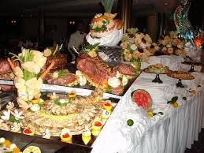
…Sensuous pleasures, feasting and drinking, were causing physical disease and degeneracy, benumbing the spiritual perceptions, and lessening the sensibility to sin. John was to stand as a reformer. By his abstemious life and plain dress he was to rebuke the excesses of his time. Hence the directions given to the parents of John,—a lesson of temperance by an angel from the throne of heaven. In childhood and youth the character is most impressible. The power of self-control should then be acquired.” DA, pgs. 100,101

Slide 10
Devotional Time With God!
“He looked upon the King in His beauty, and self was forgotten. He beheld the majesty of holiness, and felt himself to be inefficient and unworthy. He was ready to go forth as Heaven's messenger, unawed by the human, because he had looked upon the Divine. He could stand erect and fearless in the presence of earthly monarchs, because he had bowed low before the King of kings.” DA, pg. 103

Slide 11
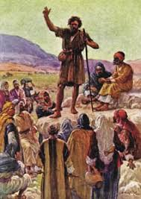
“And saying, Repent ye: for the kingdom of heaven is at hand.” Matthew 3:2
“Then went out to him Jerusalem, and all Judaea, and all the region round about Jordan, And were baptized of him in Jordan, confessing their sins. But when he saw many of the Pharisees and Sadducees come to his baptism, he said unto them, O generation of vipers, who hath warned you to flee from the wrath to come? Bring forth therefore fruits meet for repentance:” Matthew 3:5-8

Slide 12
More Than Profession
“John proclaimed the coming of the Messiah, and called the people to repentance. As a symbol of cleansing from sin, he baptized them in the waters of the Jordan. Thus by a significant object lesson he declared that those who claimed to be the chosen people of God were defiled by sin, and that without purification of heart and life they could have no part in the Messiah's kingdom. Princes and rabbis, soldiers, publicans, and peasants came to hear the prophet. For a time the solemn warning from God alarmed them. Many were brought to repentance, and received baptism…

Slide 13
Calling to God’s People!
“…Persons of all ranks submitted to the requirement of the Baptist, in order to participate in the kingdom he announced. Many of the scribes and Pharisees came confessing their sins, and asking for baptism. They had exalted themselves as better than other men, and had led the people to entertain a high opinion of their piety; now the guilty secrets of their lives were unveiled. But John was impressed by the Holy Spirit that many of these men had no real conviction of sin. They were timeservers. As friends of the prophet, they hoped to find favor with the coming Prince. And by receiving baptism at the hands of this popular young teacher, they thought to strengthen their influence with the people. John met them with the scathing inquiry, “O generation of vipers, who hath warned you to flee from the wrath to come? Bring forth therefore fruits meet for repentance; and think not to say within yourselves, We have Abraham to our father: for I say unto you, that God is able of these stones to raise up children unto Abraham.” The Jews had misinterpreted God's promise of eternal favor to Israel:” DA, pgs. 104, 105

Slide 14
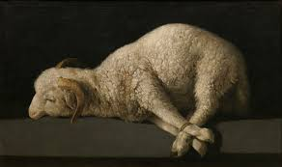
John's Messages
1. called to repentance, turning back to God’s commandments.
2. Demanded more than lip service Christianity.
3. Pointed people to Christ as the Lamb of God. “The next day John seeth Jesus coming unto him, and saith, Behold the Lamb of God, which taketh away the sin of the world.” John 1:29

Slide 15
John was Elijah
1. “And he shall go before him in the spirit and power of Elias, to turn the hearts of the fathers to the children, and the disobedient to the wisdom of the just; to make ready a people prepared for the Lord.” Luke 1:17
2. “And this is the record of John, when the Jews sent priests and Levites from Jerusalem to ask him, Who art thou? And he confessed, and denied not; but confessed, I am not the Christ. And they asked him, What then? Art thou Elias? And he saith, I am not. Art thou that prophet? And he answered, No.” John 1:19-21

Slide 16
Jesus Said He was!
“And his disciples asked him, saying, Why then say the scribes that Elias must first come? And Jesus answered and said unto them, Elias truly shall first come, and restore all things. But I say unto you, That Elias is come already, and they knew him not, but have done unto him whatsoever they listed. Likewise shall also the Son of man suffer of them. Then the disciples understood that he spake unto them of John the Baptist.” Matthew 17:10-13
“But what went ye out for to see? A prophet? yea, I say unto you, and more than a prophet. For this is he, of whom it is written, Behold, I send my messenger before thy face, which shall prepare thy way before thee. Verily I say unto you, Among them that are born of women there hath not risen a greater than John the Baptist: notwithstanding he that is least in the kingdom of heaven is greater than he. And from the days of John the Baptist until now the kingdom of heaven suffereth violence, and the violent take it by force. For all the prophets and the law prophesied until John. And if ye will receive it, this is Elias, which was for to come.” Matthew 11:9-14

Slide 17
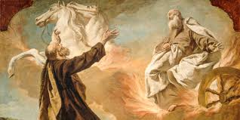
Was he or wasn’t he?
1. John said he wasn’t Elijah.
2. Jesus said he was Elijah.
3. Gabriel said John would have the same spirit and give the same message as Elijah.
4. Malachi 4:5 says, “Behold, I will send you Elijah the prophet before the coming of the great and dreadful day of the LORD:”

Slide 18
The Voice of Stern Rebuke!
“Today there is need of the voice of stern rebuke; for grievous sins have separated the people from God. Infidelity is fast becoming fashionable. "We will not have this man to reign over us," is the language of thousands. Luke 19:14. The smooth sermons so often preached make no lasting impression; the trumpet does not give a certain sound. Men are not cut to the heart by the plain, sharp truths of God's word.
“There are many professed Christians who, if they should express their real feelings, would say, What need is there of speaking so plainly? They might as well ask, Why need John the Baptist have said to the Pharisees, "O generation of vipers, who hath warned you to flee from the wrath to come?" Luke 3:7. Why need he have provoked the anger of Herodias by telling Herod that it was unlawful for him to live with his brother's wife? The forerunner of Christ lost his life by his plain speaking. Why could he not have moved along without incurring the displeasure of those who were living in sin? So men who should be standing as faithful guardians of God's law have argued, till policy has taken the place of faithfulness, and sin is allowed to go unreproved. When will the voice of faithful rebuke be heard once more in the church?” PK, pgs. 140, 141

