Slide 1
Imhotep: Jacob’s Boy

Slide 2
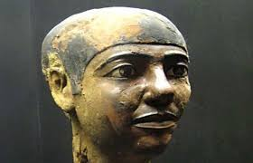
Have You Ever Wondered?
He basically ruled the world for 7 years because he saved the world from a terrible famine during that time. He was known throughout the world as a savior because of this. And yet, outside the Bible there is no record of such a man??? Are you kidding?? In order to invalidate the beauty of the Bible, his name would have to be obscured in history so that no one would associate such a man to such heroic deeds. However, his deeds would not die. Somewhere, somehow, the world would know of the Bible character named Joseph!!!

Slide 3
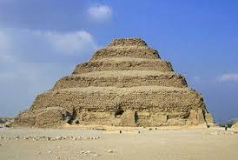
Saqqara in Memphis Outside Cairo
Unlike the pyramids at Giza, the step pyramid north of Giza is a step pyramid. History tells us it was built by a man named Imhotep for the burial site of his King Djoser, who reigned from 2630-2611 BC. Other than the fact that this was a step pyramid, there is nothing out of the ordinary when looking at the pyramids of Egypt. What is more stunning is the resume of this man Imhotep! Let us learn more about him.

Slide 4
Brilliance
“The Step Pyramid at Sakkara is the only one of Imhotep's achievements that can still be seen and appreciated today. Its reputation is largely based on Imhotep's accomplishments as the pyramid's inventor and builder. This pyramid was the first structure ever built of cut stone, and is by far the oldest of the Seven Wonders of the World, the seven structures of the ancient world that were astonishing accomplishments for their time. It took twenty years to complete—not very long, given the newness of the idea and the state of structural science in the Bronze Age (between 3000 B.C.E. and 1100 C. E.), the period of development where metals, particularly bronze, were used for the first time.” Ency. Of World Biography

Slide 5
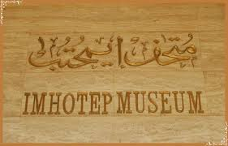
Saqqara
At the Saqqara site, there is a small museum that is dedicated to this very extraordinary man in Egyptian history named Imhotep! In fact, the inscription at the museum, upon entering, is profound. Imhotep was known as the following: ““Imhotep, Chancellor of the King of Lower Egypt, Chief under the King, Administrator of the Great Palace, Hereditary Lord, High Priest of Heliopolis, Imhotep the Builder, the Sculptor, the Maker of Stone Vases…”
1. chief sculptor, architect
2. chief of the wise men
3. top physician
4. vizier-highest ranking political advisor.
5. sage-famous for his wisdom
6. seer-could predict the future

Slide 6

Supervisor of the whole land
“The office of the vizier in politics was literally described as "supervisor of everything in this entire land." Only the best educated citizen could handle the range of duties of this position that worked closely with the Pharaoh, or king of Egypt. As vizier, Imhotep was chief advisor to Djoser in both religious and practical matters, and he controlled the departments of the Judiciary (court system), Treasury, War, Agriculture, and the General Executive.” Ency. Of World biography, Imhotep

Slide 7
Impressive
“Imhotep (Greek name, Imouthes, c. 2667-2600 BCE) was an Egyptian polymath (a person expert in many areas of learning) best known as the architect of King Djoser's Step Pyramid at Saqqara. His name means "He Who Comes in Peace" and he is the only Egyptian besides Amenhotep to be fully deified, becoming the god of wisdom and medicine (or, according to some sources, god of science, medicine, and architecture). Imhotep was a priest, vizier to King Djoser (and possibly to the succeeding three kings of the Third Dynasty), a poet, physician, mathematician, astronomer, and architect.
Although his Step Pyramid is considered his greatest achievement, he was also remembered for his medical treatises which regarded disease and injury as naturally occurring instead of punishments sent by gods or inflicted by spirits or curses. He was deified by the Egyptians in c. 525 BCE and was equated with the demi-god of healing Asclepius by the Greeks.” Egyptian Encyclopedia

Slide 8
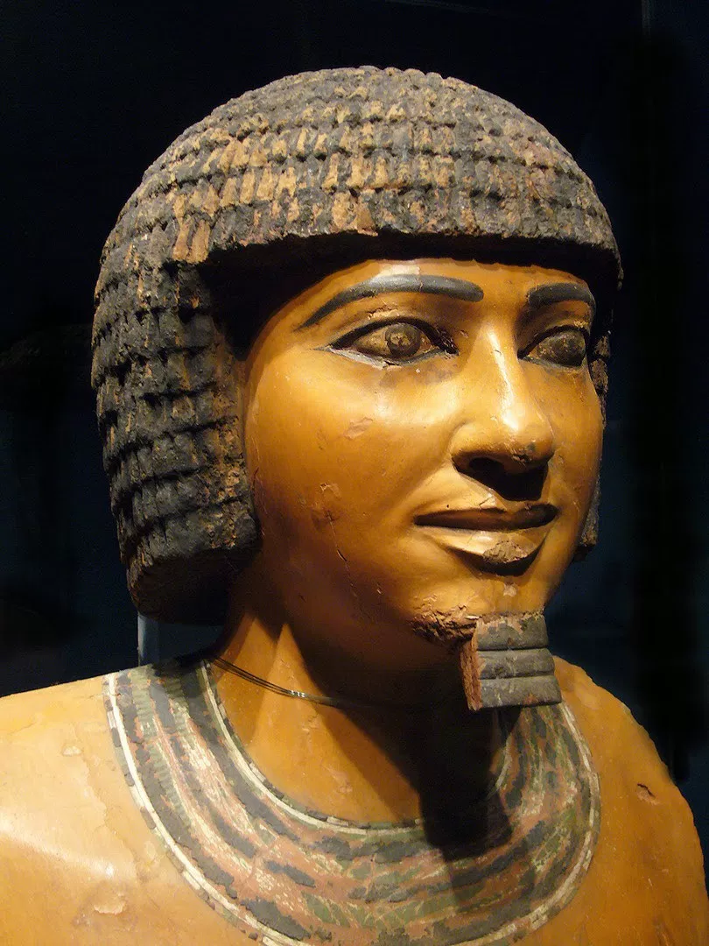
Commoner by Birth
“Under King Djoser's reign (c. 2630-2611 BC) Imhotep was vizier and chief architect. Throughout his life, he would hold many titles including First After the King of Upper Egypt, Administrator of the Great Palace, Chancellor of the King of Lower Egypt, Hereditary Nobleman, High Priest of Heliopolis, and Sculptor and Maker of Vases Chief. Imhotep was a commoner by birth who advanced to the position of one of the most important and influential men in Egypt through his natural talents.” Egyptian Encyclopedia He was one of only two commoners ever to be deified after death (the other being Amenhotep, son of Hapu).

Slide 9

A Rare Feat Indeed
Imhotep was not born into royalty. He was a commoner, born of humble birth. To rise up to second in command of one of the greatest nations at that time, is stunning. Royalty was something people were born into, not something that you rose up to attain. Imhotep was truly brilliant and maybe he came to occupy the position at some extraordinary moment in Egyptian history!

Slide 10

Doctor of Medicine
Imhotep was practicing medicine and writing on the subject 2,200 years before Hippocrates, the Father of Modern Medicine, was born. He is generally considered the author of the Edwin Smith Papyrus, an Egyptian medical text, which contains almost 100 anatomical terms and describes 48 injuries and their treatment. The text may have been a military field manual and dates to c. 1600 BCE, long after Imhotep's time, but is thought to be a copy of his earlier work.” Egyptian Encyclopedia

Slide 11
“The Edwin Smith Papyrus is so named for the collector who purchased it from an antiquities dealer in 1862 CE. It is written in hieratic script, the cursive shorthand of Egyptian hieroglyphics. The most interesting aspect of the work is the modern approach it has to treating injuries. Unlike many medical texts of the ancient world, there is little recourse to magical treatments in the Edwin Smith Papyrus. Every injury is described and diagnosed rationally with a following treatment, prognosis, and explanatory notes. This is not to say there is no allusion to medical practices commonly used at the time; the reverse side of the papyrus features eight magic spells and chants for healing. Examinations are described along the same lines as a modern-day visit to a doctor.

Slide 12
Conclusion
…Patients are asked where they are injured/feel pain, the physician then addresses the wound by touching or prodding and questioning the patient. The prognosis given after every entry begins with the phrases "An ailment I will handle" or "An ailment I will fight with" or "An ailment for which nothing can be done" which, according to the U.S. National Library of Medicine's article on the subject, "could be seen as the earliest form of medical ethics as an ancient physician would generally refuse to treat a condition he knew was fatal." The National Library article goes on to observe that these prognoses could also have served as a kind of insurance "when a poor outcome is expected" and would have helped save a physician's reputation if treatment failed to cure the patient.” Egyptian Encyclopedia

Slide 13
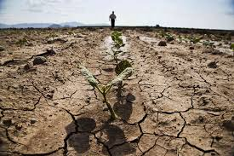
Saved Egypt From a 7 year Famine
“There are no historical records of Imhotep's acts as a political figure, but his wisdom as a religious advisor was widely recognized after he ended a terrible famine (a severe shortage of food) that dominated Egypt during seven years of Djoser's reign. It is said that the king was failing in his responsibility to please the god Khnum, and his neglect was causing the Nile to fall short of a flood level which would support Egyptian farms. Imhotep, having a vast knowledge of the proper traditions and methods of worship, was able to counsel Djoser on pleasing the god of the cataract (heavy rain), allowing the Nile to return to its usual flood level.” Imhotep. Courtesy of the Library of Congress.

Slide 14
Ancient Inscription
The first evidence which connects Imhotep with Joseph is an amazing inscription found carved on a large rock on the island of Sihiel just below the First Cataract of the Nile. This inscription claims to be a copy of a document written by Djoser in the 18th year of his reign,- this copy being written over 1,000 years after the events it claims to be relating. It goes on to tell of a 7 year famine and 7 years of plenty. Let’s look at a few passages from this inscription and compare them with the Biblical account, keeping in mind that this was written a millennium after the events it claims to be describing:…
But, the next thing in the inscription tells that when the king slept, the Nile god Khnum, revealed himself to him in a dream and promised the Nile would pour forth her waters and the land would yield abundantly for 7 years, after a 7 year drought. This passage reflects the fact of a dream by the pharaoh of 7 years of plenty and 7 years of famine, although reversed….” Wyatt Archaeological Research

Slide 15
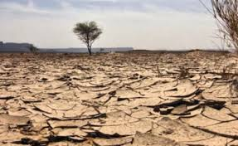
Imhotep Did What?
Imhotep saved Egypt from a disastrous 7 year famine!!! Does this sound familiar to you?? Have you ever heard of a 7 year famine in Egypt?? Did a remarkable man, under the control of God, save Egypt and the world from a 7 year famine??
Was he not born of a common birth, outside of royalty, but rose up because of his skills and eventually stood next to the king and was the overseer of the whole land??? “Thou shalt be over my house, and according unto thy word shall all my people be ruled: only in the throne will I be greater than thou. And Pharaoh said unto Joseph, See, I have set thee over all the land of Egypt.” Gen. 41:40, 41

Slide 16
His Secret of Success
“And it came to pass after these things, that his master's wife cast her eyes upon Joseph; and she said, Lie with me. But he refused, and said unto his master's wife, Behold, my master wotteth not what is with me in the house, and he hath committed all that he hath to my hand; There is none greater in this house than I; neither hath he kept back any thing from me but thee, because thou art his wife: how then can I do this great wickedness, and sin against God?” Genesis 39:7-9

Slide 17
Never Alone!
“Joseph's answer reveals the power of religious principle. He would not betray the confidence of his master on earth, and, whatever the consequences, he would be true to his Master in heaven. Under the inspecting eye of God and holy angels many take liberties of which they would not be guilty in the presence of their fellow men, but Joseph's first thought was of God. "How can I do this great wickedness, and sin against God?" he said. If we were to cherish an habitual impression that God sees and hears all that we do and say and keeps a faithful record of our words and actions, and that we must meet it all, we would fear to sin. Let the young ever remember that wherever they are, and whatever they do, they are in the presence of God. No part of our conduct escapes observation. We cannot hide our ways from the Most High. Human laws, though sometimes severe, are often transgressed without detection, and hence with impunity. But not so with the law of God. The deepest midnight is no cover for the guilty one. He may think himself alone, but to every deed there is an unseen witness. The very motives of his heart are open to divine inspection. Every act, every word, every thought, is as distinctly marked as though there were only one person in the whole world, and the attention of heaven were centered upon him.” PP, pgs. 217, 218

Slide 18
Imhotep, powerfully used by God to tell the future, stepped into Egyptian history and the world was effected dramatically by this humble man. The Bible tells us, “Joseph is a fruitful bough, even a fruitful bough by a well; whose branches run over the wall: The archers have sorely grieved him, and shot at him, and hated him: But his bow abode in strength, and the arms of his hands were made strong by the hands of the mighty God of Jacob; (from thence is the shepherd, the stone of Israel:) Even by the God of thy father, who shall help thee; and by the Almighty, who shall bless thee with blessings of heaven above, blessings of the deep that lieth under, blessings of the breasts, and of the womb: The blessings of thy father have prevailed above the blessings of my progenitors unto the utmost bound of the everlasting hills: they shall be on the head of Joseph, and on the crown of the head of him that was separate from his brethren.” Genesis 49:22-26

