Slide 1
What is the Difference Between Mormons, Jehovah’s Witnesses, and Seventh-day Adventists? pt 15

Slide 2
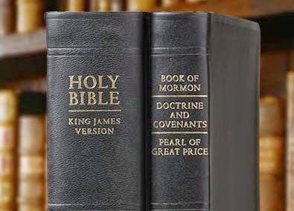
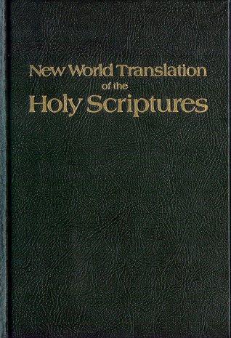
What We Will Study….
Origins of the Religion
Their Authorities and/or Authoritative Texts
Their Doctrinal Differences
Their Message to the World

Slide 3
Pastor Russell Said He/Watchtower are “God’s Mouthpiece”
“No, the truths I present, as God’s mouthpiece, were not revealed in visions or dreams, nor by God’s audible voice, nor all at once, but gradually, especially since 1870, and particularly since 1880. Neither is this clear unfolding of truth due to any human ingenuity or acuteness of perception, but to the simple fact that God’s due time has come; and if I did not speak, and no other agent could be found, the very stones would cry out.”—Watchtower, July 15, 1906

Slide 4
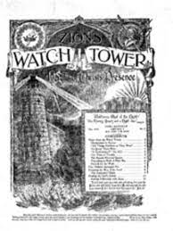
Watchtower is the “Voice of God”
“It is vital that we appreciate this fact and respond to the directions of the ‘slave’ [Watchtower] as we would to the voice of God, because it is His provision”—Watchtower, June 15, 1957

Slide 5
Watchtower is God’s Prophet
“So, does Jehovah have a prophet to help them, to warn them of dangers and to declare things to come? These questions can be answered in the affirmative. Who is this prophet? . . . . This ‘prophet’ was not one man, but was a body of men and women. It was the small group of footstep followers of Jesus Christ, known at that time as International Bible Students. Today they are known as Jehovah’s Christian witnesses.”—Watchtower, April 1, 1972

Slide 6
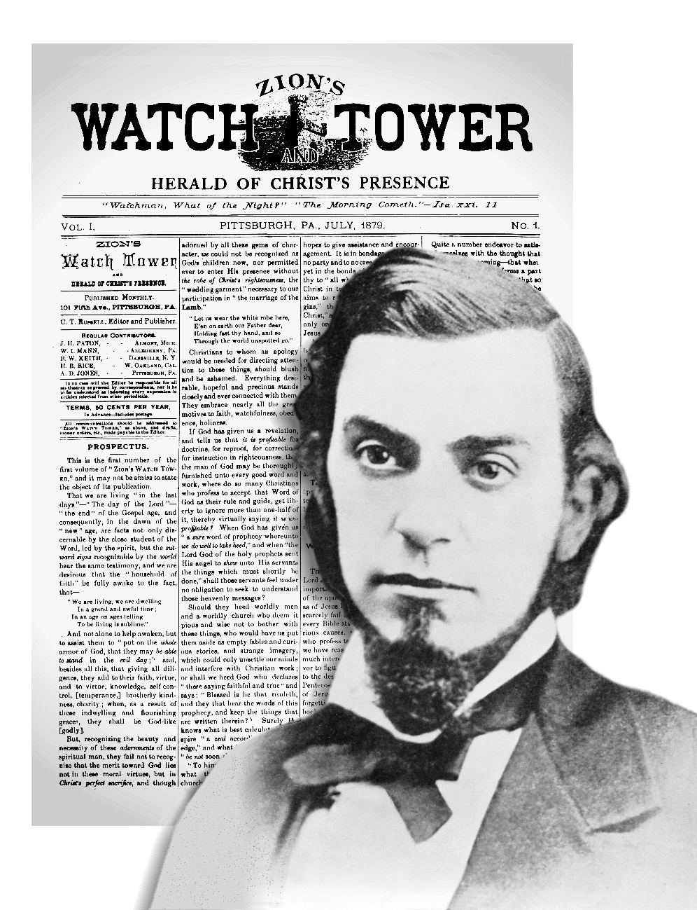
You Can Only Understand the Bible Through Us!
“Only this organization functions for Jehovah's purpose and to his praise. To it alone God's Sacred Word, the Bible, is not a sealed book. Many persons of the world are very intelligent, capable of understanding complex matters. They can read the Holy Scriptures, but they cannot understand their deep meaning." Watchtower 1973 Jul 1 p.402

Slide 7
The Watchtower Claims…
To Be God’s mouthpiece, which continues to advance toward perfection/perfect doctrine over time via study as God’s chosen vessel
Watchtower is the “voice of God” on earth, to be obeyed and submitted to as His provision
Is God’s prophet on earth (this includes the organization)
The Bible is ONLY to be studied and understood through the guidance of the Watchtower

Slide 8
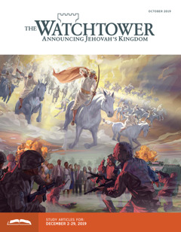
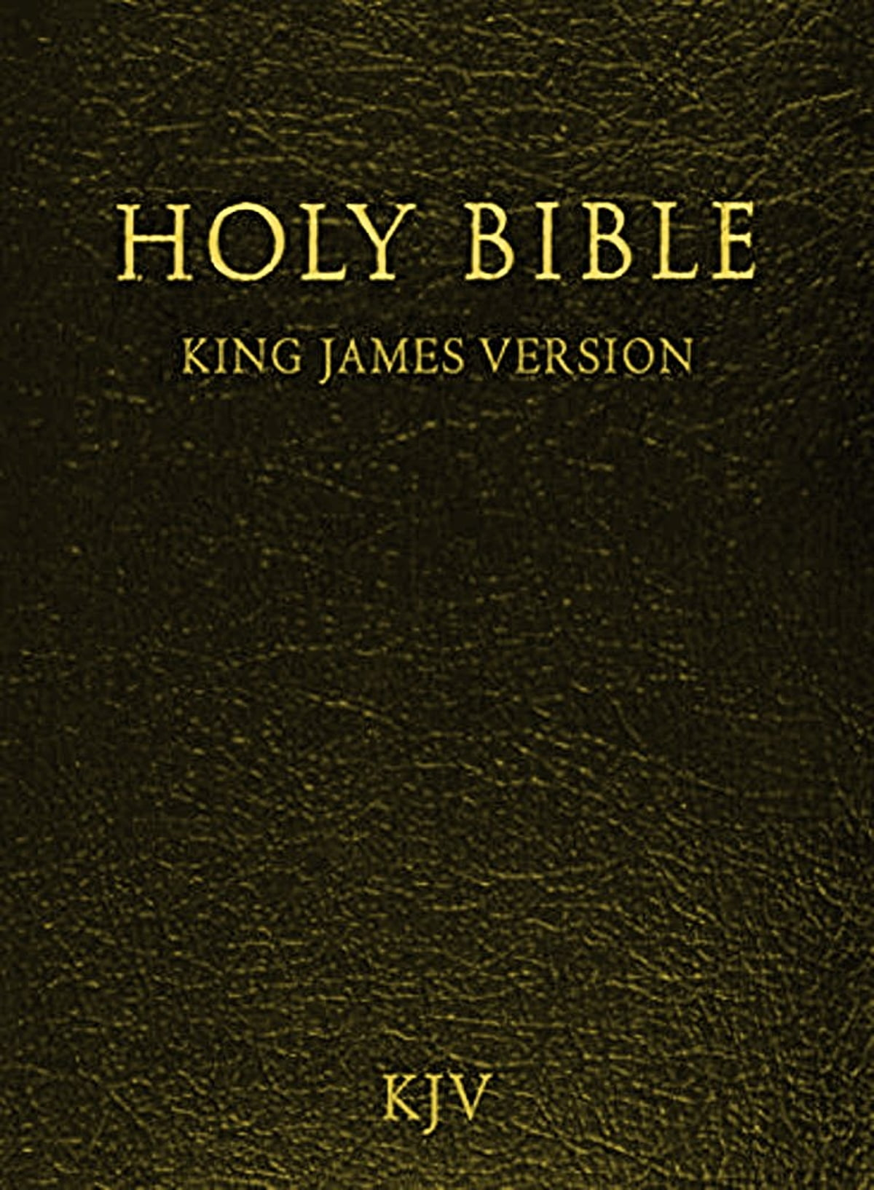
If Watchtower’s Claims are true then….
New claims of important truths will lead to more perfect doctrines NOT error. (Prov. 4:18 “But the path of the just is as the shining light, that shineth more and more unto the perfect day.”
If the Watchtower is the “voice of God” it will not be in error/contradict itself (2 Tim. 3:16-17 “All scripture is given by inspiration of God, and is profitable for doctrine, for reproof, for correction, for instruction in righteousness: That the man of God may be perfect, thoroughly furnished unto all good works.”)
If the Watchtower is a prophet, it will abide by the biblical warnings of a prophet—it will not make/insist/promote false predictions (Deut. 18:22 “When a prophet speaketh in the name of the Lord, if the thing follow not, nor come to pass, that is the thing which the Lord hath not spoken, but the prophet hath spoken it presumptuously: thou shalt not be afraid of him.”)
If the Bible is only to be understood via the Watchtower lessons, then it will never contradict the Bible (Is. 8:20 “To the law and to the testimony: if they speak not according to this word, it is because there is no light in them.”)

Slide 9
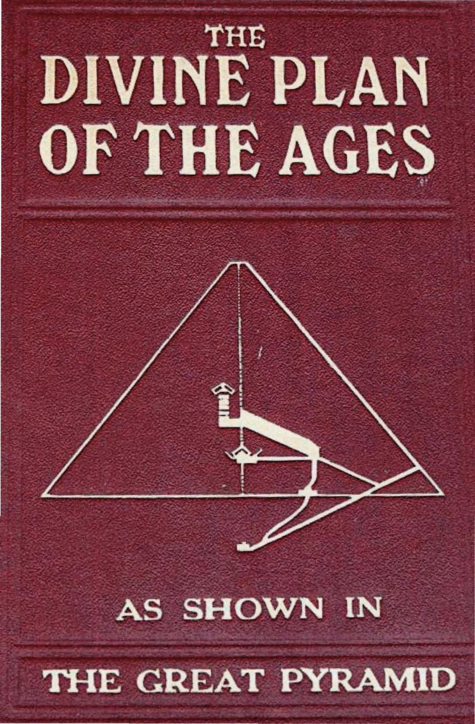
Exhibit 1: Pyramidology
"In the passages of the great pyramid of Gizeh the agreement of one or two measurements with present truth chronology might be accidental, but the correspondency of dozens of measurements proves the same God designed both pyramid and plan…" (Watchtower June 15, 1922 p.187)
"The great pyramid of Egypt, standing as a silent and inanimate witness of the Lord, is a messenger; and its testimony speaks with great eloquence concerning the divine plan." (Watchtower May 15, 1925 p.148)
Based on the measurements of the pyramids, the following dates were furnished as keystone prophetic events 1878—the resurrection of patriarchs and prophets/beginning of the final battle, 1881—the final year of selection of the 144,000, 1910—End of the Gentile Times, and Jews to re-found Israel, 1914—End of the Gentile Times/End of the World, 1915—End of the Gentile Times/End of the World, 1918—End of the Gentile Times/End of the World

Slide 10
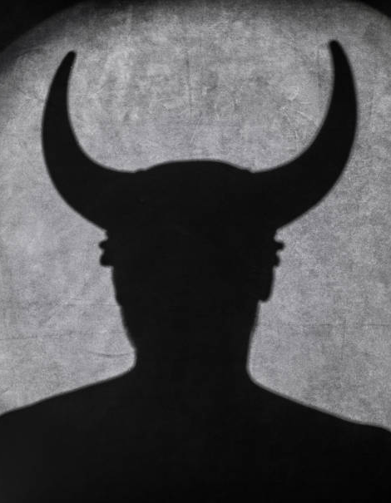
“God’s Mouthpiece” led by the Devil?
"Then Satan put his knowledge into dead stone, which may be called Satan's Bible, not Gods stone witness…" (WT, 11/15/1928 p.344)
"It is more reasonable to conclude that the great pyramid of gizeh, as well as the other pyramids thereabout, also the sphinx, were built by the rulers of Egypt and under the direction of Satan the devil." (WT, 11/15/1928 p.344)
The Watchtower: led to error, contradicted itself, produced and insisted on false predictions, contradicts the Bible

Slide 11
Exhibit 2: Time-setting
“Studying God’s Word, we have measured the 2520 years, the seven symbolic times, from that year 606 BC and have found that it reached down to October, 1914, as nearly as we were able to reckon. We did not say positively that this would be the year.”–WT 11/01/1914
“the setting up of the Kingdom of God has already begun, that is pointed out in prophecy as due to begin the exercise of power in AD 1878, and that the ‘battle of the great day of God Almighty’ (Rev. 16:14), which will end in AD 1914 with the complete overthrow of earth’s present rulership, is already commenced”—The Time is at Hand 1905 ed., p. 101

Slide 12
Time-setting Continued…
Thus far, we have already seen repeatedly the dates for the “end of the world” set to be 1910, 1914, 1915, 1918. Did this habit of making time-setting errors continue in the afterwords?
“Volume Seven [The Finished Mystery] is precious beyond any dollar value—I would be glad if the payment were a thousand times more, I’ve only had time to taste a little of this ‘meat in due season’ and oh! It’s so good. Oh, how good God is! His ways are past understanding”—WT 12/01/1917

Slide 13
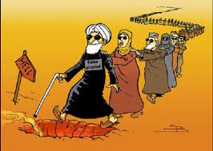
1920, 1921???
“16:20. And every island fled away.—Even the republics will disappear in the fall of 1920”—The Finished Mystery, 1918 ed., p. 258 (an earlier edition of the same year insisted that “the spring of 1918” would be the “glorification of the little Flock” ending with the close of the Gentile times in 1921—The Finished Mystery, 1918 ed., p. 83

Slide 14
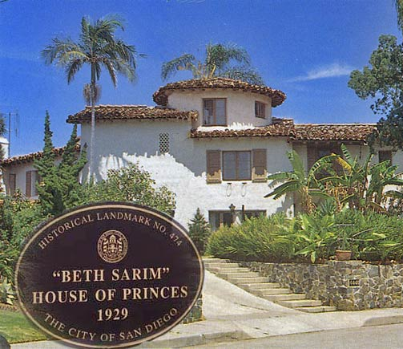
Doesn’t Stop There!
“Also, in the year 1918, when God destroys the churches wholesale and the church members by millions, it shall be that any that escape shall come to the works of Pastor Russell to learn the meaning of the downfall of ‘Christianity’.”—The Finished Mystery, 1918 ed., p. 699
Joseph Rutherford tried his hand at time-setting as well, claiming that the patriarchs would resurrect in 1925 (see “The Way to Salvation”, p. 224, which led to the building of “Beth Sarim” for soon arrival of the prophets, he also changed the “high-calling” of 1881 to 1935)

Slide 15
Eventually You’ll Get It, Don’t Give Up!
“Receiving the gift, the marching children clasped it to them, not a toy or plaything for idle pleasure, but the Lord’s provided instrument for most effective work in the remaining months before Armageddon”—WT 09/15/1941
Based on this error, Rutherford encouraged his followers not to marry until after Armageddon (see—”Face the Facts”, 1938, p. 50 & “Children”, 1941 p. 366

Slide 16
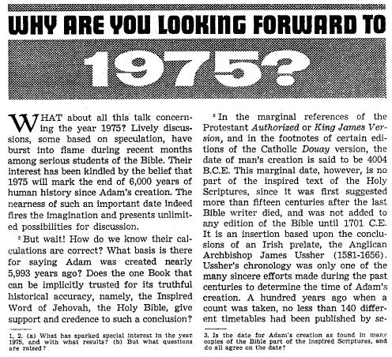
Time-setting Again! 1975
“Does this mean that the above evidence positively points to 1975 as the complete end of this system of things? Since the Bible does not specifically state this, no man can say... If the 1970s should see intervention by Jehovah God to bring an end to a corrupt world drifting toward ultimate disintegration, that should surely not surprise us.”—"What will the 1970's Bring?". Awake!. Watch Tower Society. October 8, 1968. p. 14.

Slide 17
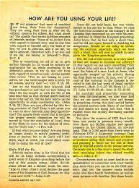
Give it all to the Church!
“Reports are heard of brothers selling their homes and property and planning to finish out the rest of their days in this old system in the pioneer service. Certainly, this is a fine way to spend the short time remaining before the wicked world's end”—"How Are You Using Your Life?". Our Kingdom Ministry. May 1, 1974. p. 63.
“Stay Alive Till 75!”

Slide 18
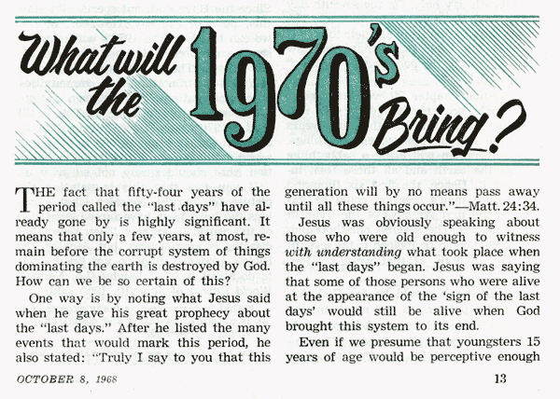
Whoops!
“With the appearance of the book Life Everlasting—in Freedom of the Sons of God, ... considerable expectation was aroused regarding the year 1975. ... there were other statements published that implied that such realization of hopes by that year was more of a probability than a mere possibility. It is to be regretted that these latter statements apparently overshadowed the cautionary ones and contributed to a buildup of the expectation already initiated. ... persons having to do with the publication of the information ... contributed to the buildup of hopes centered on that date.”—"Choosing the Best Way of Life". The Watchtower. March 15, 1980. pp. 17–18.
Whether we are talking about 1874, 1878, 1881, 1910, 1914, 1915, 1918, 1920, 1921, 1925, 1941, 1975 the JW and Watchtower have consistently repeated the same error of time-setting over and over to the enriching of the church via the sacrifice of its members. On this issue, the watchtower led into error, contradicted itself, made false predictions, and contradicted the Bible
The Last Generation has changed in the WT from 1995-the wicked, 2008-the anointed, 2010-an overlap of generations

Slide 19
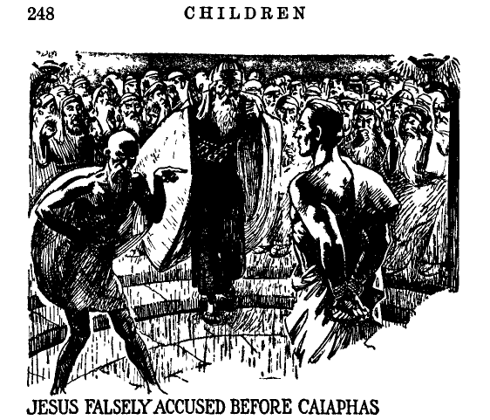
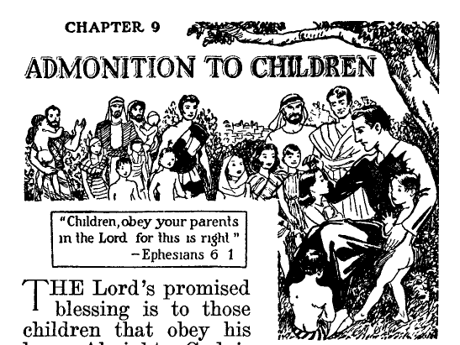
Exhibit 3: Jesus’ face was shaved
Jesus’ began to be depicted as shaved under Rutherford in 1936 and he insisted that all Jehovah’s Witnesses shave their faces as well. The photos above are both from the book “Children” (1941) p. 248 (left) and p. 256 (right)—this was later reversed.

Slide 20
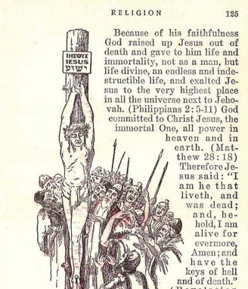
Errors and More Errors
Is. 50:6 “I gave my back to the smiters, and my cheeks to them that plucked off the hair: I hid not my face from shame and spitting.”
Rutherford: “Enemies”, (1937), p. 125
jw.org, “Is Jesus Almighty God?”

Slide 21
Exhibit 4: Vaccines
From 1931 until 1952 vaccinations were banned in Jehovah’s Witnesses. The publication “Golden Age”, Feb. 4, 1931 stated: “Vaccination is a direct violation of the everlasting covenant that God made with Noah after the flood.”
In the Watchtower Dec. 15, 1952, this policy was reversed:
“The matter of vaccination is one for the individual that has to face it to decide for himself”

Slide 22
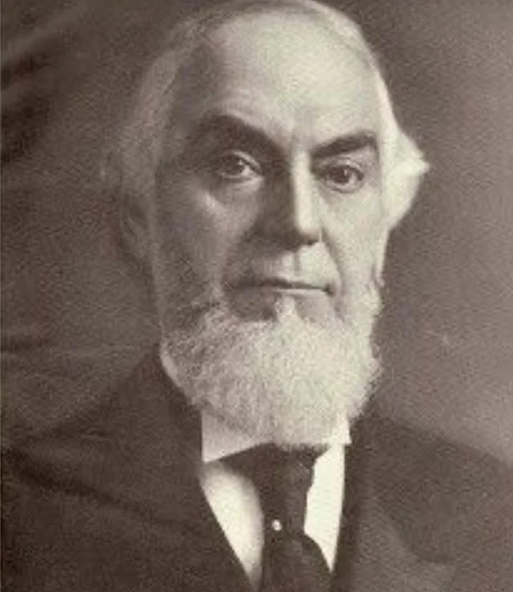
Exhibit 5: Phrenology
“Without claiming that phrenology has reached a perfection of development—without claiming that any has learned to read accurately from the shape of the human skull the variating that such a reading of character might be defective, and particularly so with those whose characters have been transformed by the renewing of their mind through the begettal of the holy Spirit—nevertheless we may admit that phrenology so far as understood fully corroborates the picture given us in the arrangement of the Tabernacle of Israel surrounded by the camp.”—WT 07/15/1907

Slide 23
Exhibit 6: Health Defects—Causation
In Watchtower fashion, Charles Taze Russell claimed that the cause of Appendicitis was due to “biting worms” in the appendix:
“It is known that only about three out of every one hundred operated upon for appendicitis really have a diseased appendix needing removal. We give below a simple cure for appendicitis symptoms. The pain in the appendix region caused by the biting of worms near the junction of the transverse colon with the small intestines, low down on the right side of the abdomen”--Watchtower Reprints, vol. 6, p. 4963.

