Slide 1
Asher-the Prosperous

Slide 2
An Either/Or Proposition
The old saying goes, “Crisis does not change character; it exposes it!” What was revealed in this son of Jacob at the capturing and subsequent selling of Joseph was not pretty. In fact, that one event shaped the lives of each one of the brothers. The characteristics revealed there brought each one face to face with evil so deep; it makes one shudder to think about it. The ensuing years would reveal stark changes that occurred as a result of that one event! Asher would never be the same again!

Slide 3
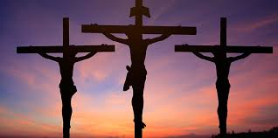
One Event-Never the Same!
Cain’s killing of his brother.
Jacob stealing the birthright from Esau.
David and Bathsheba.
Of course, the one day that changed the world was Calvary! The planet would never be the same again and the individuals who engaged in those scenes!
Each of us has that moment. For me, a brother who……………….

Slide 4
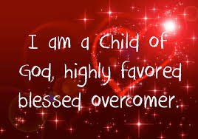
The Blessed One!
“And Zilpah Leah's maid bare Jacob a second son. And Leah said, Happy am I, for the daughters will call me blessed: and she called his name Asher.” Genesis 30:12,13

Slide 5
Jacob and Moses Benediction on Asher
“Out of Asher his bread shall be fat, and he shall yield royal dainties.” Genesis 49:20
“And of Asher he said, Let Asher be blessed with children; let him be acceptable to his brethren, and let him dip his foot in oil. Thy shoes shall be iron and brass; and as thy days, so shall thy strength be.” Deuteronomy 33:24,25

Slide 6
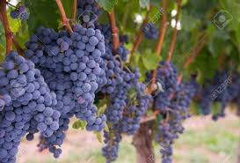
Earthly Blessings in Abundance
1. fatness/prosperity, abundance.
2. royal dainties/exaltation.
3. blessed with children.
4. foot dipped in oil/ well greased.
5. shoes never failing/durable, strong.
6. strength would always be his.

Slide 7
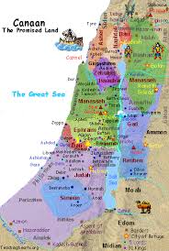
Given a Choice Inheritance
Asher’s inheritance was in the north and on the sea coast. This territory would be present day Lebanon, known for its richness in soil and vegetation. Indeed, Asher was richly blessed!

Slide 8
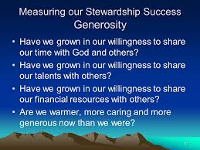
Too Much Leads to Selfishness???
Too much prosperity could lead to selfish. For the most part, the tribe of Asher were unselfish. As Jacob had declared, “Out of Asher his bread shall be fat, and he shall yield royal dainties.” Genesis 49:20
The Hebrew phrase here indicates Asher’s willingness to share of Heaven’s blessings with others.

Slide 9
Had Good Family Ties!
Asher’s willingness to give of his bounties was a great boon toward maintaining good interpersonal relationships with his extended family. If he had been snobbish and covetous, there would have been trouble, but, for the most part, this was not so. In fact, Moses had declared of him, “let him be acceptable to his brethren.” indeed, because of his looking out for his family, he was acceptable to his brothers!

Slide 10
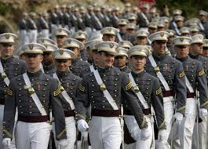
Good Military Men Too!
In the days of David, we read of the men of Asher, “All these were the children of Asher, heads of their father's house, choice and mighty men of valour, chief of the princes. And the number throughout the genealogy of them that were apt to the war and to battle was twenty and six thousand men.” 1 Chronicles 7:40

Slide 11
It would seem…….
With his willingness to share with his brethren of his bounties and his strong abilities in war, it is a stunning comment made by Deborah in the crisis of Megiddo, a type of the final battle in earth’s history, “And the princes of Issachar were with Deborah; even Issachar, and also Barak: he was sent on foot into the valley. For the divisions of Reuben there were great thoughts of heart. Why abodest thou among the sheepfolds, to hear the bleatings of the flocks? For the divisions of Reuben there were great searchings of heart. Gilead abode beyond Jordan: and why did Dan remain in ships? Asher continued on the sea shore, and abode in his breaches.” Judges 5:15-17

Slide 12
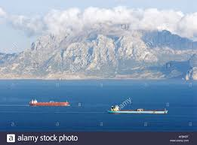
Crunch Time Failure! Big Time!
While Issachar, Zebulun, and Naphtali were giving their lives to drive out Jabin, the mighty Canaanite king and his powerful general, Sisera, with his 900 chariots, Asher was at home, taking care of his material interests! Asher felt that it would be too great a sacrifice to get involved in this struggle! He was having a good time!

Slide 13
Will We Miss Like Asher?
“The time is not far distant when the test will come to every soul. The observance of the false sabbath will be urged upon us. The contest will be between the commandments of God and the commandments of men. Those who have yielded step by step to worldly demands and conformed to worldly customs will then yield to the powers that be, rather than subject themselves to derision, insult, threatened imprisonment, and death. At that time the gold will be separated from the dross. True godliness will be clearly distinguished from the appearance and tinsel of it. Many a star that we have admired for its brilliance will then go out in darkness. Those who have assumed the ornaments of the sanctuary, but are not clothed with Christ's righteousness, will then appear in the shame of their own nakedness.” PK, pg. 188

Slide 14
Now, it Makes Sense
With everything at his fingertips; prosperity on every side, the promise of Moses to Asher seems somewhat silly. “and as thy days, so shall thy strength be.” Deut. 33:24,25
The Lord knew that this son of Jacob would be tempted to covet the bounties of heaven and become selfish and self engrossed. The Lord knew Asher’s specific struggle and promised that He would give him strength each day to meet his challenges.

Slide 15
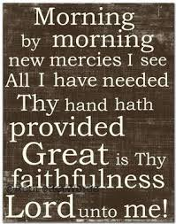
Strength for Today
Not for tomorrow, or next week, or next year, is strength promised. The Lord has promised strength for today to meet the challenges we face. To get that strength, we must spend time with Him. “But seek ye first the kingdom of God, and his righteousness; and all these things shall be added unto you. Take therefore no thought for the morrow: for the morrow shall take thought for the things of itself. Sufficient unto the day is the evil thereof.” Matthew 6:33,34

Slide 16
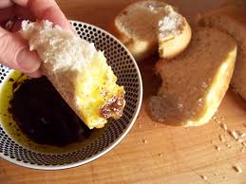
Asher Learned the Greatest of Lessons
Moses told us of Asher, “, and let him dip his foot in oil. “
Asher had been led astray by his brothers at Dothan. He had felt the coldness of an Egyptian dungeon and realized his efforts to attain to righteousness by himself were futile. He realized his need for a righteousness out of himself and for a daily refreshing of the Holy Spirit!

Slide 17
Oil Symbolic of the Holy Spirit!
"The Angel that talked with me," Zechariah declares, "came again, and waked me, as a man that is wakened out of his sleep, and said unto me, What seest thou? And I said, I have looked, and behold a candlestick all of gold, with a bowl upon the top of it, and his seven lamps thereon, and seven pipes to the seven lamps, which are upon the top thereof: and two olive trees by it, one upon the right side of the bowl, and the other upon the left side thereof.
"So I answered and spake to the Angel that talked with me, saying, What are these, my Lord? . . . Then He answered and spake unto me, saying, This is the word of the Lord unto Zerubbabel, saying, Not by might, nor by power, but by My Spirit, saith the Lord of hosts."

Slide 18
"Then answered I, and said unto Him, What are these two olive trees upon the right side of the candlestick and [594] upon the left side thereof? And I answered again, and said unto Him, What be these two olive branches which through the two golden pipes empty the golden oil out of themselves? . . . Then said He, These are the two anointed ones, that stand by the Lord of the whole earth." Zechariah 4:1-6, 11-14.
In this vision the two olive trees which stand before God are represented as emptying the golden oil out of themselves through golden tubes into the bowl of the candlestick. From this the lamps of the sanctuary are fed, that they may give a bright, continuous light. So from the anointed ones that stand in God's presence the fullness of divine light and love and power is imparted to His people, that they may impart to others light and joy and refreshing. Those who are thus enriched are to enrich others with the treasure of God's love.” PK, pgs. 593,594

Slide 19
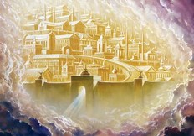
Oil of Power
The power of the 3rd Person of the Godhead, the Holy Spirit enables people to overcome sin. It was this experience, dipping his mind in the Spirit’s power, that secured for Asher a place in the New Jerusalem. He will do the same for us!!

