Slide 1
Running With Patience
Just Like Cliff Young

Slide 2
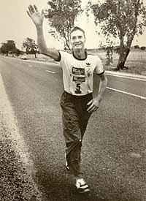
Racing Differently
“In 1983, the 61-year-old potato farmer won the first Westfield Sydney to Melbourne Ultra Marathon(875 kilometres, 544 miles). The race was run between what were then Australia's two largest shopping centres: Westfield Parramatta, in Sydney, and Westfield Doncaster, in Melbourne.^{[4]} Cliff arrived at the start line with overalls and gumboots. He ran at a slow loping pace and trailed the leaders for most of the course…………….

Slide 3
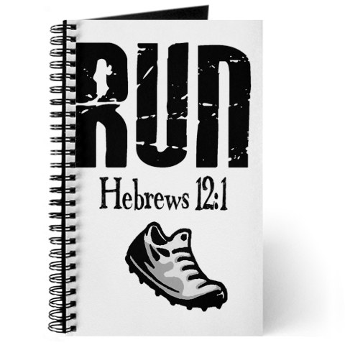
Called to Run
“Wherefore seeing we also are compassed about with so great a cloud of witnesses, let us lay aside every weight, and the sin which doth so easily beset us, and let us run with patience the race that is set before us,” Heb. 12:1

Slide 4
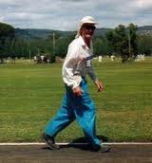

Slide 5
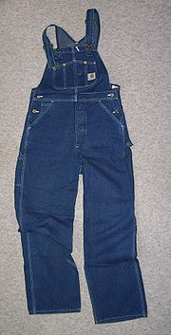
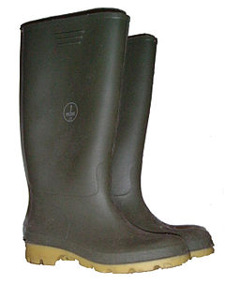
He Ran in These

Slide 6
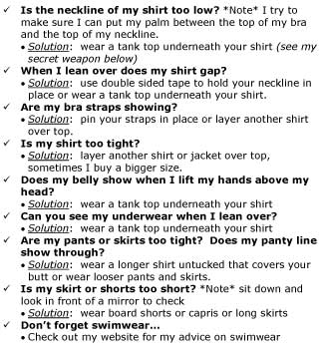
Peculiar to say the Least
“But ye are a chosen generation, a royal priesthood, an holy nation, a peculiar people; that ye should shew forth the praises of him who hath called you out of darkness into his marvellous light: Which in time past were not a people, but are now the people of God: which had not obtained mercy, but now have obtained mercy. Dearly beloved, I beseech you as strangers and pilgrims, abstain from fleshly lusts, which war against the soul;” 1 Peter 2:9-11

Slide 7
It Makes no Difference how I Dress!
Low cut dresses, mini-skirts, bare backs, tight pants, you name it; we have compromised so far in our dress that it stinks!! It is important how we dress!!!
“In like manner also, that women adorn themselves in modest apparel, with shamefacedness and sobriety; not with broided hair, or gold, or pearls, or costly array;
But (which becometh women professing godliness) with good works.” 1 Timothy 2:9,10
“Whose adorning let it not be that outward [adorning] of plaiting the hair, and of wearing of gold, or of putting on of apparel;
But [let it be] the hidden man of the heart, in that which is not corruptible, [even the ornament] of a meek and quiet spirit, which is in the sight of God of great price.” 1 Peter 3:3,4

Slide 8
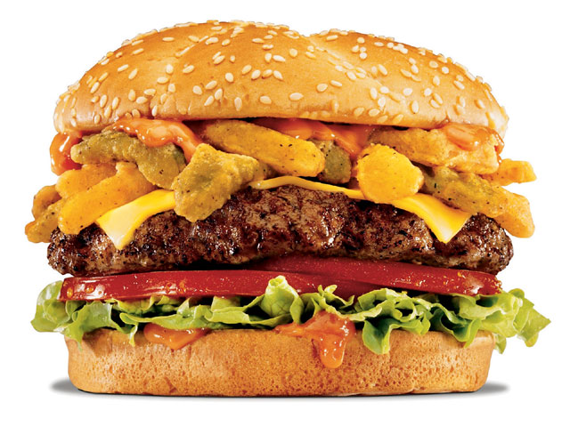
It is Important what ,when ,and how much we eat, sleep, and exercise ,etc.
Eat what I want, eat when I want, and sleep all hours of the night; it doesn’t make any difference at all. Stop meddling and stick to preaching!!

Slide 9
Self-Denial
When Paul talks about running the race, he says to lay aside every weight that would hold us back. Peter, in discussing being peculiar, he talks about staying away from fleshly lusts that war against the soul. The SOP says it thus: “The runners put aside every indulgence that would tend to weaken the physical powers, and by severe and continuous discipline trained their muscles to strength and endurance, that when the day of the contest should arrive, they might put the heaviest tax upon their powers. How much more important that the Christian, whose eternal interests are at stake, bring appetite and passion under subjection to reason and the will of God! Never must he allow his attention to be diverted by amusements, luxuries, or ease. All his habits and passions must be brought under the strictest discipline. Reason, enlightened by the teachings of God's word and guided by His Spirit, must hold the reins of control.” AA, pg. 311

Slide 10
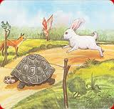
Run with Patience
Australia hosts 543.7-mile (875-kilometer) endurance racing from Sydney to Melbourne. It is considered among the world's most grueling ultra-marathons. The race takes five days to complete and is normally only attempted by world-class athletes who train specially for the event. These athletes are typically less than 30 years old and backed by large companies such as Nike… The press and other athletes became curious and questioned Cliff. They told him, "You're crazy, there's no way you can finish this race." To which he replied, "Yes I can. ”

Slide 11
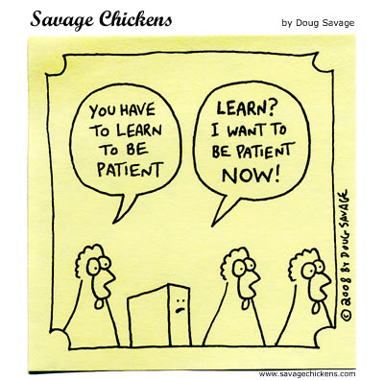
A Day at a Time
“My brethren, count it all joy when ye fall into divers temptations; Knowing this, that the trying of your faith worketh patience. But let patience have her perfect work, that ye may be perfect and entire, wanting nothing.” James 1:2-4

Slide 12
patience
“My brethren, count it all joy when ye fall into divers temptations; Knowing this, that the trying of your faith worketh patience. But let patience have her perfect work, that ye may be perfect and entire, wanting nothing.” James 1:2-4
“Take, my brethren, the prophets, who have spoken in the name of the Lord, for an example of suffering affliction, and of patience. Behold, we count them happy which endure. Ye have heard of the patience of Job, and have seen the end of the Lord; that the Lord is very pitiful, and of tender mercy.” James 5:10,11

Slide 13
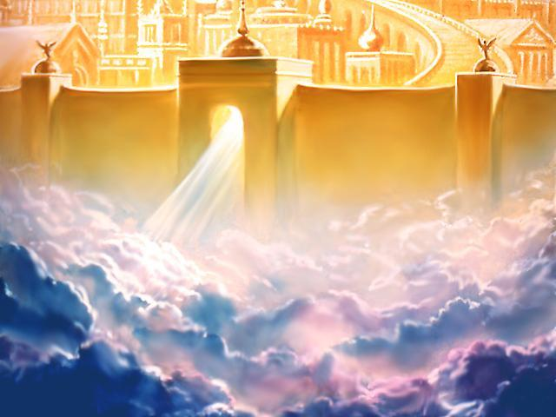
Will This Amount to Anything?
“And I saw as it were a sea of glass mingled with fire: and them that had gotten the victory over the beast, and over his image, and over his mark, and over the number of his name, stand on the sea of glass, having the harps of God. And they sing the song of Moses the servant of God, and the song of the Lamb, saying, Great and marvellous [are] thy works, Lord God Almighty; just and true [are] thy ways, thou King of saints.” Rev. 15:2,3

Slide 14
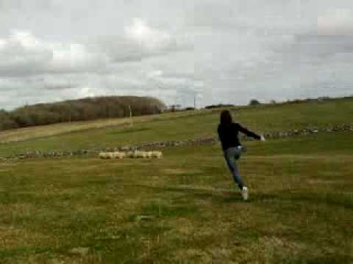
The Key to Victory
“Before running the race, he (Cliff Young) told the press that he had previously run for two to three days straight rounding up sheep. He claimed afterwards that during the race, he imagined that he was running after sheep and trying to outrun a storm.” Wikipedia

Slide 15
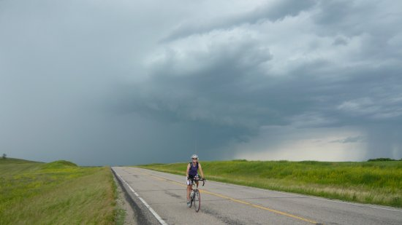
Focus is the Key!
Cliff young didn’t focus on his pain. He didn’t focus on his fatigue. He didn’t focus on the race or the soreness in his legs. He didn’t focus on the cramps in his sides. He focused on catching his sheep or out running the storm. Throughout the race, Cliff was sure his cup was half full and not half empty!!! “Rejoice evermore. Pray without ceasing. In every thing give thanks: for this is the will of God in Christ Jesus concerning you.” 1 Thess. 5:16-18

Slide 16
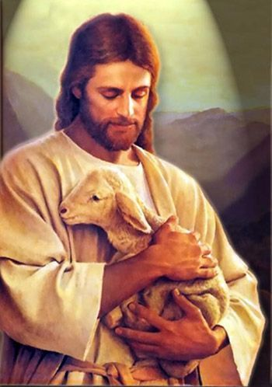
Looking unto Jesus
“ Wherefore seeing we also are compassed about with so great a cloud of witnesses, let us lay aside every weight, and the sin which doth so easily beset us, and let us run with patience the race that is set before us, Looking unto Jesus the author and finisher of our faith; who for the joy that was set before him endured the cross, despising the shame, and is set down at the right hand of the throne of God. For consider him that endured such contradiction of sinners against himself, lest ye be wearied and faint in your minds.”

Slide 17
Focus
“In the last great conflict of the controversy with Satan those who are loyal to God will see every earthly support cut off. Because they refuse to break His law in obedience to earthly powers, they will be forbidden to buy or sell. It will finally be decreed that they shall be put to death. See Rev. 13:11-17. But to the obedient is given the promise, "He shall dwell on high: his place of defense shall be the munitions of rocks: bread shall be given him; his waters shall be sure." Isa. 33:16. By this promise the children of God will live. When the earth shall be wasted with famine, they shall be fed. "They shall not be ashamed in the evil time: and in the days of famine they shall be satisfied." Ps. 37:19.

Slide 18
…To that time of distress the prophet Habakkuk looked forward, and his words express the faith of the church: "Although the fig tree shall not blossom, neither shall fruit be in the vines; the labor of the olive shall fail, and the fields shall yield no meat; the flock shall be cut off from the fold, and there shall be no herd in the stalls: yet I will rejoice in the Lord, I will joy in the God of my salvation." Hab. 3:17,18…"By every word that proceedeth out of the mouth of God" are we to live. When assailed by temptation, look not to circumstances or to the weakness of self, but to the power of the word. All its strength is yours. "Thy word," says the psalmist, "have I hid in mine heart, that I might not sin against Thee." "By the word of Thy lips I have kept me from the paths of the destroyer." Ps. 119:11; 17:4.” DA, pgs. 121-123

