Slide 1
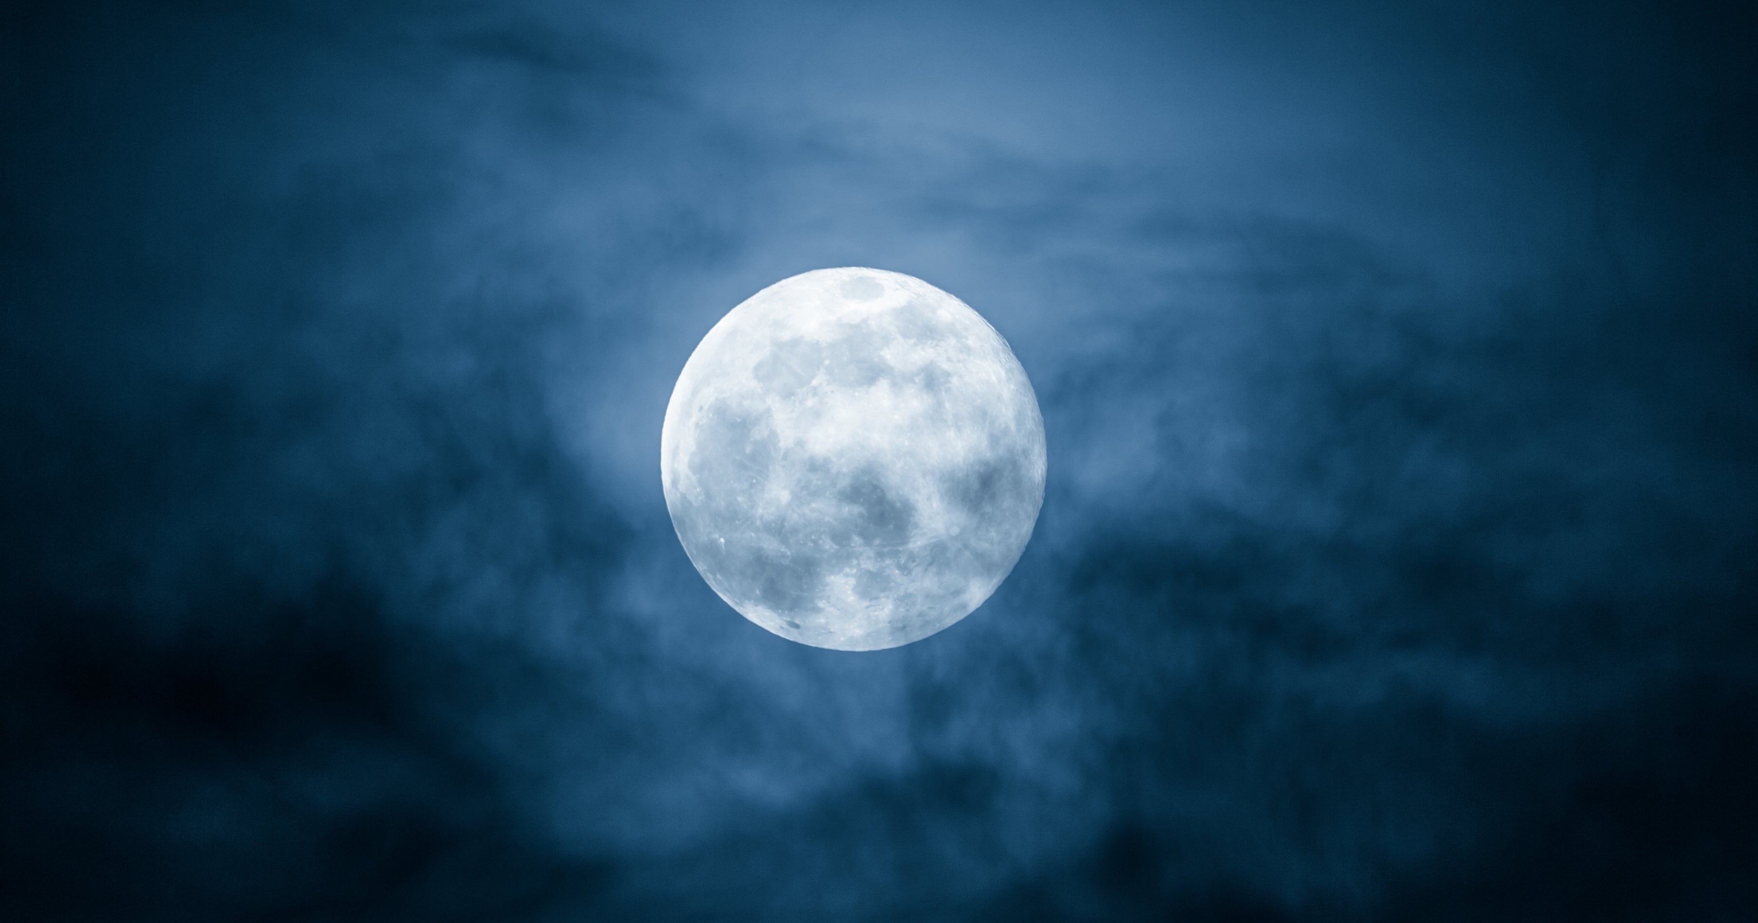
The Sanctuary pt 49: New Moons

Slide 2
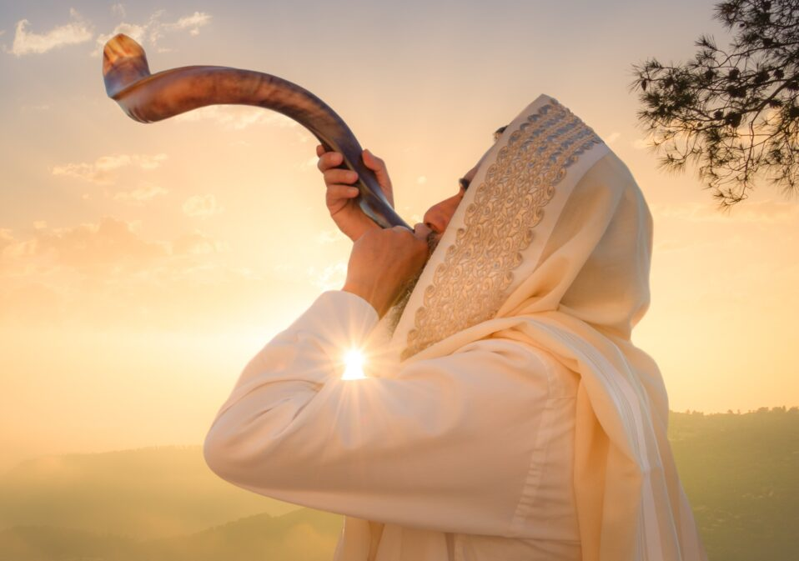
What We will Study Today:
What Happened during this feast
What it meant for ancient Israel and What it means for us today
It’s prophetic fulfillment

Slide 4
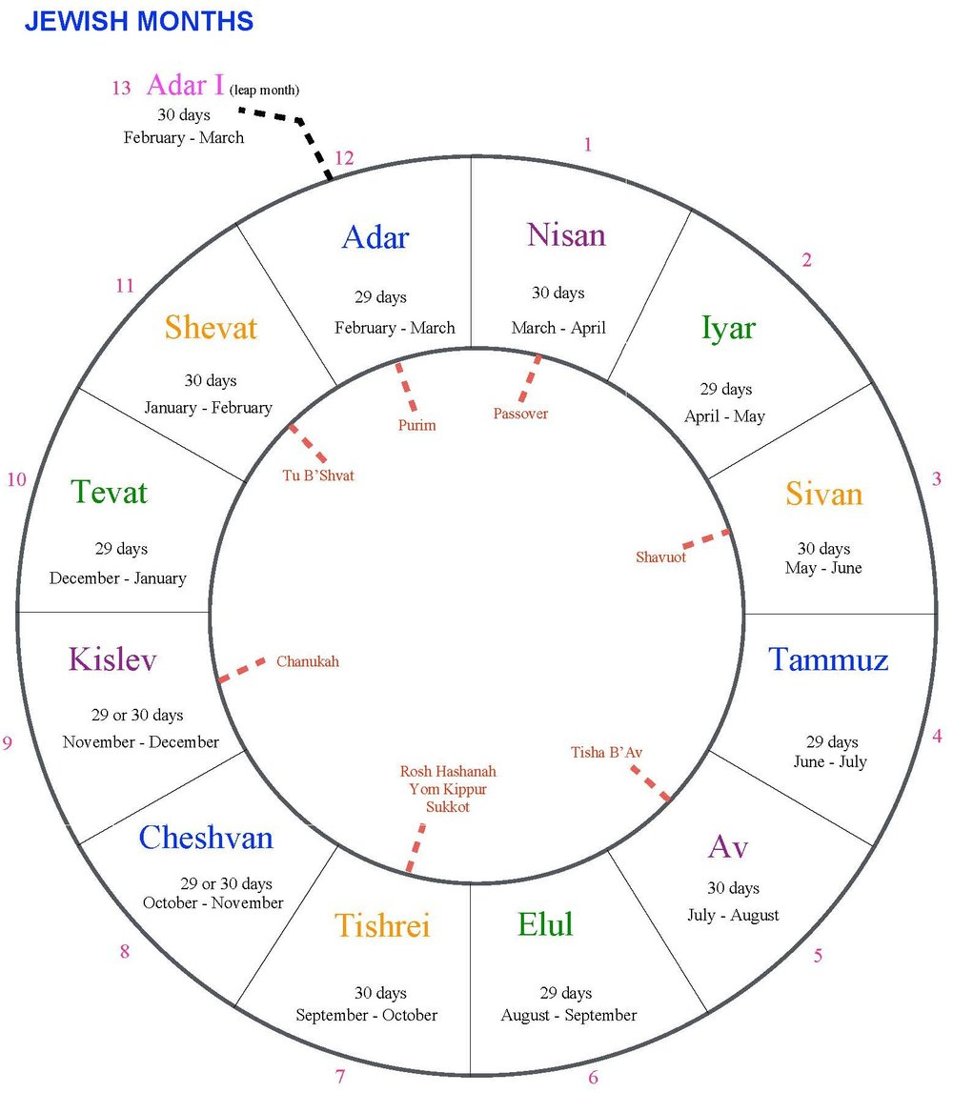
What Began a Month?
Gen. 1:14 “And God said, Let there be lights in the firmament of the heaven to divide the day from the night; and let them be for signs, and for seasons, and for days, and years”

Slide 5
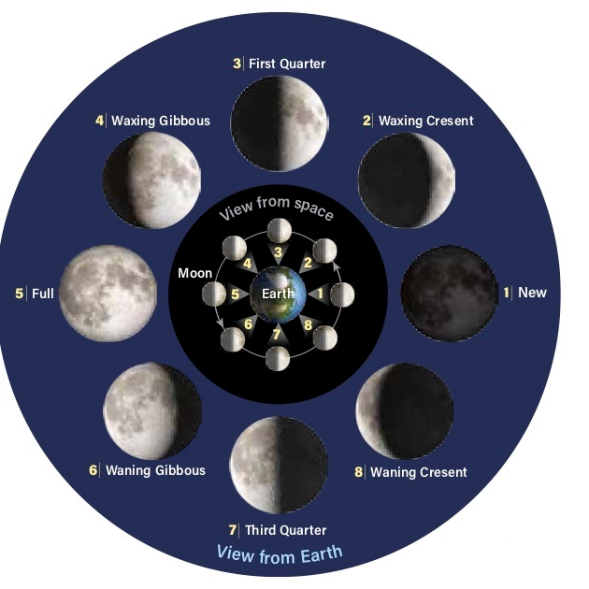
What Happened on a “New Moon”?
1 Chron. 29:30-32 “And to stand every morning to thank and praise the Lord, and likewise at even: And to offer all burnt sacrifices unto the Lord in the sabbaths, in the new moons, and on the set feasts, by number, according to the order commanded unto them, continually before the Lord: And that they should keep the charge of the tabernacle of the congregation, and the charge of the holy place, and the charge of the sons of Aaron their brethren, in the service of the house of the Lord.”

Slide 6
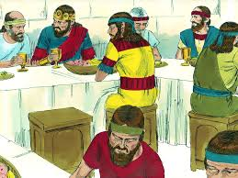
1 Sam. 20:5, 24 “And David said unto Jonathan, Behold, to morrow is the new moon, and I should not fail to sit with the king at meat: but let me go, that I may hide myself in the field unto the third day at even. . . . So David hid himself in the field: and when the new moon was come, the king sat him down to eat meat.”

Slide 7
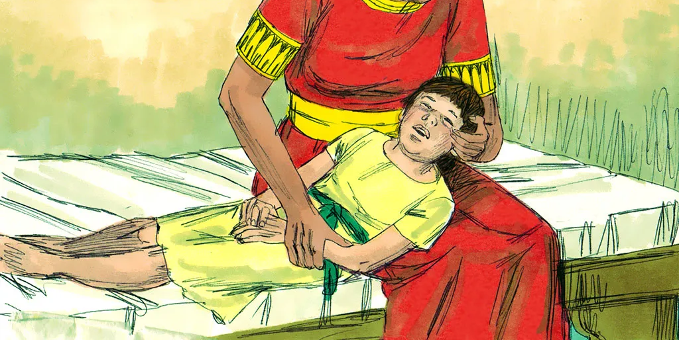
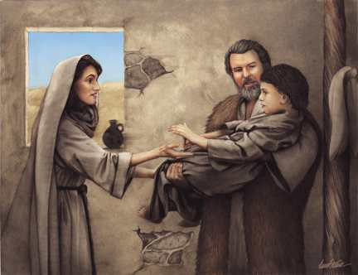
Spiritual Assistance!
2 Kings 4:20-24 “And when he had taken him, and brought him to his mother, he sat on her knees till noon, and then died. And she went up, and laid him on the bed of the man of God, and shut the door upon him, and went out. And she called unto her husband, and said, Send me, I pray thee, one of the young men, and one of the asses, that I may run to the man of God, and come again. And he said, Wherefore wilt thou go to him to day? it is neither new moon, nor sabbath. And she said, It shall be well. Then she saddled an ass, and said to her servant, Drive, and go forward; slack not thy riding for me, except I bid thee.”

Slide 8
A sabbath?
Amos 8:4-7 “Hear this, O ye that swallow up the needy, even to make the poor of the land to fail, Saying, When will the new moon be gone, that we may sell corn? and the sabbath, that we may set forth wheat, making the ephah small, and the shekel great, and falsifying the balances by deceit? That we may buy the poor for silver, and the needy for a pair of shoes; yea, and sell the refuse of the wheat? The Lord hath sworn by the excellency of Jacob, Surely I will never forget any of their works.”

Slide 9
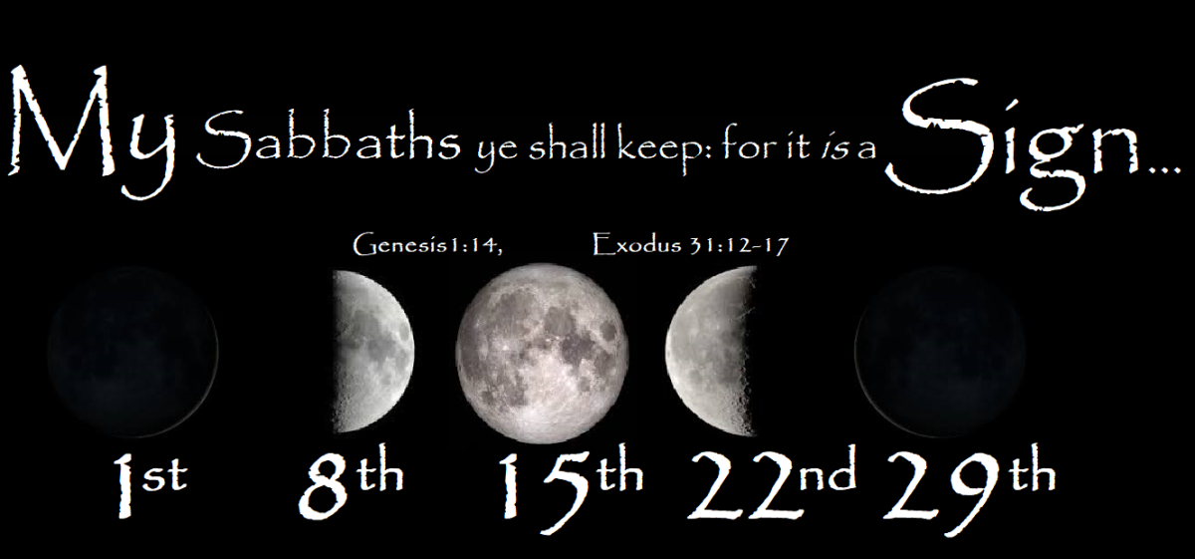
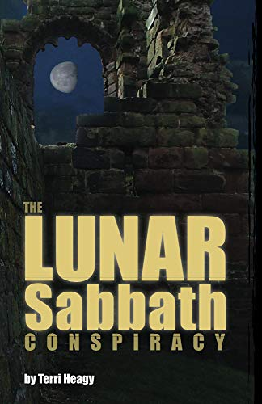
Lunar Sabbaths?
Lunar Sabbatarians suggest new light on the topic of new moons to be kept in a literal sense. There is no consensus on this subject, but it goes something like this:
“Because new moons were ‘sabbath’ days, true Christians should be keeping every new moon as a sabbath day as well.”
Others say or add to this, saying:
“You need to be keeping every 7th day starting in the new moon”—(sometimes this is in addition to the 7th Day Sabbath, but very often it is the replacement for it.)
Proponents of this belief insist that this is “new light” for the last days that Mrs. White did not understand in her day.

Slide 10
Mrs. White on “New Light”
“We are God’s commandment-keeping people, For the past fifty years every phase of heresy has been brought to bear upon us, to becloud our minds regarding the teaching of the word,--especially concerning the ministration of Christ in the heavenly sanctuary, and the message of heaven for these last days, as given by the angels of the fourteenth chapter of Revelation. Messages of every order and kind have been urged upon Seventh-day Adventists, to take the place of the truth, which, point by point, has been sought out by prayerful study, and testified by the miracle-working power of the Lord. But the waymarks which have made us what we are, are to be preserved, as God has signified through His word and the testimony of His Spirit. He calls upon us to hold firmly, with the grip of faith, to the fundamental principles that are based upon unquestionable authority.” Special Testimonies, Series B, No. 2, p. 59

Slide 11
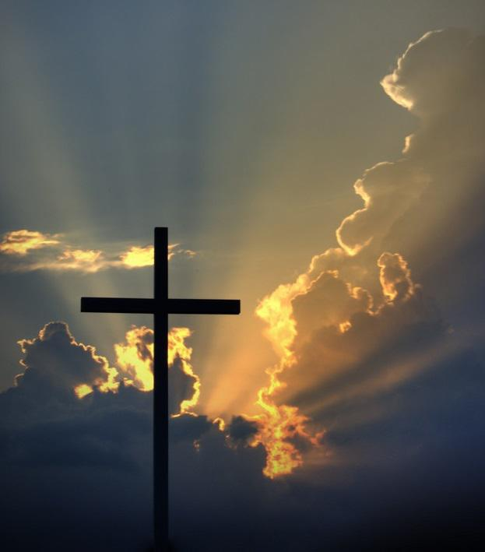
Ceremonies Ended in Christ’s Fulfillment
“When type met antitype in the death of Christ, the sacrificial offerings ceased. The ceremonial law was done away.” R&H, June 26, 1900

Slide 12
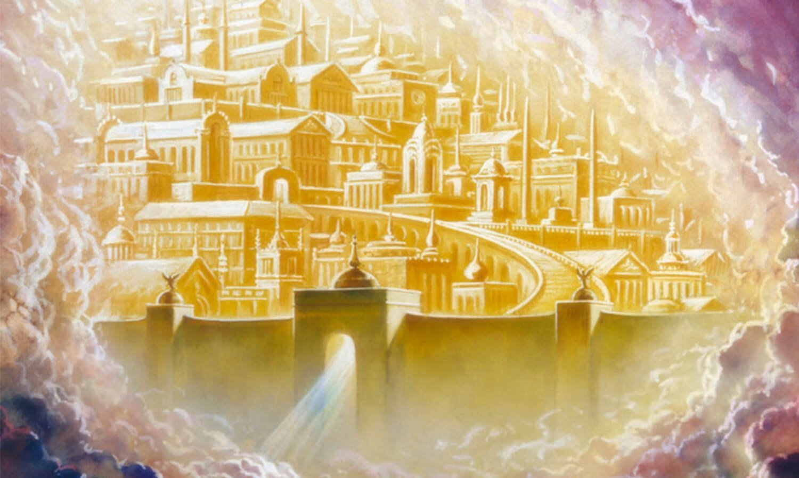
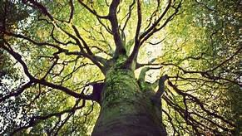
The Future New Moons
Is. 66:22-23 “For as the new heavens and the new earth, which I will make, shall remain before me, saith the Lord, so shall your seed and your name remain. And it shall come to pass, that from one new moon to another, and from one sabbath to another, shall all flesh come to worship before me, saith the Lord.”
Rev. 22:2 “In the midst of the street of it, and on either side of the river, was there the tree of life, which bare twelve manner of fruits, and yielded her fruit every month: and the leaves of the tree were for the healing of the nations.”

Slide 13
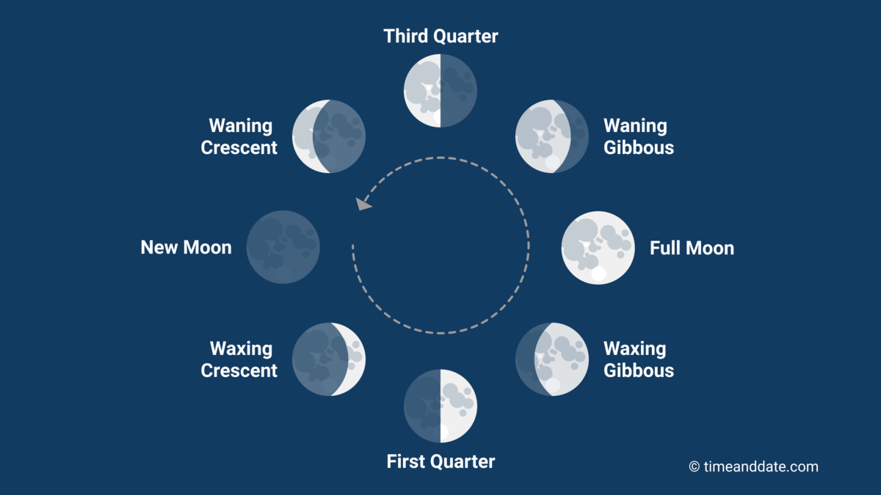
How Was the “New Moon” Signaled?
Ps. 81:1-3 “Sing aloud unto God our strength: make a joyful noise unto the God of Jacob. Take a psalm, and bring hither the timbrel, the pleasant harp with the psaltery. Blow up the trumpet in the new moon, in the time appointed, on our solemn feast day.”

Slide 14
The Silver Trumpets
Num. 10:1-8 “And the Lord spake unto Moses, saying, Make thee two trumpets of silver; of a whole piece shalt thou make them: that thou mayest use them for the calling of the assembly, and for the journeying of the camps. And when they shall blow with them, all the assembly shall assemble themselves to thee at the door of the tabernacle of the congregation. And if they blow but with one trumpet, then the princes, which are heads of the thousands of Israel, shall gather themselves unto thee. When ye blow an alarm, then the camps that lie on the east parts shall go forward.6 When ye blow an alarm the second time, then the camps that lie on the south side shall take their journey: they shall blow an alarm for their journeys. But when the congregation is to be gathered together, ye shall blow, but ye shall not sound an alarm. And the sons of Aaron, the priests, shall blow with the trumpets; and they shall be to you for an ordinance for ever throughout your generations.”

Slide 15
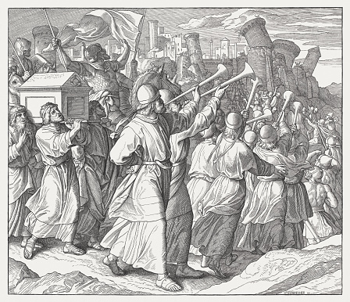
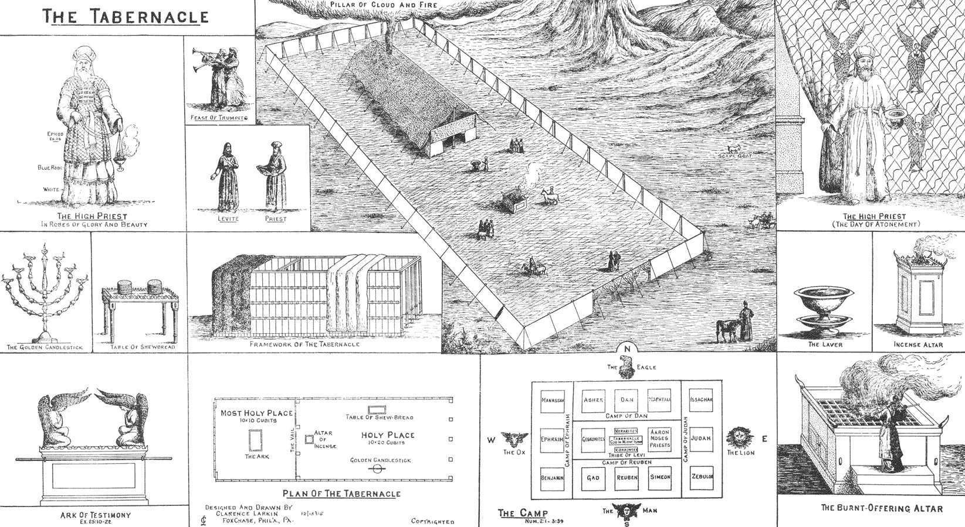
Importance of Trumpets in Ancient Israel
“In all the journeyings of Israel, "the ark of the covenant of the Lord went before them, . . . to search out a resting place for them." Numbers 10:33. Borne by the sons of Kohath, the sacred chest containing God's holy law was to lead the van. Before it went Moses and Aaron; and the priests, bearing silver trumpets, were stationed near. These priests received directions from Moses, which they communicated to the people by the trumpets. It was the duty of the leaders of each company to give definite directions concerning all the movements to be made, as indicated by the trumpets. Whoever neglected to comply with the directions given was punished with death.” PP, 375-376

Slide 16
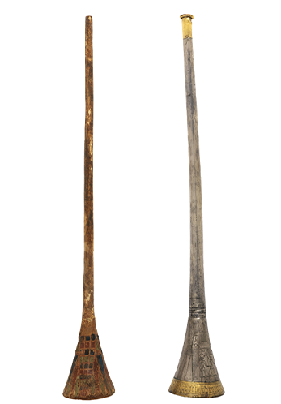
Still Important Today!!!
1 Cor. 14:7-9 “And even things without life giving sound, whether pipe or harp, except they give a distinction in the sounds, how shall it be known what is piped or harped? For if the trumpet give an uncertain sound, who shall prepare himself to the battle? So likewise ye, except ye utter by the tongue words easy to be understood, how shall it be known what is spoken? for ye shall speak into the air.”
1 Cor. 13:1 “Though I speak with the tongues of men and of angels, and have not charity, I am become as sounding brass, or a tinkling cymbal.”

Slide 17
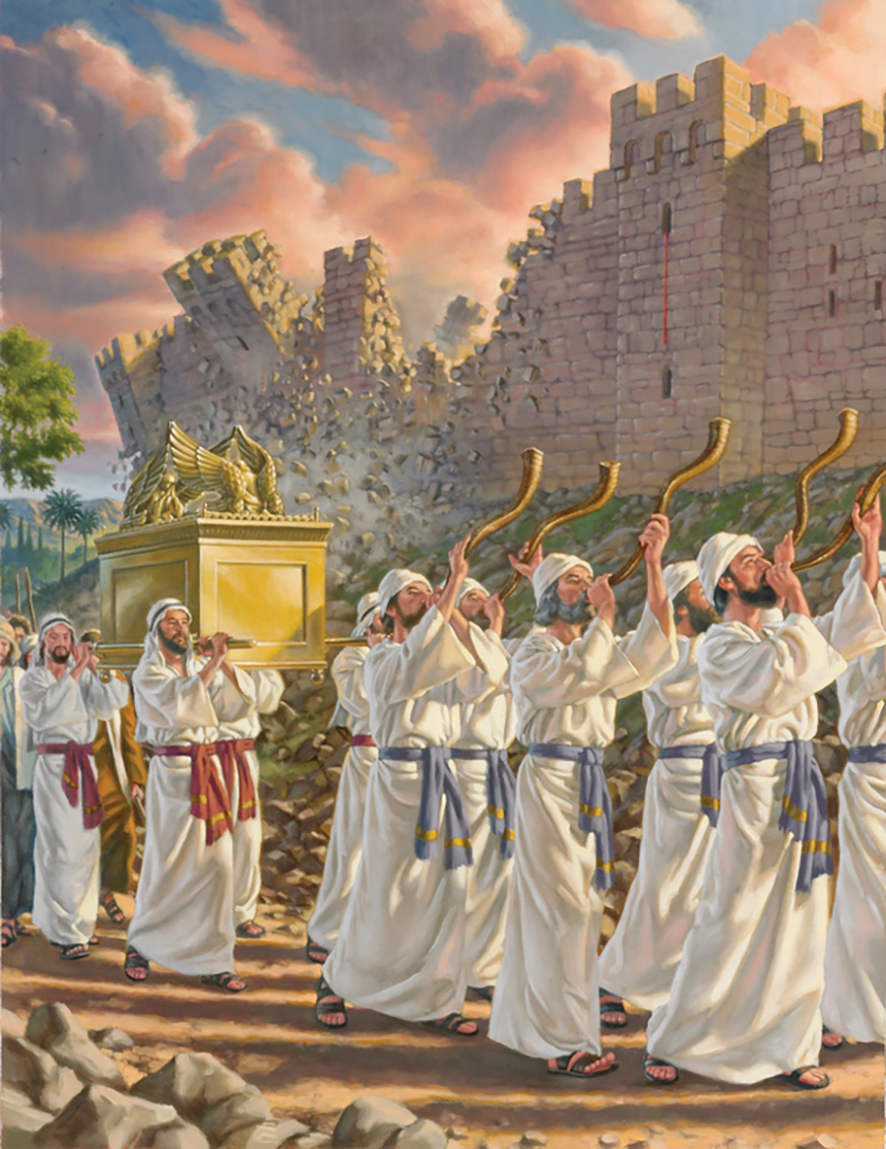
Ancient Examples: Judgment!
Josh. 6:4-5, 20 “And seven priests shall bear before the ark seven trumpets of rams' horns: and the seventh day ye shall compass the city seven times, and the priests shall blow with the trumpets. And it shall come to pass, that when they make a long blast with the ram's horn, and when ye hear the sound of the trumpet, all the people shall shout with a great shout; and the wall of the city shall fall down flat, and the people shall ascend up every man straight before him. . . . So the people shouted when the priests blew with the trumpets: and it came to pass, when the people heard the sound of the trumpet, and the people shouted with a great shout, that the wall fell down flat, so that the people went up into the city, every man straight before him, and they took the city.”

Slide 18
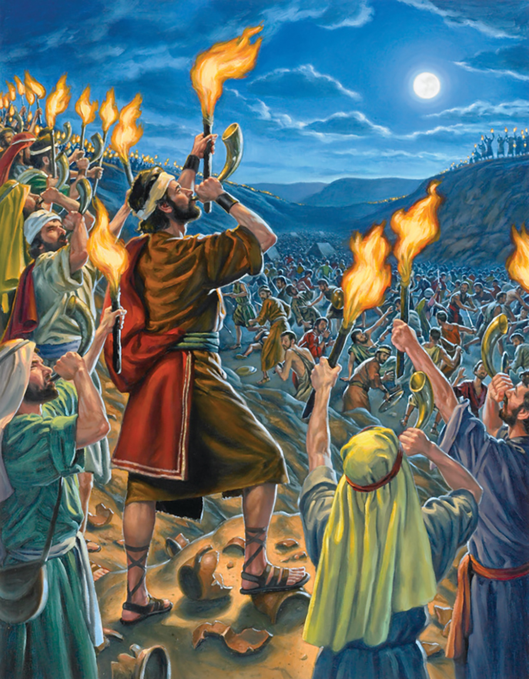
Gideon and the Judgment of Midian
Judges 7:18-21 “When I blow with a trumpet, I and all that are with me, then blow ye the trumpets also on every side of all the camp, and say, The sword of the Lord, and of Gideon. So Gideon, and the hundred men that were with him, came unto the outside of the camp in the beginning of the middle watch; and they had but newly set the watch: and they blew the trumpets, and brake the pitchers that were in their hands. And the three companies blew the trumpets, and brake the pitchers, and held the lamps in their left hands, and the trumpets in their right hands to blow withal: and they cried, The sword of the Lord, and of Gideon. And they stood every man in his place round about the camp; and all the host ran, and cried, and fled.”

Slide 19
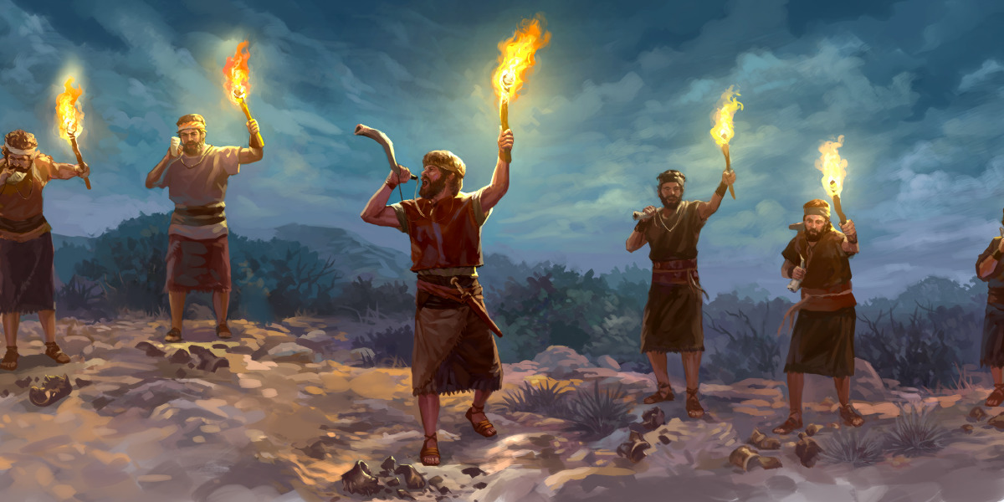
Does God Need Numbers?
“In this signal defeat not less than one hundred and twenty thousand of the invaders perished. The power of the Midianites was broken, so that they were never again able to make war upon Israel. The tidings spread swiftly far and wide, that Israel's God had again fought for His people. No words can describe the terror of the surrounding nations when they learned what simple means had prevailed against the power of a bold, warlike people.”—PP, p. 553

Slide 20
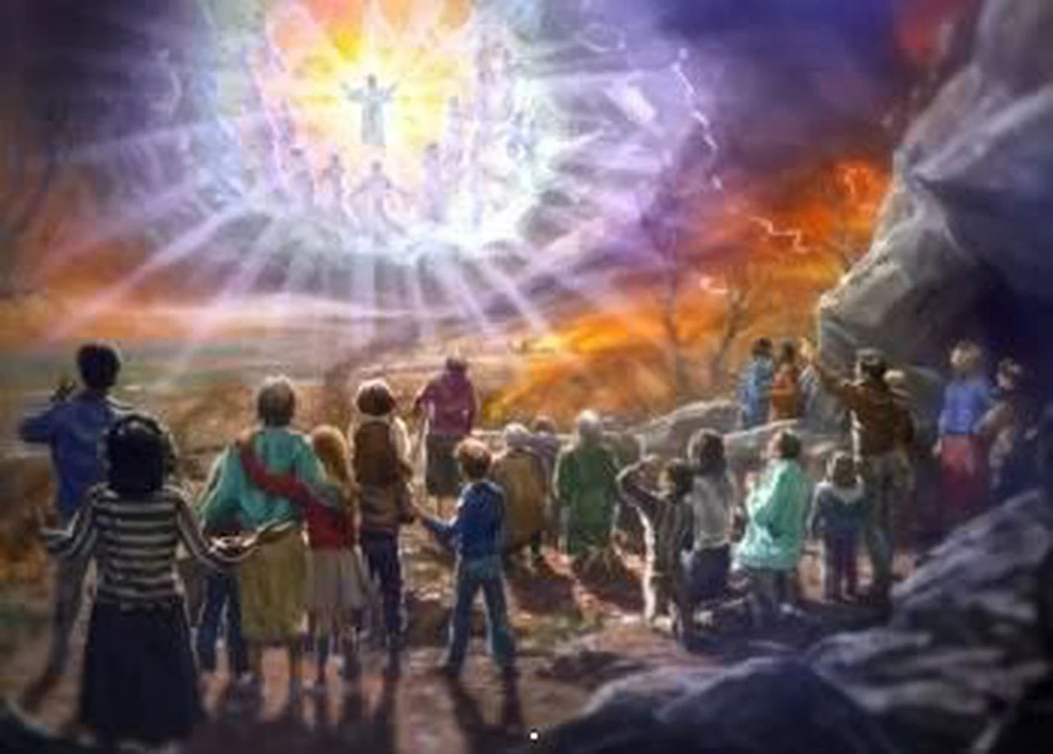
Prophetic Trumpets
Joel 2:1-2 “Blow ye the trumpet in Zion, and sound an alarm in my holy mountain: let all the inhabitants of the land tremble: for the day of the Lord cometh, for it is nigh at hand; A day of darkness and of gloominess, a day of clouds and of thick darkness, as the morning spread upon the mountains: a great people and a strong; there hath not been ever the like, neither shall be any more after it, even to the years of many generations.”

Slide 21
Trumpets and Judgment
Rev. 8:1-2 “And when he had opened the seventh seal, there was silence in heaven about the space of half an hour. And I saw the seven angels which stood before God; and to them were given seven trumpets.”

Slide 22
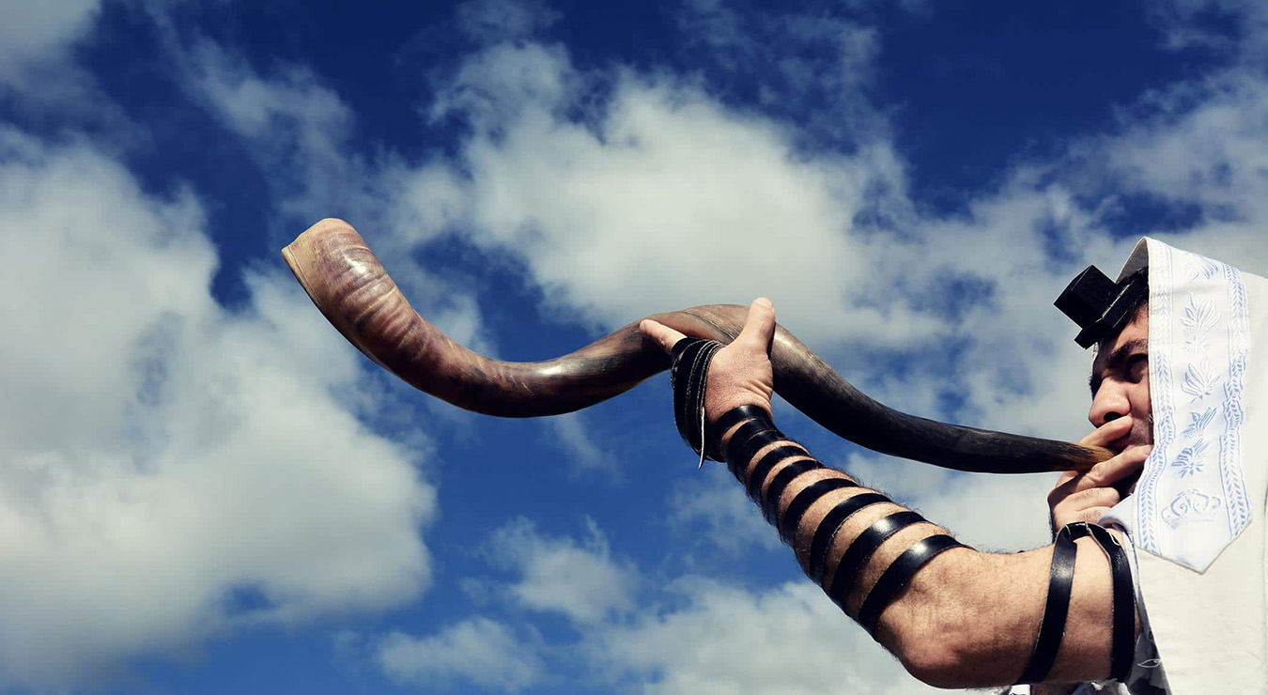
Trumpets….
“The sound of the trumpet summoned Israel to meet with God. The voice of the archangel and the trump of God shall summon, from the whole earth, both the living and the dead to the presence of their Judge.”—PP, 339
Num. 10:10 “Also in the day of your gladness, and in your solemn days, and in the beginnings of your months, ye shall blow with the trumpets over your burnt offerings, and over the sacrifices of your peace offerings; that they may be to you for a memorial before your God: I am the Lord your God.”

Slide 23
Give the Trumpet a Certain Sound!
“Brethren and sisters, the Lord wants to impart to us increased light. He desires that we shall have distinct revealings of his glory; that ministers and people shall become strong in his strength. When the angel was about to unfold to Daniel the intensely interesting prophecies to be recorded for us who are to witness their fulfillment, the angel said, "Be strong, yea, be strong." We are to receive the very same glory that was revealed to Daniel, because it is for God's people in these last days, that they may give the trumpet a certain sound. God help us to work unitedly and as we never have worked before, is my prayer. There is need now of faithful Calebs, whose voices will be heard in clear, ringing notes, saying of the immortal inheritance, "Let us go up at once and possess it, for we are well able." We need now the courage of God's faithful servant of old; not one wavering, uncertain note should come from the watchers' trumpets. They must be true to the sacred, solemn work that has been intrusted to them, and lead the flock of God in right pathways.”—R&H, December 24, 1889

Slide 24
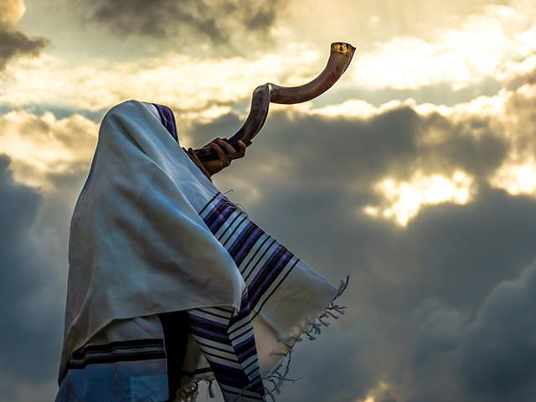
A New Vital Force!
“The Lord will put new, vital force into His work as human agencies obey the command to go forth and proclaim the truth. He who declared that His truth would shine forever will proclaim this truth through faithful messengers, who will give the trumpet a certain sound. The truth will be criticized, scorned, and derided; but the closer it is examined and tested the brighter it will shine. As a people, we are to stand firm on the platform of eternal truth that has withstood test and trial. We are to hold to the pillars of our faith.”—Special Testimonies, Series B, No. 2, p. 51

Slide 25
Comparison
New Moon:
Was a time of rejoicing and fellowship
Was signaled by the blowing of the trumpet
Included a sabbath/communion
Included feasting
Burnt Offering
Future New Moon:
Will be a continual time of rejoicing and fellowship
The antitypical first true new moon spent with the Lord will be signaled by the trumpet blast
All flesh will come before the Lord
The Tree of Life will provide 12 fruits for all eternity—1 in each month
Consecration/Dedication to God

Slide 26
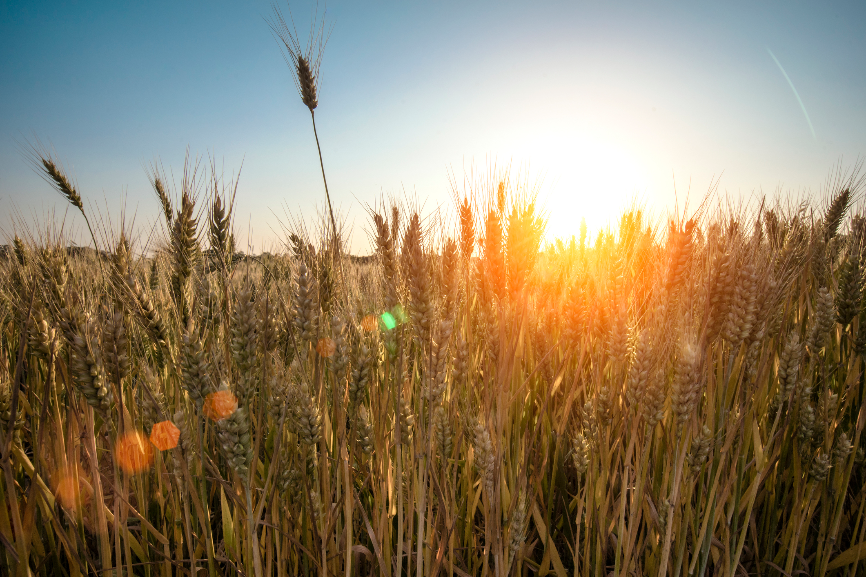
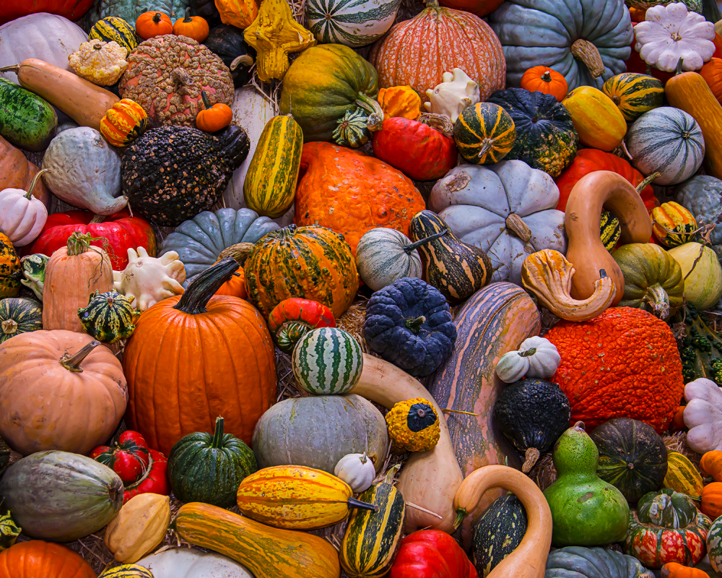
Difference Between the Spring and the Fall Feasts
Spring: The Spring Feasts in prophecy surrounded the 1st Coming of the Son of God, each element highlighted the ministry, death, burial, resurrection of Christ and the beginning of His ministration in the Sanctuary above—these feasts revolve around the literal and spiritual harvest time
Fall: The Fall Feasts in prophecy surround the 2nd Coming of the Son of God, each element highlights the ministry, Judgment, and Return of Christ and the closing of His ministration in the Sanctuary above—these feasts revolve around the literal and spiritual harvest time

