Slide 1
The ‘Puzzling’ Prophet?
Connecting the Pieces

Slide 2
Elijah Would Come
“Behold, I will send you Elijah the prophet before the coming of the great and dreadful day of the LORD: And he shall turn the heart of the fathers to the children, and the heart of the children to their fathers, lest I come and smite the earth with a curse.” Malachi 4:5,6
Before the coming of Christ, Elijah would appear. Two questions immediately present themselves to our minds.
1. Is this Elijah in person or is it someone who would come with a mission and a message similar to his?
2. What is the dreadful day of the Lord?

Slide 3
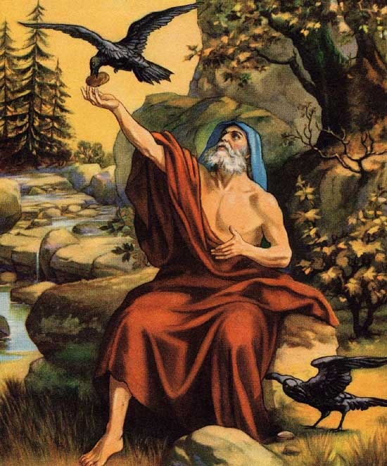
The Hairy Man with strange clothes
Many years ago, I went to a stage play at the junior college I was attending. It was on the apocalypse. At one point…………….

Slide 4
John Said No: Jesus Said Yes!
“And this is the record of John, when the Jews sent priests and Levites from Jerusalem to ask him, Who art thou? And he confessed, and denied not; but confessed, I am not the Christ. And they asked him, What then? Art thou Elias? And he saith, I am not. Art thou that prophet? And he answered, No.” John 1:19-21
“And from the days of John the Baptist until now the kingdom of heaven suffereth violence, and the violent take it by force. For all the prophets and the law prophesied until John. And if ye will receive it, this is Elias, which was for to come.” Matthew 11:12-14

Slide 5
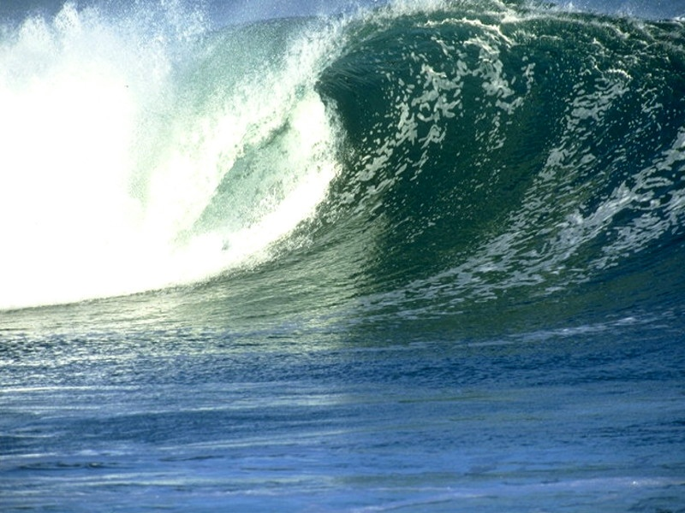
Emphasizing the Point
“And his disciples asked him, saying, Why then say the scribes that Elias must first come? And Jesus answered and said unto them, Elias truly shall first come, and restore all things. But I say unto you, That Elias is come already, and they knew him not, but have done unto him whatsoever they listed. Likewise shall also the Son of man suffer of them. Then the disciples understood that he spake unto them of John the Baptist.” Matthew 17:10-13

Slide 6
No Contradiction at All
“But the angel said unto him, Fear not, Zacharias: for thy prayer is heard; and thy wife Elisabeth shall bear thee a son, and thou shalt call his name John. And thou shalt have joy and gladness; and many shall rejoice at his birth. For he shall be great in the sight of the Lord, and shall drink neither wine nor strong drink; and he shall be filled with the Holy Ghost, even from his mother's womb. And many of the children of Israel shall he turn to the Lord their God. And he shall go before him in the spirit and power of Elias, to turn the hearts of the fathers to the children, and the disobedient to the wisdom of the just; to make ready a people prepared for the Lord.” Luke 1:13-17
John the Baptist was not Elijah in the flesh. However, he was Elijah in mission and message. He came to bring God’s professed people back to Heaven’s standard and preached the same message that Elijah did!

Slide 7
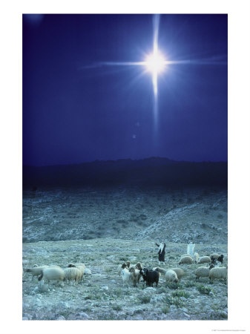
The Dreadful Day of the Lord
The First Coming of Christ ?
“And there were in the same country shepherds abiding in the field, keeping watch over their flock by night. And, lo, the angel of the Lord came upon them, and the glory of the Lord shone round about them: and they were sore afraid. And the angel said unto them, Fear not: for, behold, I bring you good tidings of great joy, which shall be to all people. For unto you is born this day in the city of David a Saviour, which is Christ the Lord.” Luke 2:8-11

Slide 8
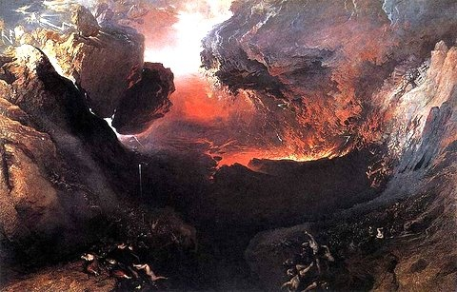
The Dreadful Day: The Second Coming
“let all the inhabitants of the land tremble: for the day of the LORD cometh, for it is nigh at hand; A day of darkness and of gloominess, a day of clouds and of thick darkness, as the morning spread upon the mountains: a great people and a strong; there hath not been ever the like, neither shall be any more after it, even to the years of many generations.” Joel 2:1,2
“The great day of the LORD is near, it is near, and hasteth greatly, even the voice of the day of the LORD: the mighty man shall cry there bitterly. That day is a day of wrath, a day of trouble and distress, a day of wasteness and desolation, a day of darkness and gloominess, a day of clouds and thick darkness,” Zeph. 1:14,15

Slide 9

Elijah would Come
Before the Second Coming of Jesus Christ, someone would come to perform the same mission that Elijah and John the Baptist had. In performing that mission, the person would preach the same message that the Elijah and John the Baptist preached!

Slide 10
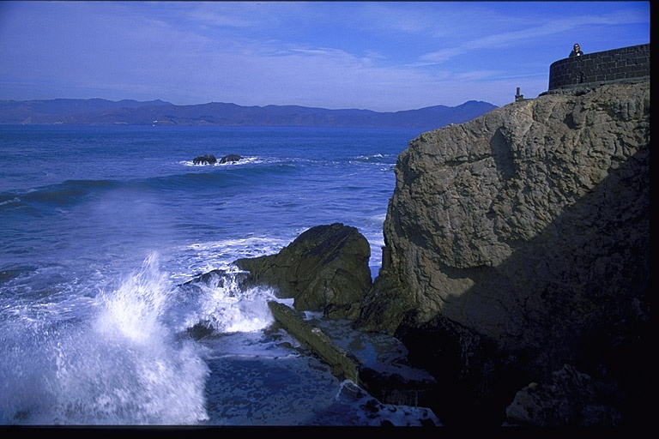
Elijah’s Message
“And it came to pass, when Ahab saw Elijah, that Ahab said unto him, Art thou he that troubleth Israel? And he answered, I have not troubled Israel; but thou, and thy father's house, in that ye have forsaken the commandments of the LORD, and thou hast followed Baalim.” 1Kings 18:17,18

Slide 11
Elijah’s Message, Pt. 1
The first part of Elijah’s message was the exaltation of the law of God. He told Ahab that the law of God had been forsaken and that it must be exalted again in Israel.
When Elijah exalted the ten commandments, he also declared that Israel was following Baalim.
“"Ba‛al" can refer to any god and even to human officials; in some texts it is used as a substitute for Hadad, a god of the rain, thunder, fertility and agriculture, and the lord of Heaven.” Wikipedia Encyclopedia
As we can see from this this definition, Baal sent the rain and was responsible for things growing. He was the life giver, the creator.
While Elijah exalted the 10 commandments, he demanded that Israel stop worshipping Baal, the false creator. In the light of the 10 commandments, which commandment would be especially denied with the exaltation of Baal, the false creator?
Which commandment exalts God as the Creator/Life-giver?

Slide 12

The Sabbath
“For in six days the LORD made heaven and earth, the sea, and all that in them is, and rested the seventh day: wherefore the LORD blessed the sabbath day, and hallowed it.” Ex. 20:11 The seventh day Sabbath especially reveals God as the Creator. It was the Sabbath that Elijah especially exalted in contrast to the worship of Baal!

Slide 13
Exaltation of the 10 Commandments
Both Elijah #2, John the Baptist and the mysterious Elijah #3 have also exalted the 10 commandments.
“In those days came John the Baptist, preaching in the wilderness of Judaea, And saying, Repent ye: for the kingdom of heaven is at hand.” Matthew 3:2
By telling people to repent, John demanded a turning from sin and obedience to God’s law.
“And I saw another angel fly in the midst of heaven, having the everlasting gospel to preach unto them that dwell on the earth, and to every nation, and kindred, and tongue, and people, Saying with a loud voice, Fear God,…” Rev. 14:6,7
By calling the world to Fear God, Elijah #3 has pointed people to obedience to God’s law. “Fear God, and keep His commandments, for this is the whole duty of man.” Eccl. 12:13

Slide 14
Part 2 of Elijah’s Message
“And Elijah came unto all the people, and said, How long halt ye between two opinions? if the LORD be God, follow him: but if Baal, then follow him. And the people answered him not a word.” 1Kings 18:21
Fence sitting, church playing, pew warming, playing games with God; these weren’t acceptable in Elijah’s day, nor is it acceptable now! Elijah demanded more than lip service Christianity. So does the message of Elijah “2 and Elijah #3!

Slide 15
No Messing Around
“ So then because thou art lukewarm, and neither cold nor hot, I will spue thee out of my mouth. Because thou sayest, I am rich, and increased with goods, and have need of nothing; and knowest not that thou art wretched, and miserable, and poor, and blind, and naked: I counsel thee to buy of me gold tried in the fire, that thou mayest be rich; and white raiment, that thou mayest be clothed, and that the shame of thy nakedness do not appear; and anoint thine eyes with eyesalve, that thou mayest see. As many as I love, I rebuke and chasten: be zealous therefore, and repent.” Rev. 3:15-19
“But when he saw many of the Pharisees and Sadducees come to his baptism, he said unto them, O generation of vipers, who hath warned you to flee from the wrath to come? Bring forth therefore fruits meet for repentance: And think not to say within yourselves, We have Abraham to our father: for I say unto you, that God is able of these stones to raise up children unto Abraham. And now also the axe is laid unto the root of the trees: therefore every tree which bringeth not forth good fruit is hewn down, and cast into the fire.” Matthew 3:7-10

Slide 16

The 3 Elijah’s
1. They all have pointed their listeners back to obedience to all of God’s commandments.
2. They have all exalted the 7th day Sabbath.
3. They have demanded more of people than lip service Christianity.

Slide 17
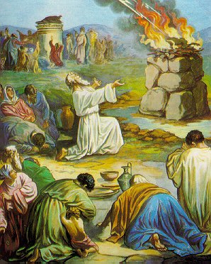
The Final Part of Elijah’s message
“And it came to pass, when midday was past, and they prophesied until the time of the offering of the evening sacrifice, that there was neither voice, nor any to answer, nor any that regarded. And Elijah said unto all the people, Come near unto me. And all the people came near unto him. And he repaired the altar of the LORD that was broken down. And Elijah took twelve stones, according to the number of the tribes of the sons of Jacob, unto whom the word of the LORD came, saying, Israel shall be thy name: And with the stones he built an altar in the name of the LORD: and he made a trench about the altar, as great as would contain two measures of seed.” 1 Kings 18:29-32

Slide 18
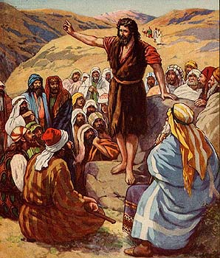
Restore the Sanctuary
The last part of Elijah’s message was not something he said as much as what he did. He restored the altar of sacrifice, showing reverence and awe for God’s instituted service of sacrifice as depicted by the altar of sacrifice in the courtyard in the sanctuary in Jerusalem. He restored respect to God’s temple service and rite.

Slide 19
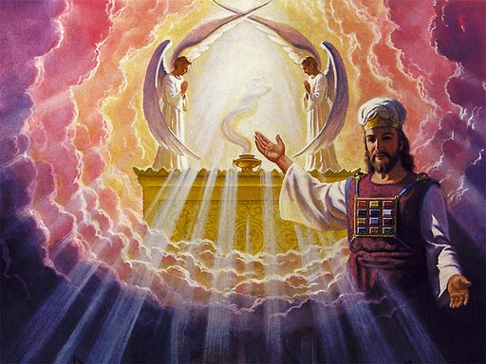
Elijah #2 and #3 did the Same!
John pointed people back to the sanctuary when he cried, “The next day John seeth Jesus coming unto him, and saith, Behold the Lamb of God, which taketh away the sin of the world.” Jn. 1:29 Both Elijah #1 and #2 pointed people to Christ in the sanctuary. Elijah #3 would do the same; however, Elijah #3 would point people to where Christ would be in the sanctuary at the end of time when Elijah #3 would appear!
Where in the sanctuary would that be?

Slide 20
The Elijah Message
1. They all have pointed their listeners back to obedience to all of God’s commandments.
2. They have all exalted the 7th day Sabbath.
3. They have demanded more of people than lip service Christianity.
4. They would point people to Christ in the sanctuary and restore its import among God’s people.
Someone would come before Christ’s 2nd Coming to proclaim these messages. Someone would come whose purpose would be “to make ready a people prepared for the Lord.” Luke 1:17
Someone HAS come………………………………………………………………………….

Slide 21

Ellen White is Elijah #3
Ellen White gave the Elijah message before the coming of the great and dreadful day of the Lord. She gave these messages to prepare a people for the Lord’s soon return.
We are called upon as God’s people today, as the Elijah people, to carry these messages to victory. What is our answer?

