Slide 1
7. Deceive/cover up. Do you lie to family, friends or others about how much you game, or try to keep your family or friends from knowing how much you game?
8. Escape adverse moods. Do you game to escape from or forget about personal problems, or to relieve uncomfortable feelings such as guilt, anxiety, helplessness or depression?
9. Risk/lose relationships/opportunities. Do you risk or lose significant relationships, or job, educational or career opportunities because of gaming?
—Petry, Nancy. et. al. 2014: An international consensus for assessing internet gaming disorder using the new DSM-5 approach

Slide 2
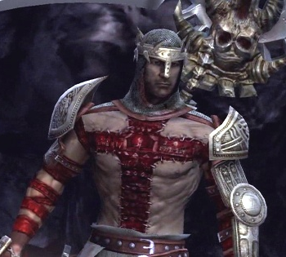
What About the Fruits???

Slide 3
Some Fruits Reveal the Plant…
1. Daniel Petric was convicted of murder at age 16 in 2007, when he shot both parents in the head, the father surviving, over Halo 3 in Wellington Ohio—Peckham, March 2009, PC World 27(3): 16
2. Zion Shockley shook, threw, and dropped infant daughter causing her death over interfering with video game—ABC 13 News, Feb. 26, 2018
3. Zhang Xiaoyi a 13 year old Chinese boy committed suicide in 2004 by jumping from a building, leaving behind a note that state he wanted “to join the heroes of the game he worshipped”—Fox News, Associated Press, May 12, 2006
“A 32-year-old man was found dead in an Internet cafe in Taiwan after a marathon three-day gaming binge, the island's second death of an online gamer this year.”—CNN, Hunt and Ng, Jan. 19, 2015

Slide 4
“David Katz, a 24-year-old gamer from Baltimore, Maryland, was in Jacksonville for the tournament at GLHF Game Bar, in the back of a pizza restaurant. On Sunday, he brought a gun into the venue and opened fire, killing two people. Then he turned the gun on himself”—Eric Levenson, AnneClaire Stapleton and Darran Simon, CNN Mon, August 27, 2018 “Mass shooting at Madden video game tournament”

Slide 5
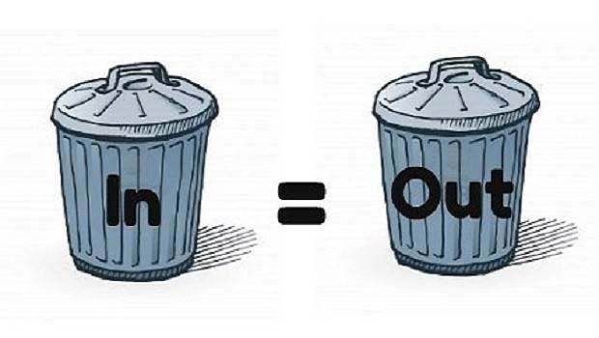
Garbage In/Garbage Out
1 Cor. 3:16-17 “Know ye not that ye are the temple of God, and that the Spirit of God dwelleth in you? If any man defile the temple of God, him shall God destroy; for the temple of God is holy, which temple ye are.”

Slide 6
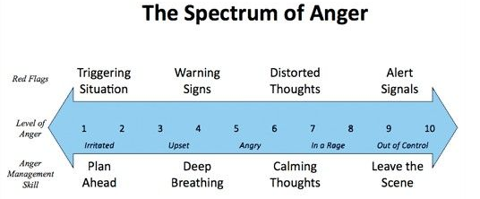
The Spectrum
2 Cor. 3:18 “But we all, with open face beholding as in a glass the glory of the Lord, are changed into the same image from glory to glory, even as by the Spirit of the Lord.”
Gal. 6:7-8 “Be not deceived; God is not mocked: for whatsoever a man soweth, that shall he also reap. For he that soweth to his flesh shall of the flesh reap corruption; but he that soweth to the Spirit shall of the Spirit reap life everlasting.

Slide 7
The Agenda…
Ps. 101:3 “I will set no wicked thing before mine eyes: I hate the work of them that turn aside; it shall not cleave to me.”
Rayman: Origins

Slide 8
Rom. 1:28-32 “And even as they did not like to retain God in their knowledge, God gave them over to a reprobate mind, to do those things which are not convenient; Being filled with all unrighteousness, fornication, wickedness, covetousness, maliciousness; full of envy, murder, debate, deceit, malignity; whisperers, Backbiters, haters of God, despiteful, proud, boasters, inventors of evil things, disobedient to parents, Without understanding, covenantbreakers, without natural affection, implacable, unmerciful:
Who knowing the judgment of God, that they which commit such things are worthy of death, not only do the same, but have pleasure in them that do them

Slide 9
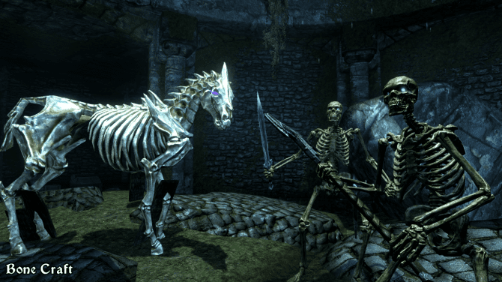

Slide 10
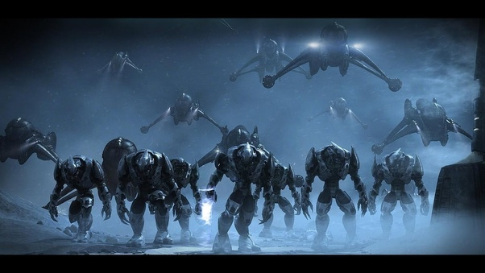
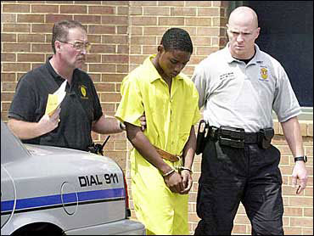
Life’s a video game. We all gotta die sometime—Devin Moore

Slide 11
Satanism in Video Games: Prophetic Alert

Slide 12
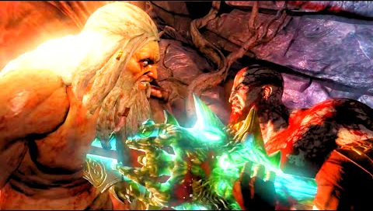
Would you play a video game about adultery? Theft from the poor? Carving and worshipping a graven image?
GEARS OF WAR

Slide 13
How will you spend your time??
Matt. 6:23 “If thine eye be evil, thy whole body shall be full of darkness. If therefore the light that is in thee be darkness, how great is that darkness!”
Rom. 12:2 “And be not conformed to this world: but be ye transformed by the renewing of your mind, that ye may prove what is that good, and acceptable, and perfect, will of God.”
Col. 4:5 “Walk in wisdom toward them that are without, redeeming the time”

