Slide 1
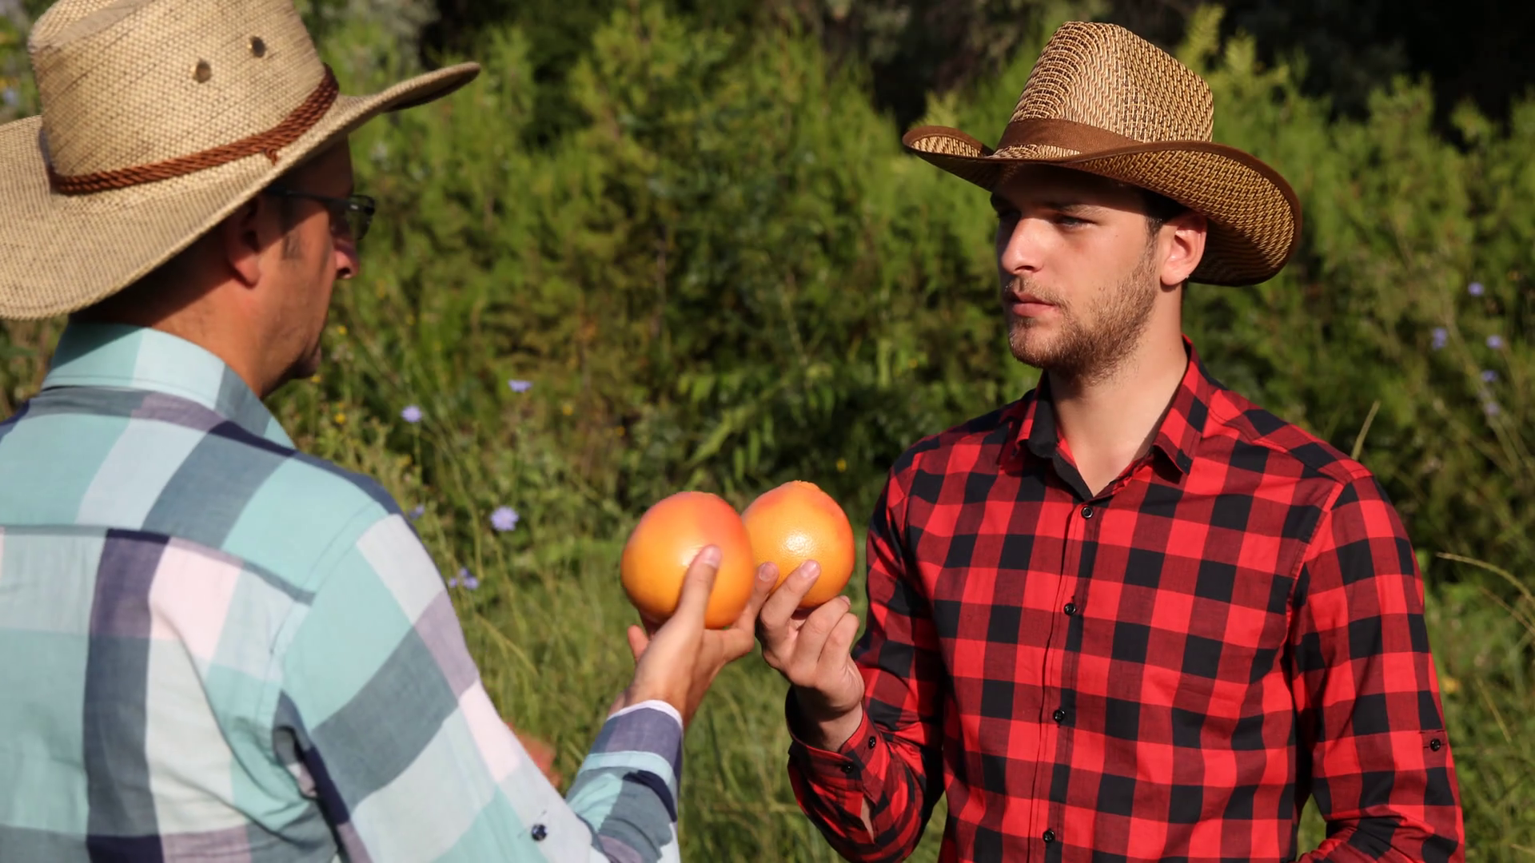

Slide 2
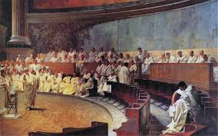
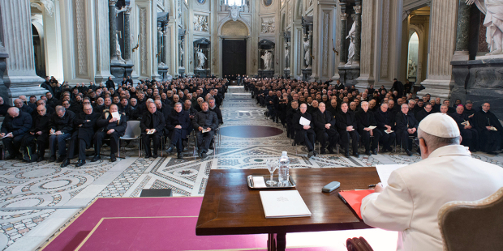
The Roman Senate
The Institutional Structure
The Cardinals/Curia
THE MORE THINGS CHANGE, THE MORE THEY STAY THE SAME!

Slide 3
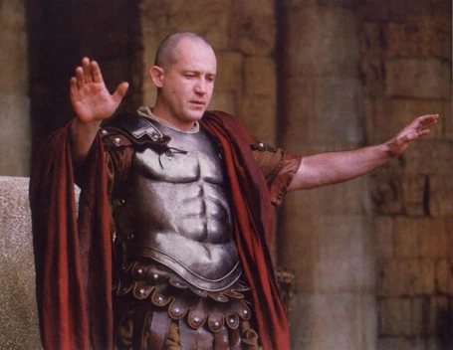
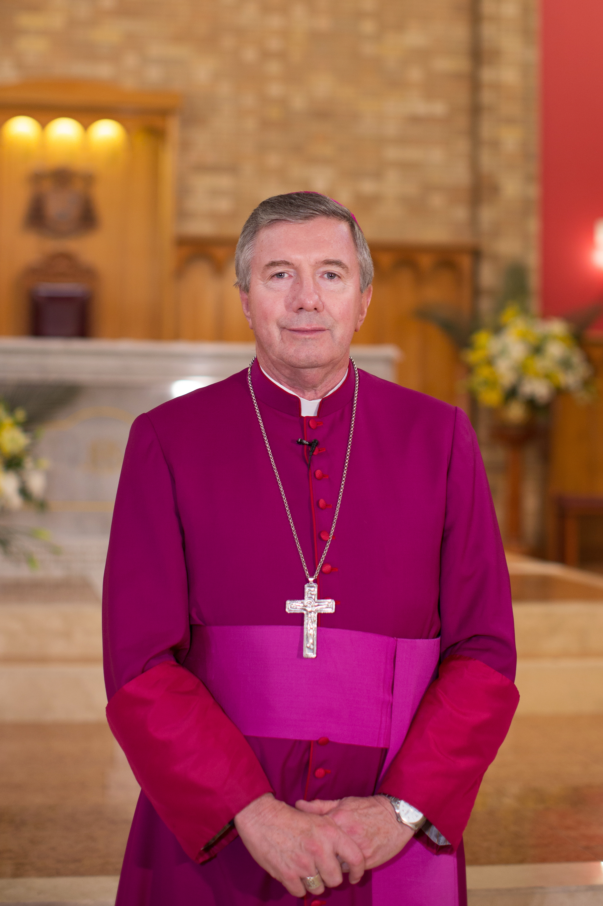
Roman Provincial Governors
Catholic Archbishops

Slide 4
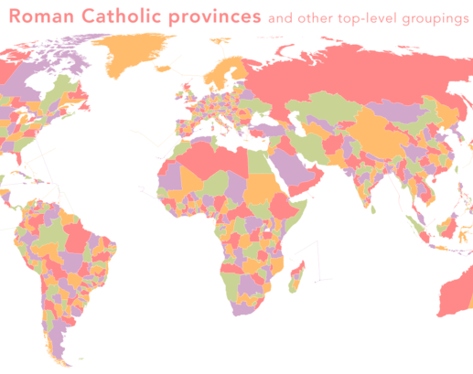
Roman Province
Archdiocese

Slide 5
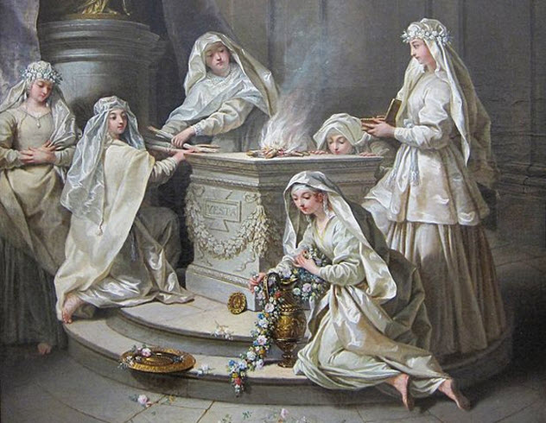
Vestal Virgins
“Vestal Virgins, in Roman religion, six priestesses, representing the daughters of the royal house, who tended the state cult of Vesta, the goddess of the hearth. The cult is believed to date to the 7th century bc; like other non-Christian cults, it was banned in ad 394 by Theodosius I. Chosen between the ages of 6 and 10 by the pontifex maximus”—Encyclopedia Britannica, “Vestal Virgins”

Slide 6
