Slide 1
A Conspiracy?!?
No Way
Bill Hughes

Slide 2
An Open Letter
From a pastor and church board in Silverton, OR “I recently received in the mail a book entitled ‘Enemy Unmasked’. At first, I thought it was mailed to a select few, but then I came to realize that it had a larger circulation... As pastor , I feel it my duty to tell the residents of Silverton that our church was not responsible in any way in the production or mailing of this material. Further, we do not approve of the contents of this volume…

Slide 3
A Conspiracy
“‘The Enemy Unmasked’, however, goes far beyond that to link many groups and individuals into a world-wide conspiracy that we do not believe is correct, and in fact, is very inflammatory and damaging to the efforts of Christian brotherhood and goodwill. I enjoy very much my fellowship with all Christian pastors and believers in my community, and I deeply regret that this book was printed and distributed anywhere. I believe it is harmful to the cause of Christ.

Slide 4
George Bush, 9-11, Conspiracy
United Nations on November 10, 2001, United States President George W. Bush denounced the emergence of "outrageous conspiracy theories ... that attempt to shift the blame away from the terrorists, themselves, away from the guilty." Later, as media exposure of conspiracy theories of the events of 9/11 increased, U.S. Government agencies and the Bush Administration issued responses to the theories, including a formal analysis by the National Institute of Standards and Technology (NIST) about the collapse of the World Trade Center,^{[11]} a revised 2006 State Department webpage to debunk the theories,^{[12]} and a strategy paper referred to by President Bush in an August 2006 speech, which declared that terrorism springs from "subcultures of conspiracy and misinformation," and that "terrorists recruit more effectively from populations whose information about the world is contaminated by falsehoods and corrupted by conspiracy theories.”

Slide 5
Conspiracy??
An agreement to perform together an illegal, wrongful, or subversive act.
2. A group of conspirators.
3. Law An agreement between two or more persons to commit a crime or accomplish a legal purpose through illegal action.
4. A joining or acting together, as if by sinister design:
a secret plan to carry out an illegal or harmful act
2. the act of making such plans
conspiracy - a secret agreement between two or more people to perform an unlawful act

Slide 6
A pastor and former President
A pastor and board don’t like the idea of an international conspiracy. Former president George Bush denounced conspiracy theorists after 9-11. Again, a conspiracy is the joining together of 2 or more groups in a secret agreement to carry out sinister and evil actions toward groups of people. Is there any possible evidence of an international conspiracy? Where would we go to decide what is true: is it the pastor and church board and former president George Bush or is it the book ‘Enemy Unmasked’? Who is telling the truth?

Slide 7
The Sure Word of Prophecy
“We have also a more sure word of prophecy; whereunto ye do well that ye take heed, as unto a light that shineth in a dark place, until the day dawn, and the day star arise in your hearts:” 2 Peter 1:19

Slide 8
Who is Right? How Can We Know?
““And there came one of the seven angels which had the seven vials, and talked with me, saying unto me, Come hither; I will shew unto thee the judgment of the great whore that sitteth upon many waters: With whom the kings of the earth have committed fornication, and the inhabitants of the earth have been made drunk with the wine of her fornication. So he carried me away in the spirit into the wilderness: and I saw a woman sit upon a scarlet coloured beast, full of names of blasphemy, having seven heads and ten horns.” Rev. 17:1-3

Slide 9
An Evil Woman In The Wilderness
The wilderness is where the good woman of Revelation 12 fled during the Dark Ages.
“And the woman fled into the wilderness, where she hath a place prepared of God, that they should feed her there a thousand two hundred and threescore days.”… “And to the woman were given two wings of a great eagle, that she might fly into the wilderness, into her place, where she is nourished for a time, and times, and half a time, from the face of the serpent.” Rev. 12:6,14

Slide 10
The Wilderness
Where did the true church go for 1,260 years?
“Persecution opened upon the faithful with greater fury than ever before, and the world became a vast battlefield. For hundreds of years the church of Christ found refuge in seclusion and obscurity. Thus says the prophet: "The woman fled into the wilderness, where she hath a place prepared of God, that they should feed her there a thousand two hundred and three-score days." Revelation 12:6. The accession of the Roman Church to power marked the beginning of the Dark Ages.” GC. Pg. 54,55 John saw the papacy in seclusion and obscurity. When did the papacy and her evil deeds go behind the scenes?

Slide 11
1798
Since 1798, Rome has been using others to do her dirty work and she shows a new face to the world. “The Roman Church now presents a fair front to the world, covering with apologies her record of horrible cruelties. She has clothed herself in Christ-like garments; but she is unchanged. Every principle of the papacy that existed in past ages exists today. The doctrines devised in the darkest ages are still held. Let none deceive themselves. The papacy that Protestants are now so ready to honor is the same that ruled the world in the days of the Reformation, when men of God stood up, at the peril of their lives, to expose her iniquity. She possesses the same pride and arrogant assumption that lorded it over kings and princes, and claimed the prerogatives of God. Her spirit is no less cruel and despotic now than when she crushed out human liberty and slew the saints of the Most High.” GC. Pg. 571

Slide 12
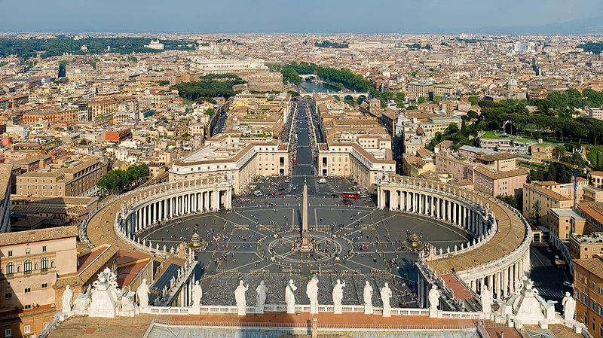
A Conspiracy?
“conspiracy - a secret agreement between two or more people to perform an unlawful act.” Is the papacy working with anyone in the world today to bring about her tyrannical plans to regain control of the earth?

Slide 13
A Conspiracy? Well?
The papacy uses the political leaders of earth to do her bidding. Do these leaders come right out and tell you so? They do not, but nevertheless, they are in cahoots with Rome and do what she wants. We already have a conspiracy… two or more groups working secretly together to some sinister end. Since George Bush was a king of the earth, was he lying because he was/is a part of this conspiracy?
“With whom the kings of the earth have committed fornication.”
Rev. 17:2
“And the woman which thou sawest is that great city which reigneth over the kings of the earth.”
Rev.17:18

Slide 14
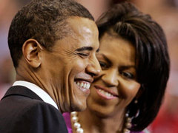
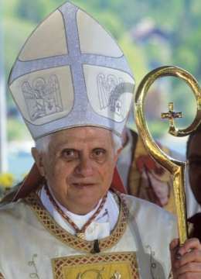
Hand in Hand

Slide 15
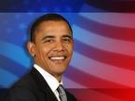
Romish Influence
“Yes, President Barack Obama is absolutely right—change is coming! Especially when we consider that many of his appointees are Jesuit-trained. For example, Obama's Chief Speechwriter, Jon Favreau, was Jesuit-trained; Obama's Senior Military and Foreign Policy Advisor, Major General J. Scott Gration, was Jesuit-trained; Obama's Deputy Communications Director, Dan Pfeiffer, was…

Slide 16
Hold On
Jesuit-trained; Obama’s Chicago mentor is Gregory Galluzzo, a “former” Jesuit priest and National Director and co-founder of the Gamaliel Foundation—a community organizing network representing more than a million multi-faith, church-going people who work on campaigns for social justice guided by an extreme, anti-American ideology; and former congressman Leon Panetta, who graduated from Santa Clara University—a comprehensive Jesuit, Catholic university, as head of the Central Intelligence Agency (CIA). Fasten your seatbelts!” D. Vierra’s, The Final Inquisition, pg. 27

Slide 17
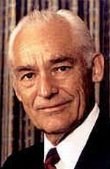
The Conspiracy Runs Deeper than that
Revelation 18 : 11-15
“And the merchants of the earth shall weep and mourn over her; for no man buyeth their merchandise any more: The merchandise of gold, and silver, and precious stones, and of pearls, and fine linen, and purple, and silk, and scarlet, and all thine wood, and all manner vessels of ivory, and all manner vessels of most precious wood, and of brass, and iron, and marble, And cinnamon, and odors, and ointments, and frankincense, and wine, and oil, and fine flour, and wheat, and beasts, and sheep, and horses, and chariots, and slaves, and souls of men. And the fruits that thy soul lusted after are departed from thee, and all things which were dainty and goodly are departed from thee, and thou shalt find them no more at all. The merchants of these things, which were made rich by her, shall stand afar off for the fear of her torment, weeping and wailing,”

Slide 18
Do We Have A Conspiracy Yet?
“ ‘The Enemy Unmasked’,… is very inflammatory and damaging to the efforts of Christian brotherhood and goodwill. I enjoy very much my fellowship with all Christian pastors and believers in my community, …I believe it is harmful to the cause of Christ.”
Do these churches have anything to do with the conspiracy?
Revelation 17:5
“And on her forehead was a name written, ‘Mystery, Babylon the Great, the Mother of harlots and abominations of the earth.”

Slide 19
Since 1982!
Since January of 1982, a document was signed by all major churches throughout the world. This took place in Lima, Peru. The document that resulted is called ‘Baptism, Eucharist, and Ministry.’ All who signed it agree in
1. infant baptism.
2. That the priest has the power to turn the bread into the actual body of Christ.
3. No proselytizing of other church members.

Slide 20
Together

Slide 21
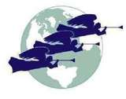
Before and After

Slide 22
Bold Face Liars
1. There is a conspiracy.
2. There are four groups united together to achieve a sinister end.
3. The groups are the papacy, the political leaders of earth, the business people of earth, and the churches of earth.
George Bush had every reason to lie when he said there was no conspiracy.
The pastor in Silverton, OR lied as well to cover his church’s involvement in this international conspiracy. Are we leaning toward ecumenism and Rome, or walking in harmony with Adventism’s historic messages? Where are we standing today?

