Slide 1
Final Scenes, pt. 9
The Gift

Slide 2
A Thoughtful Hour
“It would be well for us to spend a thoughtful hour each day in contemplation of the life of Christ. We should take it point by point, and let the imagination grasp each scene, especially the closing ones. As we thus dwell upon His great sacrifice for us, our confidence in Him will be more constant, our love will be quickened, and we shall be more deeply imbued with His spirit. If we would be saved at last, we must learn the lesson of penitence and humiliation at the foot of the cross.” Desire of Ages, pg. 83

Slide 3
He Could See
Jesus knew what was coming. He saw the stakes, the crosses, the dungeons, the sacrifices ahead for His disciples through all time. He wanted, He longed to give them the greatest gift He could that would help His babes in all times of trouble. He promised them the gift of the Spirit!

Slide 4
He would be There!
“Jesus read the future of His disciples. He saw one brought to the scaffold, one to the cross, one to exile among the lonely rocks of the sea, others to persecution and death. He encouraged them with the promise that in every trial He would be with them. That promise has lost none of its force. The Lord knows all about His faithful servants who for His sake are lying in prison or who are banished to lonely islands. He comforts them with His own presence. When for the truth's sake the believer stands at the bar of unrighteous tribunals, Christ stands by his side…When one is incarcerated in prison walls, Christ ravishes the heart with His love…

Slide 5
When one suffers death for His sake, Christ says, "I am He that liveth, and was dead; and, behold, I am alive forevermore, . . . and have the keys of hell and of death." Rev. 1:18. The life that is sacrificed for Me is preserved unto eternal glory. At all times and in all places, in all sorrows and in all afflictions, when the outlook seems dark and the future perplexing, and we feel helpless and alone, the Comforter will be sent in answer to the prayer of faith. Circumstances may separate us from every earthly friend; but no circumstance, no distance, can separate us from the heavenly Comforter. Wherever we are, wherever we may go, He is always at our right hand to support, sustain, uphold, and cheer.” DA, pgs. 669,670

Slide 6
The spirit
“And I will pray the Father, and he shall give you another Comforter, that he may abide with you for ever; Even the Spirit of truth; whom the world cannot receive, because it seeth him not, neither knoweth him: but ye know him; for he dwelleth with you, and shall be in you. I will not leave you comfortless: I will come to you.” Jn. 14:16-18

Slide 7
Christ’s Final Day
Before offering Himself as the sacrificial victim, Christ sought for the most essential and complete gift to bestow upon His followers, a gift that would bring within their reach the boundless resources of grace. "I will pray the Father," He said, "and He shall give you another Comforter, that He may abide with you forever; even the Spirit of truth; whom the world cannot receive, because it seeth Him not, neither knoweth Him: but ye know Him; for He dwelleth with you, and shall be in you. I will not leave you orphans: I will come to you." John 14:16-18, margin. Before this the Spirit had been in the world; from the very beginning of the work of redemption He had been moving upon men's hearts. But while Christ was on earth, the disciples had desired no other helper. Not until they were deprived of His presence would they feel their need of the Spirit, and then He would come.” DA, pgs. 668,669

Slide 8
Comforter and Teacher
”These things have I spoken unto you, being yet present with you. But the Comforter, which is the Holy Ghost, whom the Father will send in my name, he shall teach you all things, and bring all things to your remembrance, whatsoever I have said unto you. Peace I leave with you, my peace I give unto you: not as the world giveth, give I unto you. Let not your heart be troubled, neither let it be afraid.” Jn. 14:25-27

Slide 9
First, the Holy Spirit would come and bring comfort; the assurance of God’s love. Then, He comes to teach, to guide us into all truth.
“No one could then have any advantage because of his location or his personal contact with Christ. By the Spirit the Saviour would be accessible to all. In this sense He would be nearer to them than if He had not ascended on high.” DA, pg. 669

Slide 10
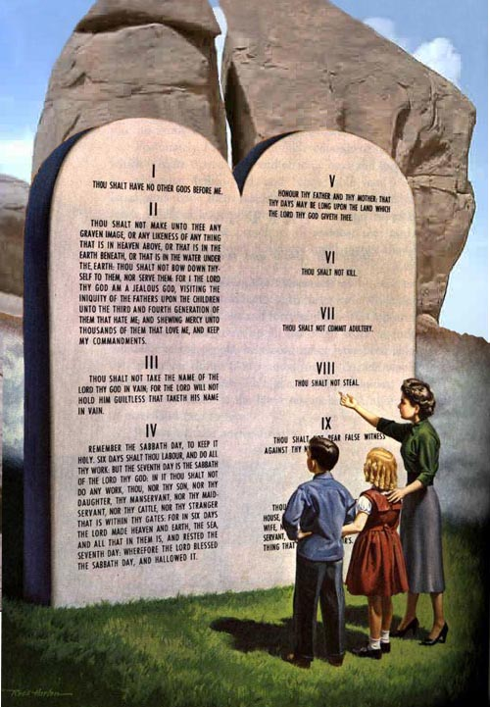
Holy Spirit’s Work
”And when he is come, he will reprove the world of sin, and of righteousness, and of judgment: Of sin, because they believe not on me; Of righteousness, because I go to my Father, and ye see me no more; Of judgment, because the prince of this world is judged.” Jn. 16:8-11

Slide 11
Holy Spirit and Law go Together
The Holy Spirit points out sin to people. Because “sin is the transgression of the law.” 1 John 3:4, and the Holy Spirit points out sin, the two work together. The Holy Spirit exalts the law of God, shows people their sin, and directs them to Christ “that we might be justified by faith.” Gal. 3:24

Slide 12
Exalts the Truth/Law
When someone claims to exalt the Holy Spirit, but rejects the 10 commandments, they really are listening to a different spirit. “To the law and to the testimony: if they speak not according to this word, it is because there is no light in them.” Isaiah 8:20
“There is comfort and peace in the truth, but no real peace or comfort can be found in falsehood. It is through false theories and traditions that Satan gains his power over the mind. By directing men to false standards, he misshapes the character. Through the Scriptures the Holy Spirit speaks to the mind, and impresses truth upon the heart. Thus He exposes error, and expels it from the soul. It is by the Spirit of truth, working through the word of God, that Christ subdues His chosen people to Himself.” DA, pg. 671

Slide 13
Empowers to Keep
“In describing to His disciples the office work of the Holy Spirit, Jesus sought to inspire them with the joy and hope that inspired His own heart. He rejoiced because of the abundant help He had provided for His church. The Holy Spirit was the highest of all gifts that He could solicit from His Father for the exaltation of His people. The Spirit was to be given as a regenerating agent, and without this the sacrifice of Christ would have been of no avail. The power of evil had been strengthening for centuries, and the submission of men to this satanic captivity was amazing. Sin could be resisted and overcome only through the mighty agency of the Third Person of the Godhead, who would come with no modified energy, but in the fullness of divine power. It is the Spirit that makes effectual what has been wrought out by the world's Redeemer. It is by the Spirit that the heart is made pure. Through the Spirit the believer becomes a partaker of the divine nature. Christ has given His Spirit as a divine power to overcome all hereditary and cultivated tendencies to evil, and to impress His own character upon His church.” DA, pg. 671

Slide 14
Rushing Mighty Wind
“So shall they fear the name of the LORD from the west, and his glory from the rising of the sun. When the enemy shall come in like a flood, the Spirit of the LORD shall lift up a standard against him.” Isa. 59:19
“And I will put my spirit within you, and cause you to walk in my statutes, and ye shall keep my judgments, and do them.” Ezek. 36:27

Slide 15
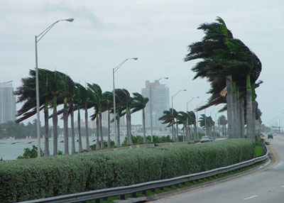
The Holy Spirit-A Person
“Sin could be resisted and overcome only through the mighty agency of the Third Person of the Godhead, who would come with no modified energy, but in the fullness of divine power.” DA, pg. 671
Throughout John 16, the Holy Spirit is referred to as ‘He’. He is a personal pronoun that refers to a real person.

Slide 16
Unstoppable Power
“So mightily can God work when men give themselves up to the control of His Spirit.
The promise of the Holy Spirit is not limited to any age or to any race. Christ declared that the divine influence of His Spirit was to be with His followers unto the end. From the Day of Pentecost to the present time, the Comforter has been sent to all who have yielded themselves fully to the Lord and to His service. To all who have accepted Christ as a personal Saviour, the Holy Spirit has come as a counselor, sanctifier, guide, and witness. The more closely believers have walked with God, the more clearly and powerfully have they testified of their Redeemer's love and of His saving grace. The men and women who through the long centuries of persecution and trial enjoyed a large measure of the presence of the Spirit in their lives, have stood as signs and wonders in the world. Before angels and men they have revealed the transforming power of redeeming love.” AA, pg. 49

Slide 17
Be Careful
“It is not essential for us to be able to define just what the Holy Spirit is. Christ tells us that the Spirit is the Comforter, "the Spirit of truth, which proceedeth from the Father." It is plainly declared regarding the Holy Spirit that, in His work of guiding men into all truth, "He shall not speak of Himself." John 15:26; 16:13. The nature of the Holy Spirit is a mystery. Men cannot explain it, because the Lord has not revealed it to them. Men having fanciful views may bring together passages of Scripture and put a human construction on them, but the acceptance of these views will not strengthen the church. Regarding such mysteries, which are too deep for human understanding, silence is golden.” AA, pgs. 51,52

