Slide 1

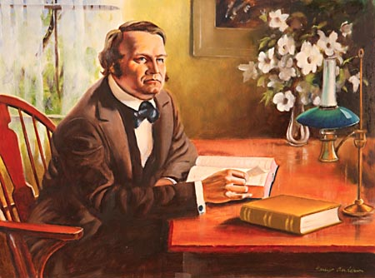
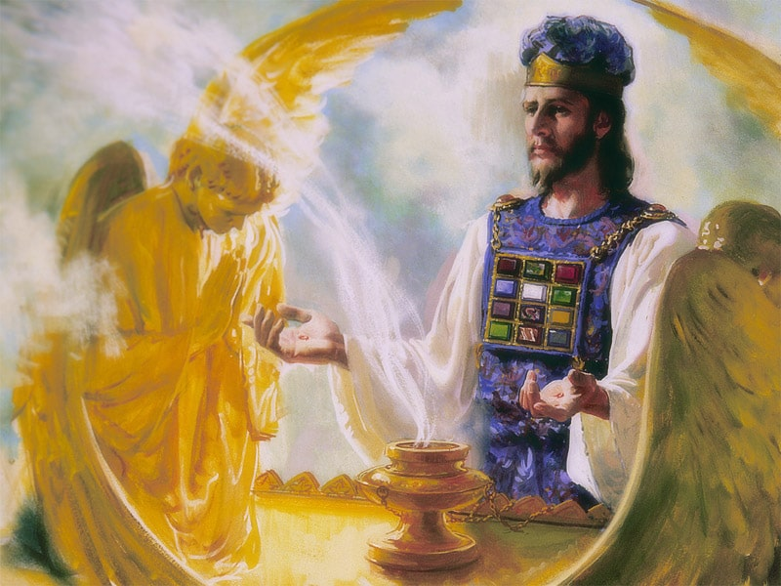
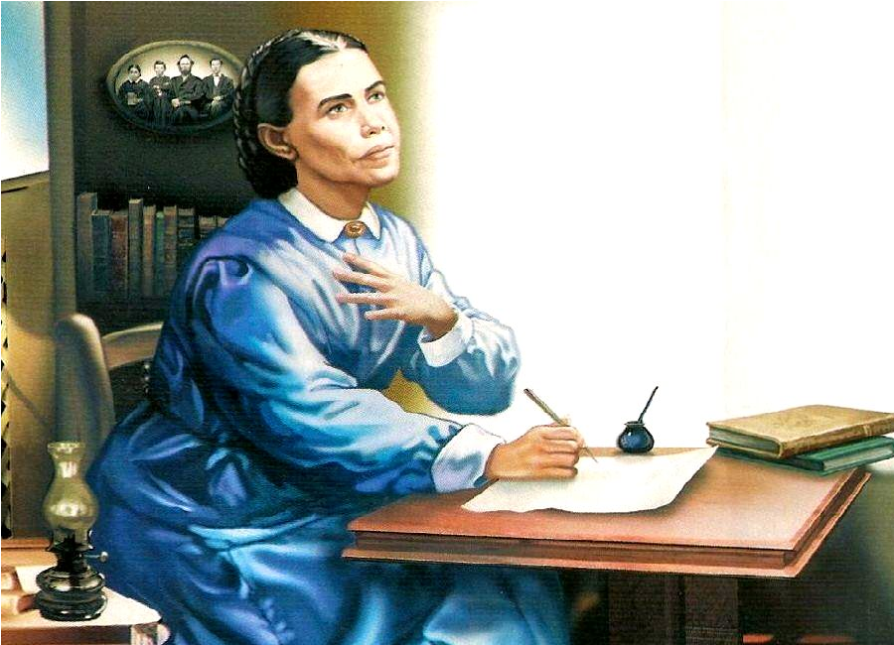
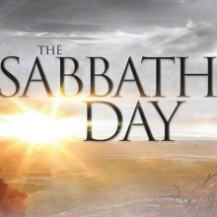
The 2300 Days

Slide 2
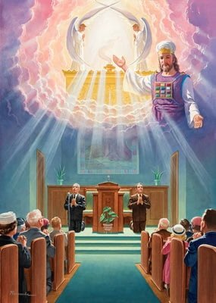
The Foundation of our Faith
“The correct understanding of the ministration in the heavenly sanctuary is the foundation of our faith”—Ellen White, Evangelism, p. 221
Ps. 77:13 “Thy way, O God, is in the sanctuary: who is so great a God as our God?”

Slide 3
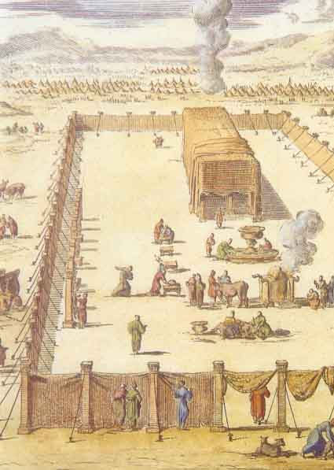
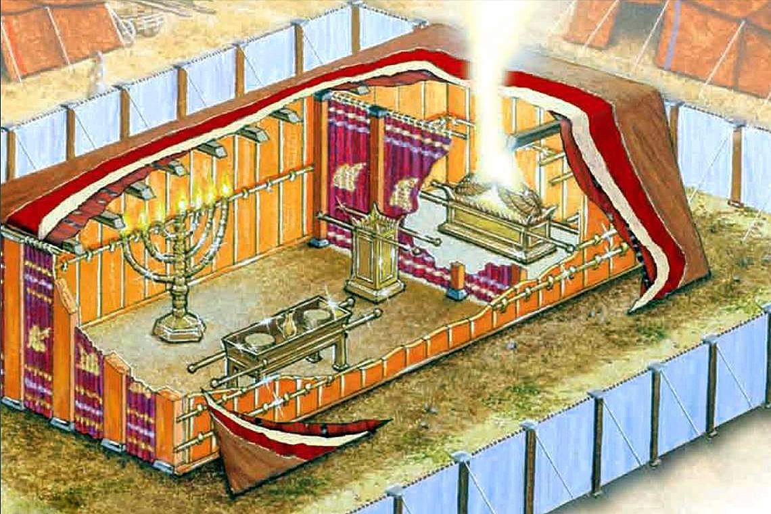
Daniel 8 Revisited…
Dan. 8:11-14 “Yea, he magnified himself even to the prince of the host, and by him the daily sacrifice was taken away, and the place of the sanctuary was cast down. And an host was given him against the daily sacrifice by reason of transgression, and it cast down the truth to the ground; and it practised, and prospered. Then I heard one saint speaking, and another saint said unto that certain saint which spake, How long shall be the vision concerning the daily sacrifice, and the transgression of desolation, to give both the sanctuary and the host to be trodden under foot? And he said unto me, Unto two thousand and three hundred days; then shall the sanctuary be cleansed.”

Slide 4
Separation Between the Law of God and Moses
-Ex. 31:18 “And he gave unto Moses, when he had made an end of communing with him upon mount Sinai, two tables of testimony, tables of stone, written with the finger of God.”
-Deut. 10:1-2 “At that time the Lord said unto me, Hew thee two tables of stone like unto the first, and come up unto me into the mount, and make thee an ark of wood. And I will write on the tables the words that were in the first tables which thou brakest, and thou shalt put them in the ark.”
-Deut. 31:24-26 “And it came to pass, when Moses had made an end of writing the words of this law in a book, until they were finished, That Moses commanded the Levites, which bare the ark of the covenant of the Lord, saying, Take this book of the law, and put it in the side of the ark of the covenant of the Lord your God, that it may be there for a witness against thee.”

Slide 5
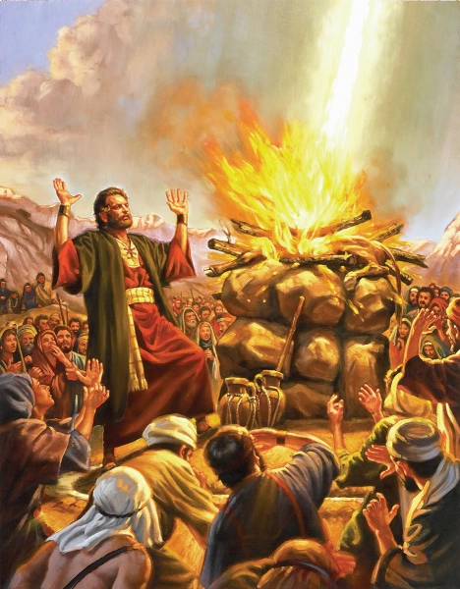
Elijah and the Restoration
Mal. 4:5 “Behold, I will send you Elijah the prophet before the coming of the great and dreadful day of the Lord”

Slide 6
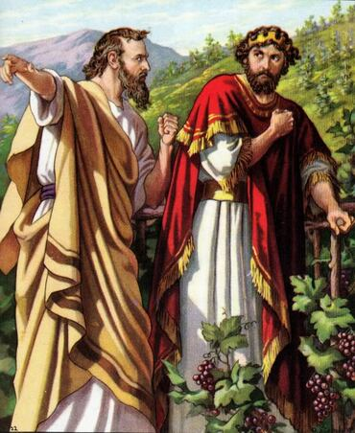
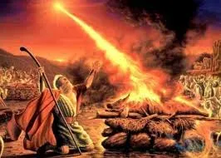
Elijah’s Works and Message
1 Kings 18:17-21 “And it came to pass, when Ahab saw Elijah, that Ahab said unto him, Art thou he that troubleth Israel? And he answered, [1] I have not troubled Israel; but thou, and thy father's house, in that ye have forsaken the commandments of the Lord, and thou hast followed Baalim. Now therefore send, and gather to me all Israel unto mount Carmel, and the prophets of Baal four hundred and fifty, and the prophets of the groves four hundred, which eat at Jezebel's table. So Ahab sent unto all the children of Israel, and gathered the prophets together unto mount Carmel. And Elijah came unto all the people, and said, [2] How long halt ye between two opinions? if the Lord be God, follow him: but if Baal, then follow him. And the people answered him not a word.”

Slide 7
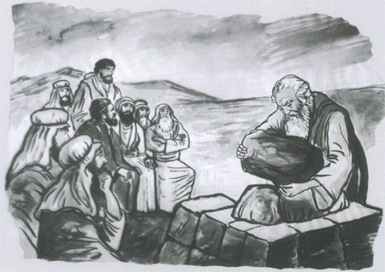
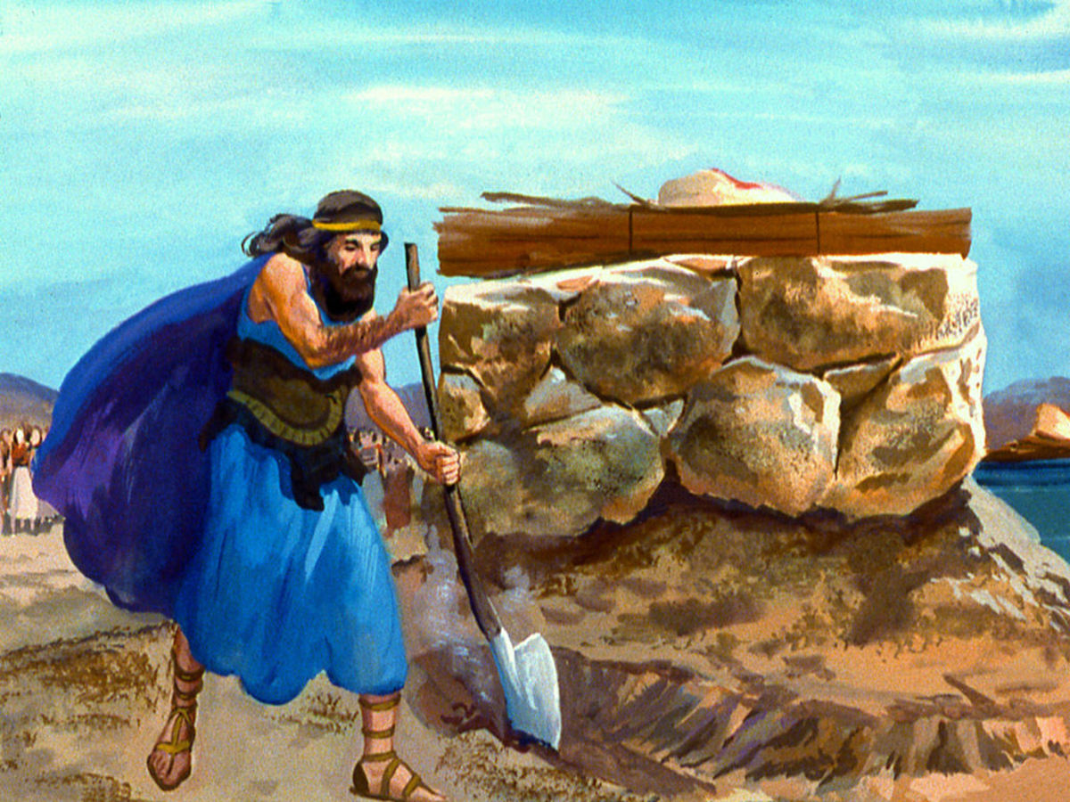
Elijah Restores the Sanctuary???
1 Kings 18:29-32 “And it came to pass, when midday was past, and they prophesied until the time of the offering of the evening sacrifice, that there was neither voice, nor any to answer, nor any that regarded. And Elijah said unto all the people, Come near unto me. And all the people came near unto him. [3] And he repaired the altar of the Lord that was broken down. And Elijah took twelve stones, according to the number of the tribes of the sons of Jacob, unto whom the word of the Lord came, saying, Israel shall be thy name: And with the stones he built an altar in the name of the Lord: and he made a trench about the altar, as great as would contain two measures of seed.”

Slide 8
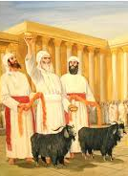
When Was the Sanctuary “Cleansed”?
Lev. 16:15-18 “Then shall he kill the goat of the sin offering, that is for the people, and bring his blood within the vail, and do with that blood as he did with the blood of the bullock, and sprinkle it upon the mercy seat, and before the mercy seat: And he shall make an atonement for the holy place, because of the uncleanness of the children of Israel, and because of their transgressions in all their sins: and so shall he do for the tabernacle of the congregation, that remaineth among them in the midst of their uncleanness. And there shall be no man in the tabernacle of the congregation when he goeth in to make an atonement in the holy place, until he come out, and have made an atonement for himself, and for his household, and for all the congregation of Israel. And he shall go out unto the altar that is before the Lord, and make an atonement for it; and shall take of the blood of the bullock, and of the blood of the goat, and put it upon the horns of the altar round about.”

Slide 9
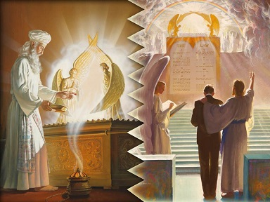
“And Cleanse it”
Lev. 16:19-21 “And he shall sprinkle of the blood upon it with his finger seven times, and cleanse it, and hallow it from the uncleanness of the children of Israel. And when he hath made an end of reconciling the holy place, and the tabernacle of the congregation, and the altar, he shall bring the live goat: And Aaron shall lay both his hands upon the head of the live goat, and confess over him all the iniquities of the children of Israel, and all their transgressions in all their sins, putting them upon the head of the goat, and shall send him away by the hand of a fit man into the wilderness:”

Slide 10
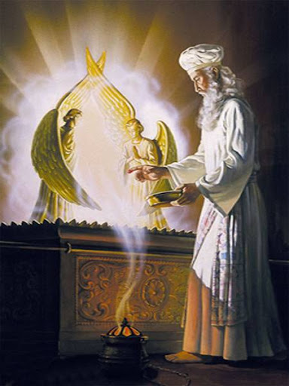
A “Judgment” Was Made???
Lev. 23: 27-29 “Also on the tenth day of this seventh month there shall be a day of atonement: it shall be an holy convocation unto you; and ye shall afflict your souls, and offer an offering made by fire unto the Lord. And ye shall do no work in that same day: for it is a day of atonement, to make an atonement for you before the Lord your God. For whatsoever soul it be that shall not be afflicted in that same day, he shall be cut off from among his people.”
Ex. 25:22 “And there I will meet with thee, and I will commune with thee from above the mercy seat, from between the two cherubims which are upon the ark of the testimony, of all things which I will give thee in commandment unto the children of Israel.

Slide 11
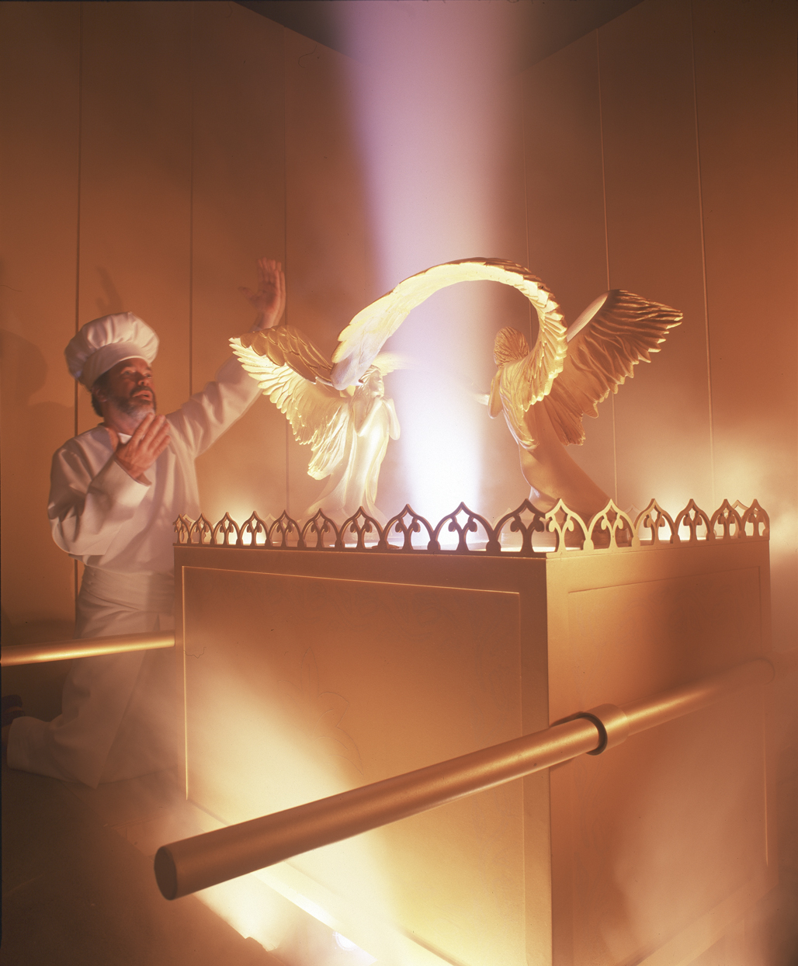
The Day of Atonement – A Time of Judgment!
“Above the mercy seat was the Shekinah, the manifestation of the divine Presence; and from between the cherubim, God made known His will. Divine messages were sometimes communicated to the high priest by a voice from the cloud. Sometimes a light fell upon the angel at the right, to signify approval or acceptance, or a shadow or cloud rested upon the one at the left to reveal disapproval or rejection” PP, 349

Slide 12
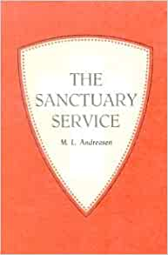
The Jewish Encyclopedia Explains… The Investigative Judgment???
“God, seated on His throne to judge the world, at the same time Judge, Pleader, Expert, and Witness, openeth the Book of Records; it is read, every man’s signature being found therein. The great trumpet is sounded; a still, small voice is heard; the angels shudder, saying, this is the day of judgment: for His very ministers are not pure before God. As a shepherd mustereth his flock, causing them to pass under his rod, so doth God cause every living soul to pass before Him to fix the limit of every creature’s life and to foreordain its destiny. On New Year’s Day the decree is written; on the Day of Atonement it is sealed who shall live and who are to die, etc. But penitence, prayer, and charity may avert the evil decree.”—Jewish Encyclopedia, “Atonement, Day of”, vol.2, p. 286

Slide 13
“Afflict Your Souls” Meant…
Afflict: 6031 anah (an-naw’): afflict, humble, force, exercised, sin, troubled, weakened, 1) to be occupied, be busied with 2) to afflict, oppress, humble, be afflicted, be bowed down 1) to be put down, become low 2) to be depressed, be downcast
Soul: 5315 nephesh (neh’-fesh): soul, self, life, creature, person, appetite, mind, living being, desire, emotion, passion 1a) that which breathes, the breathing substance or being, soul, the inner being of man 1b) living being 1c) living being (with life in the blood) 1d) the man himself, self, person or individual 1e) the seat of the appetites 1f) seat of emotions and passions 1g) activity of the mind
“To humble/afflict/bowdown yourself/mind/heart/appetite/passion to the will of God.”

Slide 14
Modern Day “Affliction of the Soul”
“I saw some, with strong faith and agonizing cries, pleading with God. Their countenances were pale and marked with deep anxiety, expressive of their internal struggle. Firmness and great earnestness was expressed in their countenances; large drops of perspiration fell from their foreheads. Now and then their faces would light up with the marks of God’s approbation, and again the same solemn, earnest, anxious look would settle upon them. Evil angels crowded around, pressing darkness upon them to shut out Jesus from their view, that their eyes might be drawn to the darkness that surrounded them, and thus they be led to distrust God and murmur against Him. Their only safety was in keeping their eyes directed upward. Angels of God had charge over His people, and as the poisonous atmosphere of evil angels was pressed around these anxious ones, the heavenly angels were continually wafting their wings over them to scatter the thick darkness. As the praying ones continued their earnest cries, at times a ray of light from Jesus came to them, to encourage their hearts and light up their countenances. Some, I saw, did not participate in this work of agonizing and pleading. They seemed indifferent and careless. They were not resisting the darkness around them, and it shut them in like a thick cloud. The angels of God left these and went to the aid of the earnest, praying ones. I saw angels of God hasten to the assistance of all who were struggling with all their power to resist the evil angels and trying to help themselves by calling upon God with perseverance. But His angels left those who made no effort to help themselves, and I lost sight of them.” EW, 269-270

Slide 15
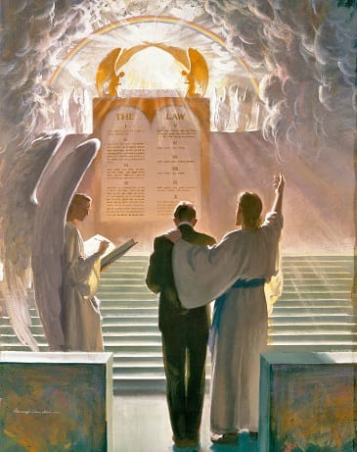
There’s An Investigation and a Judgment Coming…
Ps. 73:8-17 “They are corrupt, and speak wickedly concerning oppression: they speak loftily. They set their mouth against the heavens, and their tongue walketh through the earth. Therefore his people return hither: and waters of a full cup are wrung out to them. And they say, How doth God know? and is there knowledge in the most High? Behold, these are the ungodly, who prosper in the world; they increase in riches. Verily I have cleansed my heart in vain, and washed my hands in innocency. For all the day long have I been plagued, and chastened every morning. If I say, I will speak thus; behold, I should offend against the generation of thy children. When I thought to know this, it was too painful for me; Until I went into the sanctuary of God; then understood I their end.”

Slide 16
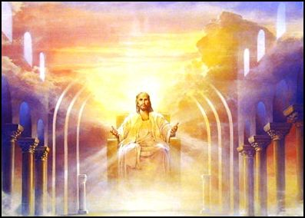
Before the Judgment Seat of Christ
2 Cor. 5:10 “For we must all appear before the judgment seat of Christ; that every one may receive the things done in his body, according to that he hath done, whether it be good or bad.”

Slide 17
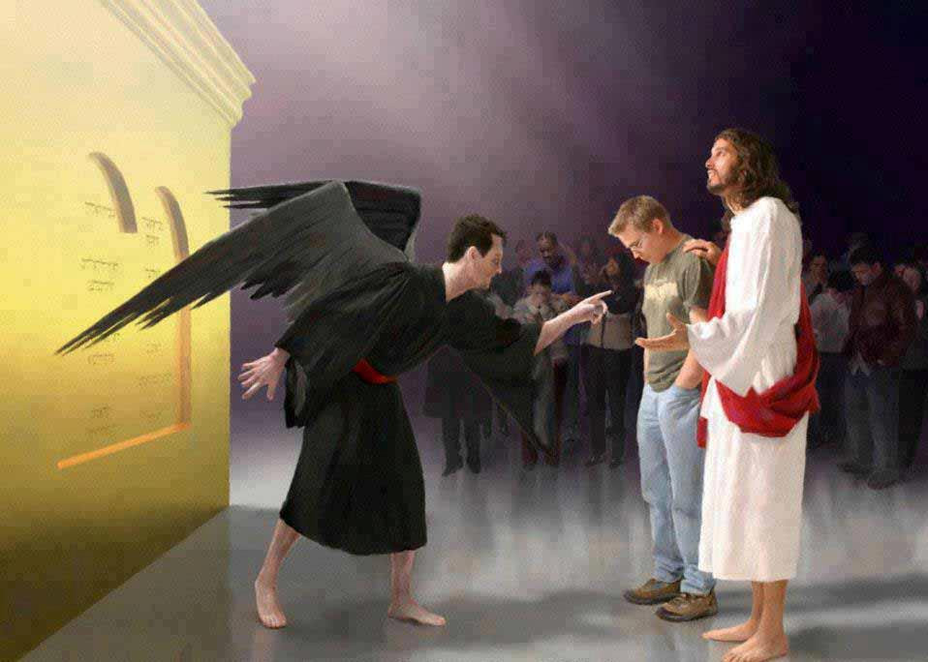
What the Tribunal Looks Like…
Zech. 3:1-4 “And he shewed me Joshua the high priest standing before the angel of the Lord, and Satan standing at his right hand to resist him. And the Lord said unto Satan, The Lord rebuke thee, O Satan; even the Lord that hath chosen Jerusalem rebuke thee: is not this a brand plucked out of the fire? Now Joshua was clothed with filthy garments, and stood before the angel. And he answered and spake unto those that stood before him, saying, Take away the filthy garments from him. And unto him he said, Behold, I have caused thine iniquity to pass from thee, and I will clothe thee with change of raiment.”

Slide 18
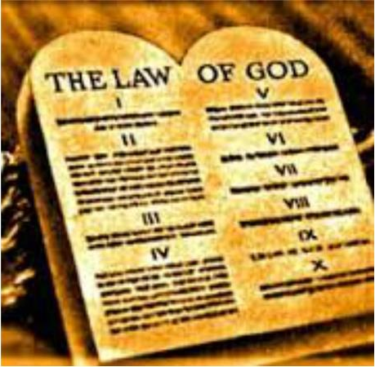
Mrs. White Sheds Some Light on Judgment Scene
“Every man's work passes in review before God and is registered for faithfulness or unfaithfulness. Opposite each name in the books of heaven is entered with terrible exactness every wrong word, every selfish act, every unfulfilled duty, and every secret sin, with every artful dissembling. Heaven-sent warnings or reproofs neglected, wasted moments, unimproved opportunities, the influence exerted for good or for evil, with its far-reaching results, all are chronicled by the recording angel. The law of God is the standard by which the characters and the lives of men will be tested in the judgment.” GC, 482

Slide 19
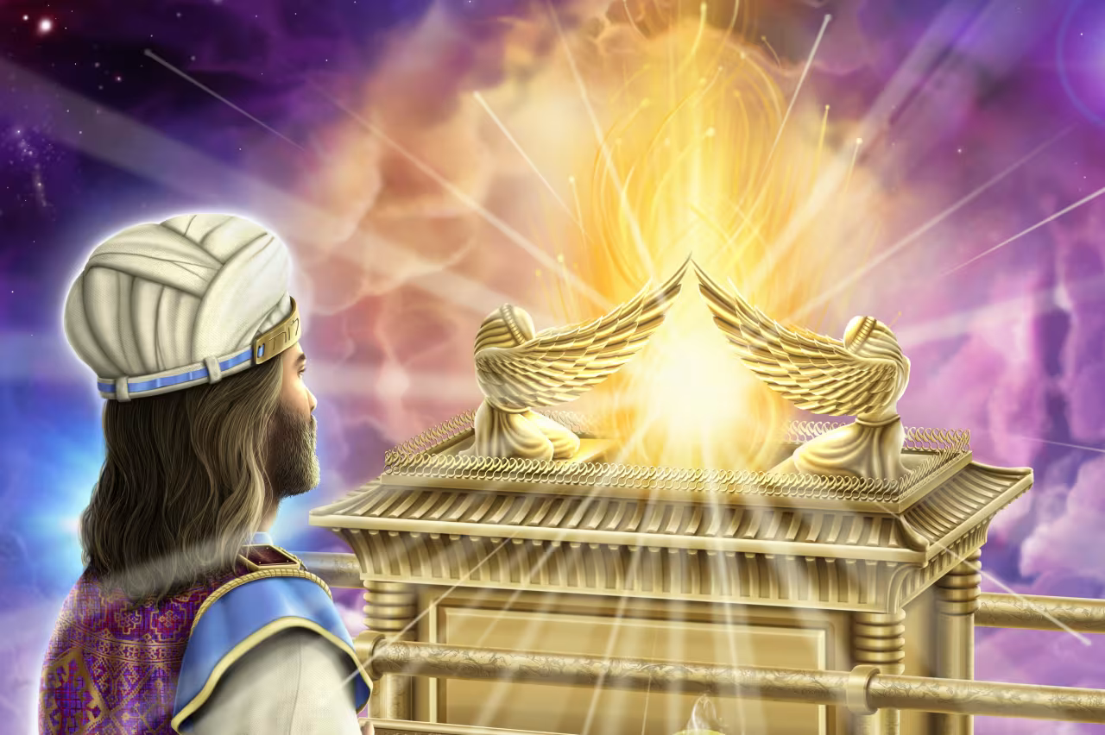
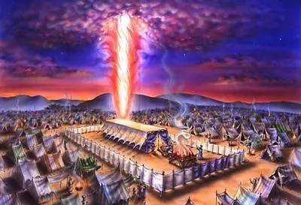
Conclusion…
Daniel 8 is all about the heavenly sanctuary. The context of the chapter emphasizes the loss of the sanctuary message in the taking away of the daily. This was done by Rome, who cast down the sanctuary to the ground—and it practiced and prospered in this work. When would the “sanctuary” be restored from being “trodden under foot”?
The answer is… Unto two thousand three hundred days, then shall the sanctuary be cleansed. In short the importance of the Sanctuary message, the restoration of the heavenly sanctuary doctrine would be restored during a prophetic sanctuary event… The Antitypical Day of Atonement. The prophecy would start with the decree to restore and to build Jerusalem, which occurred in 457BC + 2300 =1844

Slide 20
Explain the time of the end and the Reformation, restoring the Sanctuary
Elijah and the restoration of the altar
Explain the Millerite movement and the 2300 days as the only ones who understood the significance of this passage
Walk through the events and the errors, highlight the importance of the sanctuary throughout
Loughborough’s account, etc.

Slide 21
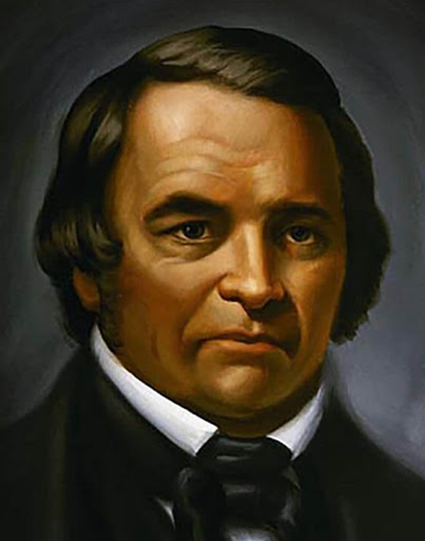
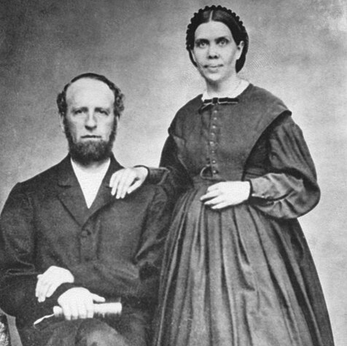
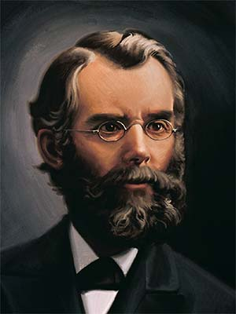
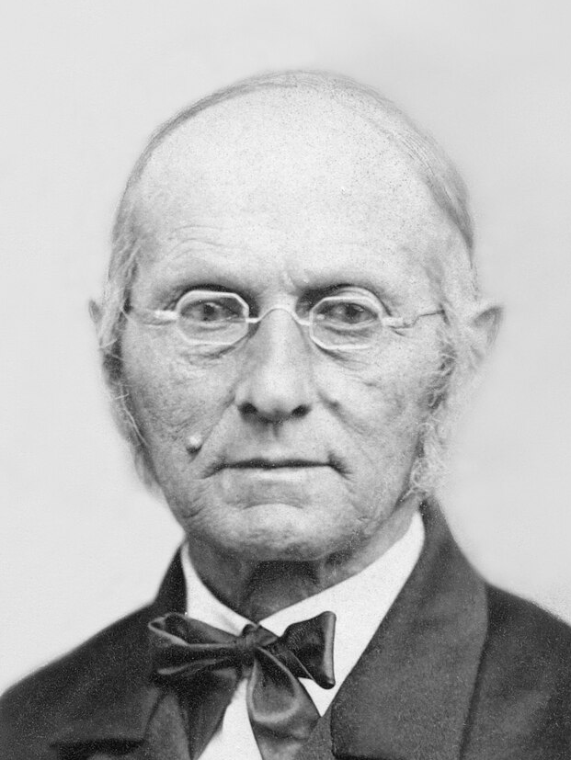
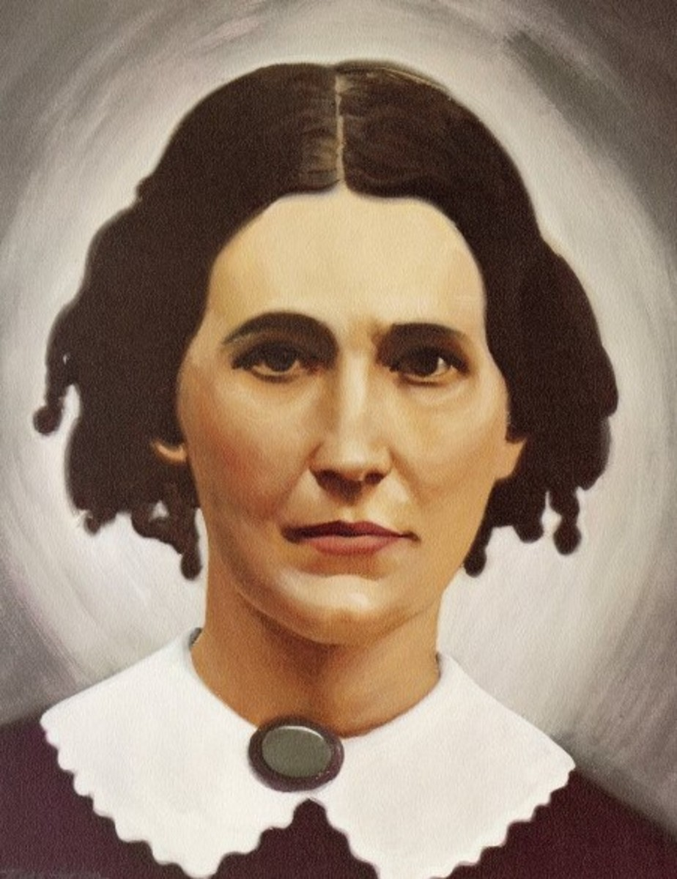
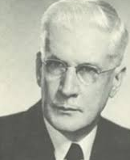
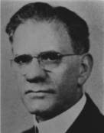
The Fruits Testify…
William Miller’s Millerite Movement bore massive fruits. Picking up where the Reformation stalled, the Millerites began studying the Bible like never before and rediscovered important Bible truths like: The State of the Dead, Prophecies of Daniel and Revelation, The Sabbath, The Investigative Judgment, The Sanctuary, Atonement, Health Principles, Binding Claims of the Law of God, Righteousness by Faith, Importance of Evangelism, Prayer, and Reading, Devotion Time, The Literal Second Coming of Christ, the Remnant, Present Truth, and more. The gift of the Spirit of Prophecy was given to Ellen White to guide this rediscovery. James and Ellen White [top right] devoted their lives to the proclamation of the 3rd Angel’s Message; Joseph Bates and Rachel Oaks [middle right] worked to reestablish the 7th Day Sabbath; John N. Andrews [middle left] was the 1st missionary to Europe and wrote the book The History of the Sabbath; Francis Nichol [bottom left] was an editor, sanitarium official, and apologetics author who wrote many works defending Adventism; Benjamin Wilkinson [bottom right] was a university professor and authored Truth Triumphant. Other names worthy of not include: JN Loughborough, Spalding & Magan, Stephen Haskell, Hyram Edson, Sylvester Bliss, ML Andreason, and many more…

Slide 22
William Miller (1782-1849): William Miller was an American Patriot and served in various offices of local government. In 1810, he moved to Poultney, Vermont where he shook off his Baptist upbringing in favor of Deism. He stated “I became acquainted with the principal men in that village [Poultney, Vermont], who were professedly Deists; but they were good citizens, and of a moral and serious deportment. They put into my hands the works of Voltaire, [David] Hume, Thomas Paine, Ethan Allen, and other deistical writers.” (Miller, William (1845). Wm. Miller's Apology and Defence. Boston, p. 24). However everything changed when he served as a captain in the War of 1812, where at the victory of the Battle of Plattsburgh (Sept. 6-11, 1814) it was evident that God had intervened on behalf of the heavily outmanned and outgunned American forces—Miller survived the battle without so much as a scratch. Recounting the affair, he said: “It seemed to me that the Supreme Being must have watched over the interests of this country in an especial manner, and delivered us from the hands of our enemies... So surprising a result, against such odds, did seem to me like the work of a mightier power than man” (Bliss, Sylvester (1853). Memoirs of William Miller, p. 32, 53). Miller was discharged from the military in 1815, and began attending the Baptist Church again in Low Hampton, NY. At this time he retained deistic views of God, until one Sunday he was volunteered to read the pastor’s sermon to the congregation during one the pastor’s absences. It was about the duty of parents to children. William Miller was so touched by the sermon that he choked up while reading; in his own words: “Suddenly the character of a Savior was vividly impressed upon my mind. It seemed that there might be a Being so good and compassionate as to Himself atone for our transgressions, and thereby save us from suffering the penalty of sin. I immediately felt how lovely such a Being must be; and imagined that I could cast myself into the arms of, and trust in the mercy of, such a One.” (Miller, William (1845). Wm. Miller's Apology and Defence, p. 5). Miller was converted and renounced Deism. When challenged by his former Deist friends on “contradictions” in the Bible, Miller undertook to reconcile these apparent “contradictions”—trusting that the Bible would render sufficient answers to these questions.

Slide 23
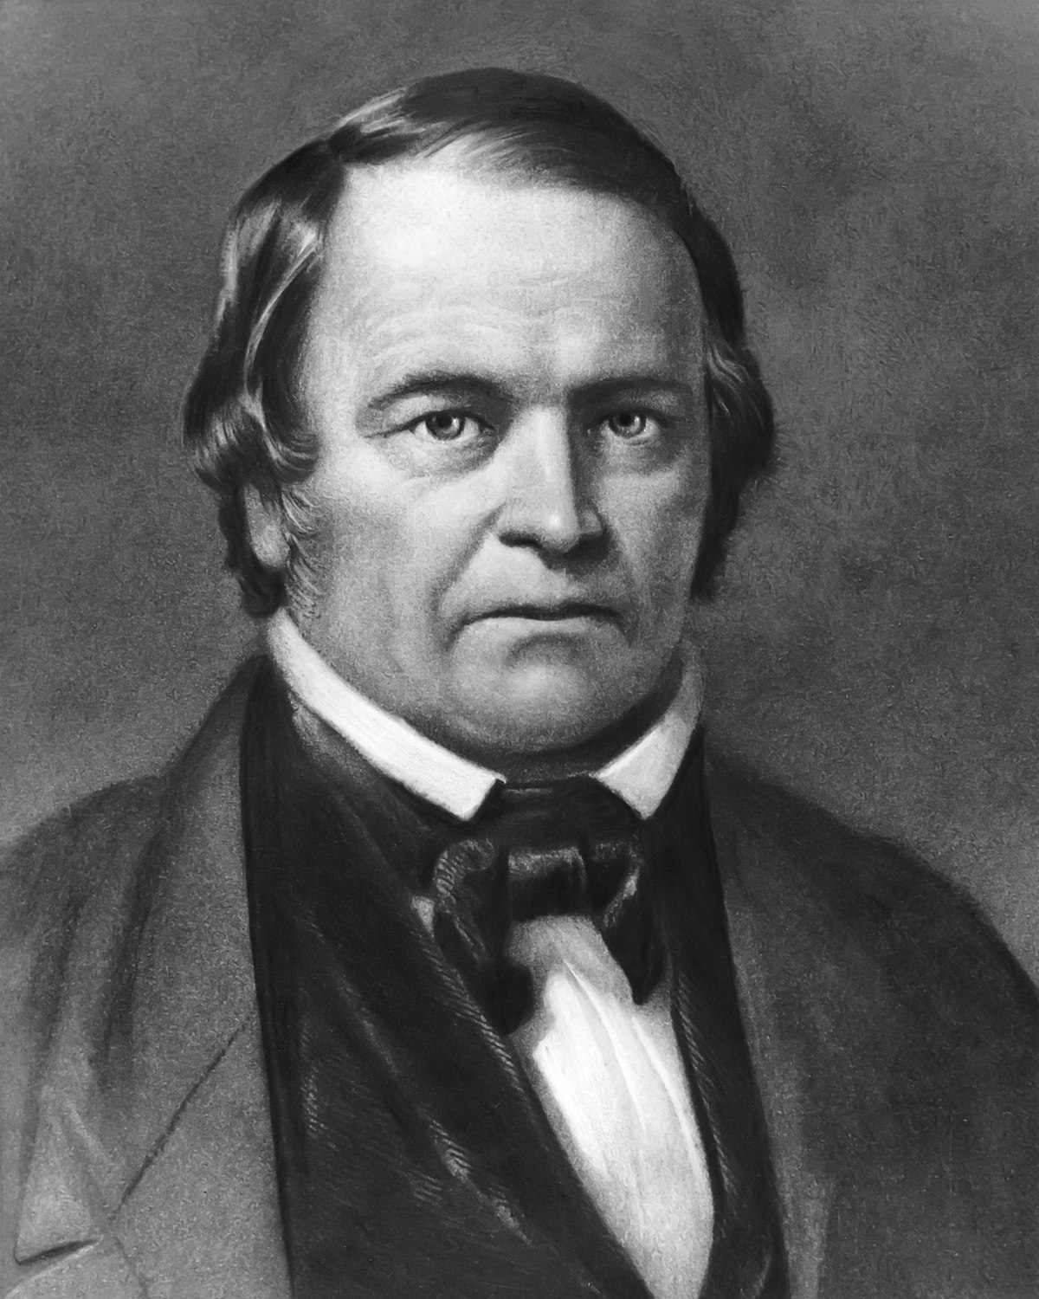
Trusting in the Bible as the Word of God, capable of giving satisfying answers to all perceived “errors” and “contradictions” William Miller began studying the Bible intensely in 1816; beginning with Genesis 1:1. By 1818 he was studying the Book of Daniel. He calculated the 2300 days mentioned in Daniel 8:14 using the Day-Year Principle to end in 1843/1844— identifying the decree to restore and build Jerusalem from Persian King Artaxerxes I in 457BC as the starting point for the prophecy (from Daniel 9:24-27). He interpreted the passage: “then shall the Sanctuary be cleansed” (Dan. 8:14) as meaning that Jesus Christ would Return to “cleanse” the earth by fire at the close of the 2300 day/year period. In 1818, he stated: “I was thus brought... to the solemn conclusion, that in about twenty-five years from that time 1818 [ending in 1843] all the affairs of our present state would be wound up” (Miller, William (1845). Wm. Miller's Apology and Defence, p. 11-12). He continued studying his views to be sure of his interpretation. Finally in 1831 he gave his first formal lecture in the town of Dresden, NY. In 1832, Miller submitted a series of articles to the Vermont Telegraph outlining his understanding of the prophecies he had been studying. The response was overwhelming: “I began to be flooded with letters of inquiry respecting my views; and visitors flocked to converse with me on the subject” (Miller, William (1845). Wm. Miller's Apology and Defence, p. 24). Unable to meet the numerous requests, Miller published: Evidence from Scripture and History of the Second Coming of Christ, about the Year 1844: Exhibited in a Course of Lectures in 1834 so that all could read about what he had discovered in the prophecies of Daniel and Revelation. In 1840, the movement grew when Joshua V. Himes allied with Miller, publishing Signs of the Times and organizing lectures for William Miller. When pressed by the people to apply a specific date for the Second Coming, Miller caved, and in 1843 predicted: “My principles in brief, are, that Jesus Christ will come again to this earth, cleanse, purify, and take possession of the same, with all the saints, sometime between March 21, 1843, and March 21, 1844” (Dick, Everett N. (1994). William Miller and the Advent Crisis, p. 96–97).

Slide 24
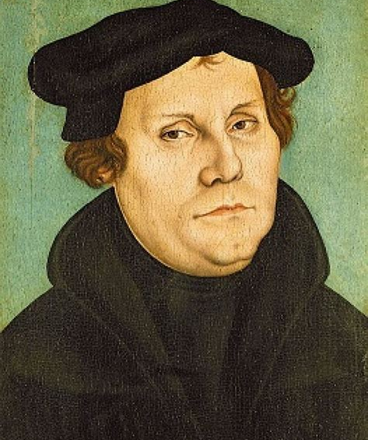
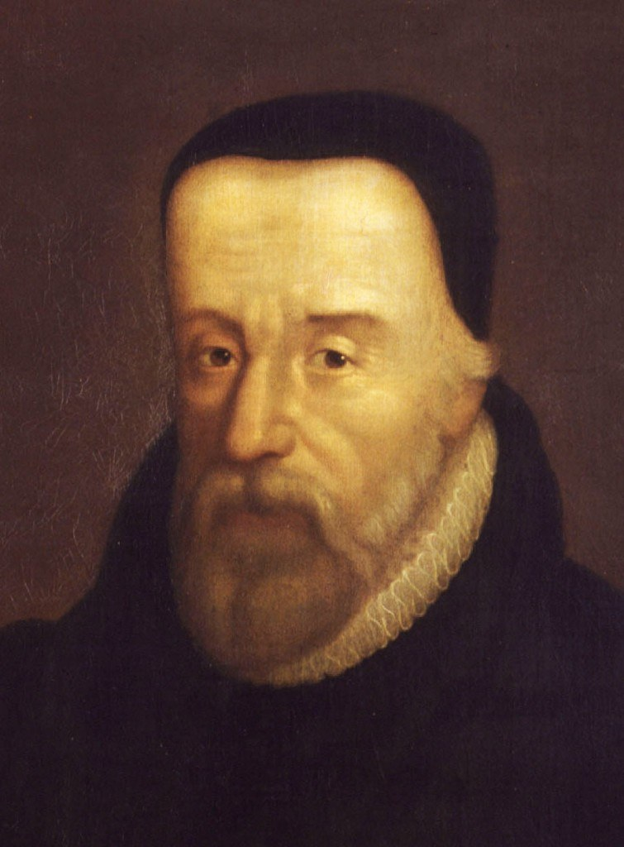
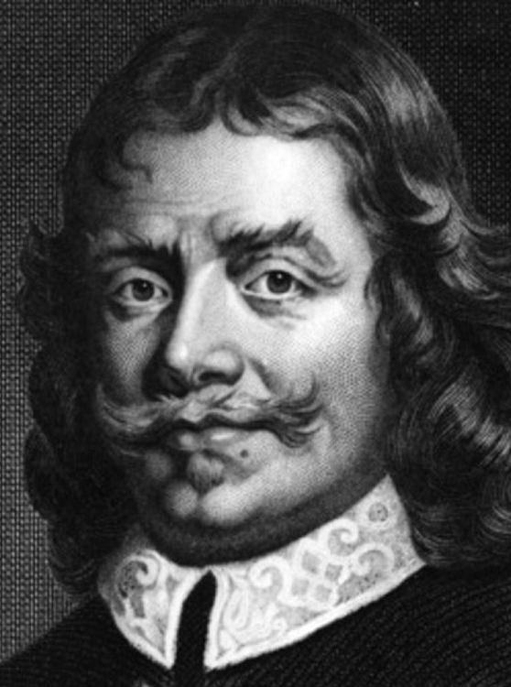
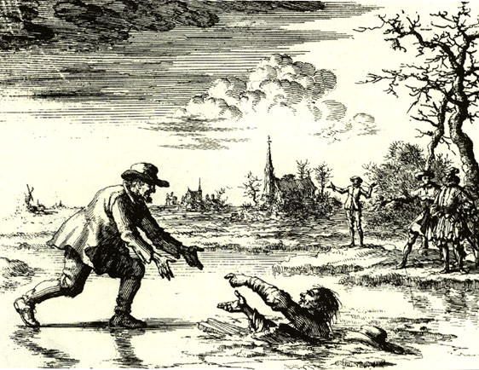
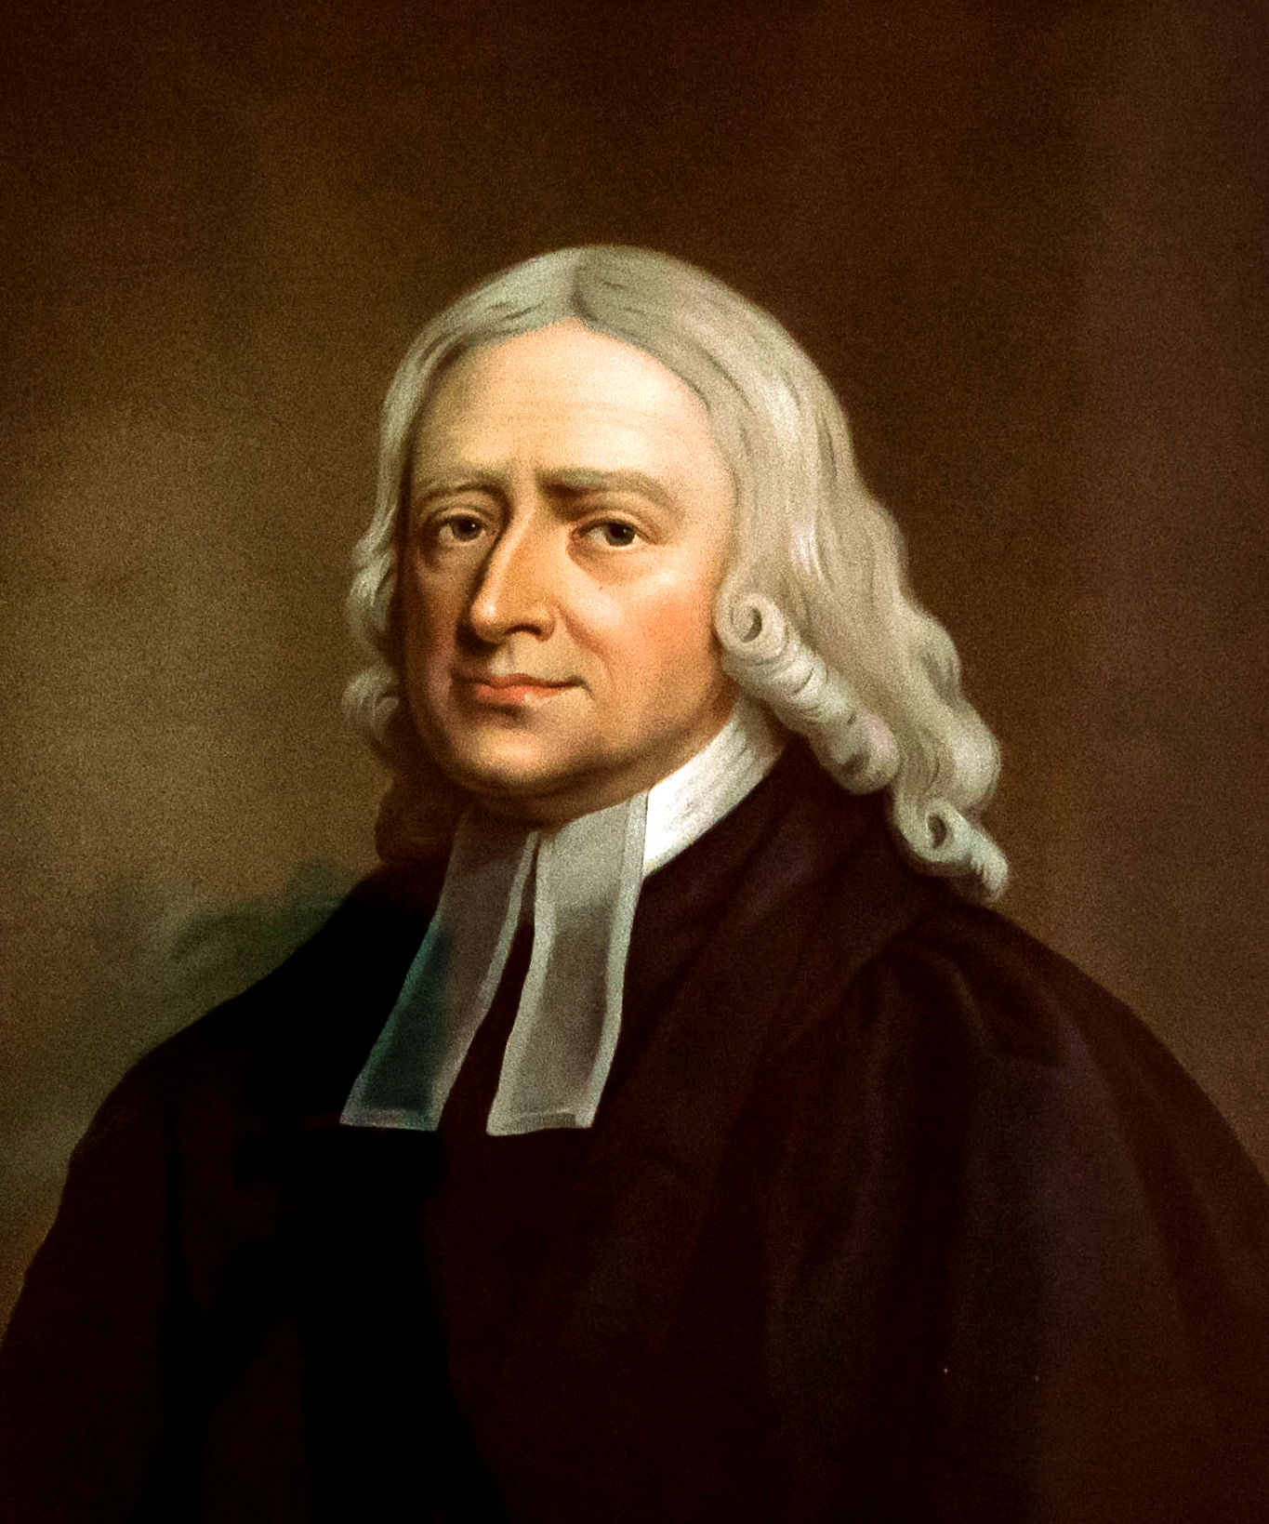
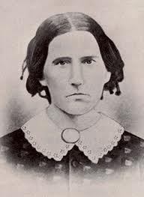

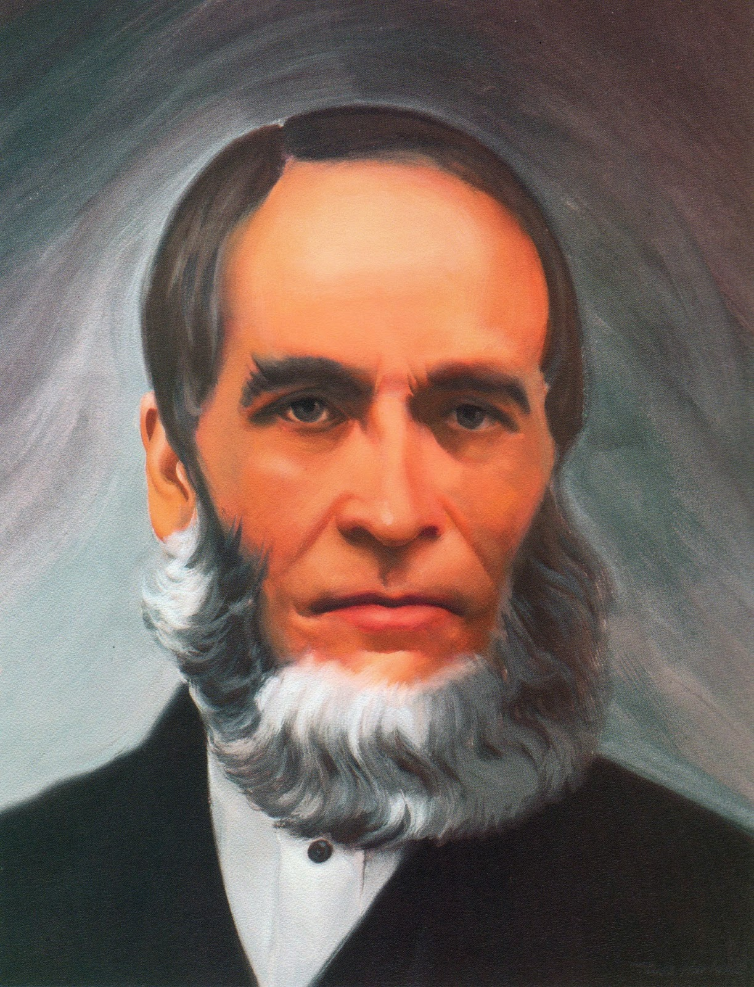
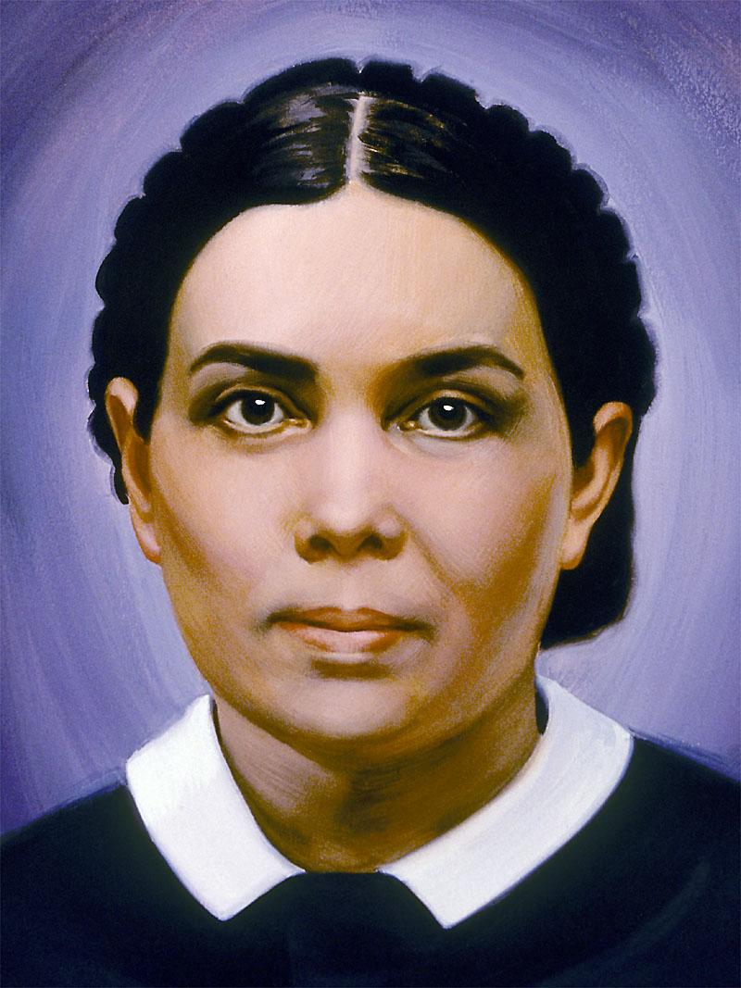

The Reformation Began Recovering the Sanctuary
The Reformation Rediscovered lost truths of the Sanctuary—effectively beginning the process of restoring the spiritual Sanctuary, culminating in the full restoration by Christ in 1844:
Justification by Faith – Altar of Burnt Offering Restored
Baptism and Communion – Laver and Drink Offering Restored
Sola Scriptura – Daily Bread/Shewbread Restored
Evangelism – Candlestick Restored
Prayer in the Spirit – Altar of Incense Restored
Righteousness by Faith – Merits of Christ/incense and oil restored
1844
7. Sabbath – Law of God Restored
8. Health Message – Manna Restored
9. Justification By Faith – Aaron’s Rod/Mercy Seat Restored
10. 3 Angel’s Messages – Judgment Hour/Day of Atonement Message Restored
11. State of the Dead – Investigative Judgment Understanding Restored

