Slide 1
What is the Difference Between Mormons, Jehovah’s Witnesses, and Seventh-day Adventists? pt 4

Slide 2
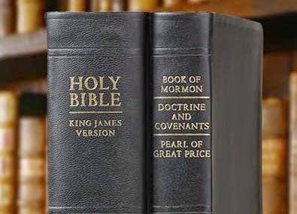
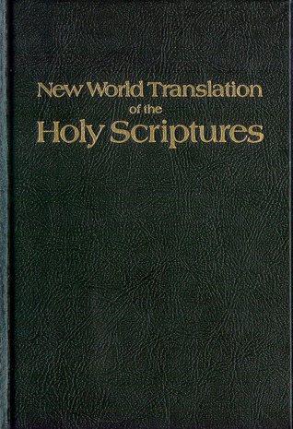
What We Will Study….
Origins of the Religion
Their Authorities and/or Authoritative Texts
Their Doctrinal Differences
Their Message to the World

Slide 3
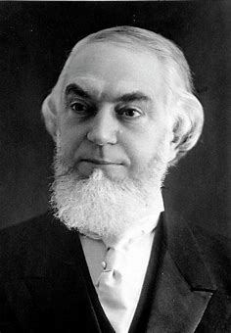
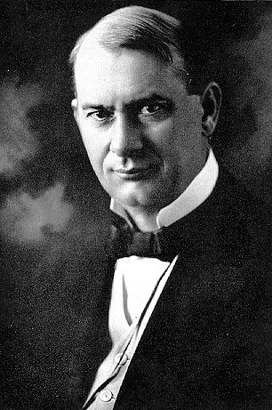
Recap:
Charles Taze Russell studied under Time-setting First Day Adventists, George Storrs, George Stenton, Nelson Barbour, Jonas Wendell
Russell began a Bible Students study group in 1870, where he rejected mainstream Christian doctrines that he felt could not be proved in the Bible: Eternal Hell, Immortality of the Soul, Trinity, Physical Second Coming of Christ, and Predestination
He set times of 1874 for the spiritual invisible Return of Christ, and 1878 for the resurrection of the saints like Abraham, 1881 as the last call to become Anointed, and 1914 as the time of Armageddon; he used the 6,000 year cycle theory, the 2520, and measurements in the Pyramids to calculate these times
In addition what Joseph Rutherford would later call “Satan’s Bible” in Pyramidology, Russell used astrology, phrenology, continued time-setting, and encouraged his followers to gain truth, even from Satanic sources; he was obsessed with Egypt and used many occult/pagan symbols on his publications
He taught dispensationalism as means of understanding prophecy, with many failed prophetic times calculated with this foundation. And the reestablishment of the Nation of Israel—he refused to present the Gospel to the Jews

Slide 4
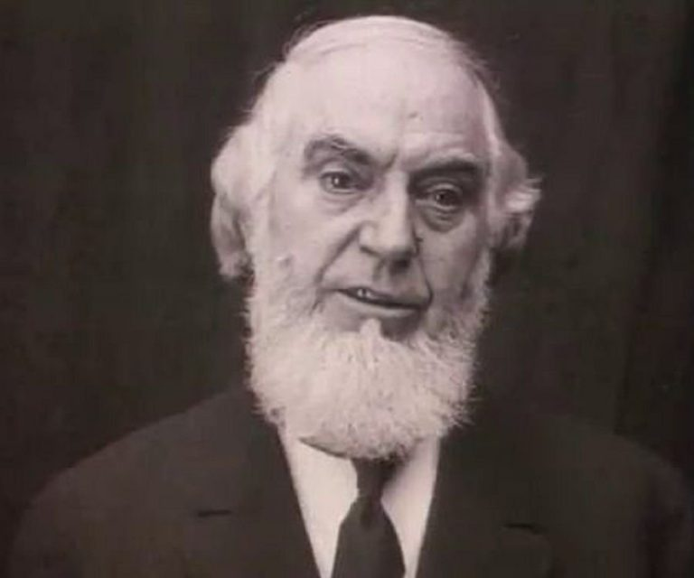
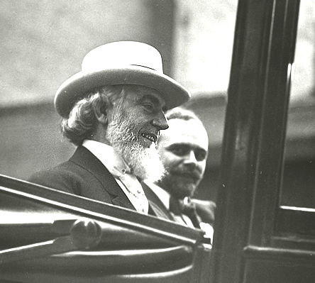
The Restoration of the Nation of Israel
“In 1910 Pastor Russell received a letter from a committee of Jewish leaders: "Dear Sir: Your Sympathetic interest in the Jewish people for years past has not escaped our notice. Your denunciation of the atrocities perpetrated against our race in the name of Christianity has added to our conviction that you are a sincere friend," wrote the committee members. "Your discourse on “Jerusalem and Jewish Hopes” has struck a responsive chord in the hearts of many of our people. Still we doubted for a time if any Christian minister could really be interested in a Jew as a Jew and merely from a hope of proselyting him…You may well understand how surprised we are to find a Christian minister acknowledging that there are prophecies of the Bible still fulfilled, which belong to the Jew and not to the Christian… These things, Pastor Russell, have led to the formation of a Jewish Mass Meeting Committee, which by this letter, request you to give a public discourse," they concluded.”-- HAARETZ.com, Before Herzl, There Was Pastor Russell: A Neglected Chapter of Zionism, Philippe Bohstrom, Aug. 22, 2018

Slide 5
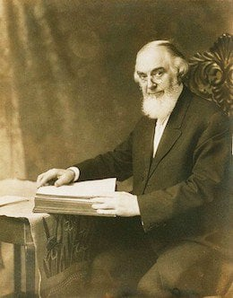
No Gospel Preached to the Jews!?
“The pastor acceded and on October 9, 1910 gave a talk titled “Zionism in Prophecy” before an audience of about 4,000 Jews at the Hippodrome, New York's largest and finest auditorium at the time. As The New York American reported on that day, “The unusual spectacle of 4,000 Hebrews enthusiastically applauding a Gentile preacher, after having listened to a sermon he addressed to them concerning their own religion…where Pastor Russell, the famous head of the Brooklyn Tabernacle conducted a most unusual service. It was not long before all reserve, and all possible doubt of Pastor Russell’s entire sincerity and friendliness were worn away. Then the mention of the name of a great leader [Herzl] who, the speaker declared, had been raised by God for the cause -- brought a burst of applause.“ Russell held similar mass meetings in Chicago, Philadelphia, St. Louis, Kansas City and Cincinnati. In England he addressed 4,600 Jews in London's Royal Albert Hall, following which he appeared in Glasgow and Manchester, then gave talks in other European cities with large Jewish populations, including Vienna, Berlin, Krakow and Budapest.” HAARETZ.com, Before Herzl, There Was Pastor Russell: A Neglected Chapter of Zionism, Philippe Bohstrom, Aug. 22, 2018

Slide 6
Does the Bible Agree???
-John 20:30-31 “And many other signs truly did Jesus in the presence of his disciples, which are not written in this book: But these are written, that ye might believe that Jesus is the Christ, the Son of God; and that believing ye might have life through his name.”
-Acts 4:10-12 “Be it known unto you all, and to all the people of Israel, that by the name of Jesus Christ of Nazareth, whom ye crucified, whom God raised from the dead, even by him doth this man stand here before you whole. This is the stone which was set at nought of you builders, which is become the head of the corner. Neither is there salvation in any other: for there is none other name under heaven given among men, whereby we must be saved.”
-Acts 8:37-38 “And Philip said, If thou believest with all thine heart, thou mayest. And he answered and said, I believe that Jesus Christ is the Son of God. And he commanded the chariot to stand still: and they went down both into the water, both Philip and the eunuch; and he baptized him.”
-Acts 16:29-31 “Then he called for a light, and sprang in, and came trembling, and fell down before Paul and Silas, And brought them out, and said, Sirs, what must I do to be saved? And they said, Believe on the Lord Jesus Christ, and thou shalt be saved, and thy house.”
-Rom. 10:9 “That if thou shalt confess with thy mouth the Lord Jesus, and shalt believe in thine heart that God hath raised him from the dead, thou shalt be saved.”

Slide 7
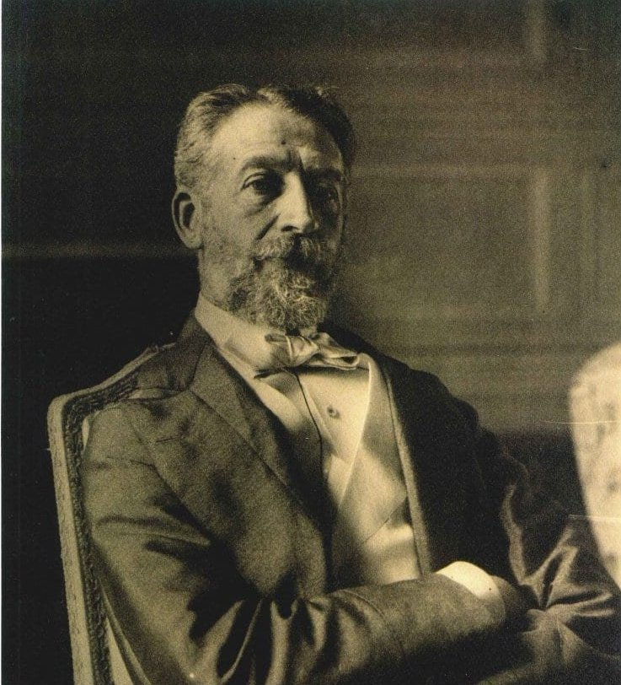
Planning with the Rothschilds???
On August 18, 1891, now in Jerusalem, Russell wrote to the philanthropists Baron Maurice de Hirsch and Baron Edmond de Rothschild, or as he puts it “the two leading Hebrews of the world.” No less, he put forward a practical plan for Zionism. It involved purchasing all government-owned land in Palestine, i.e., land not held by private owners, from the impoverished Ottoman Empire. Years later Herzl would make similar proposals. (A copy of the letter is published in "Zion's Watchtower and Herald of Christ's Presence", December 1891, pp. 170-171.)” Ibid.

Slide 8
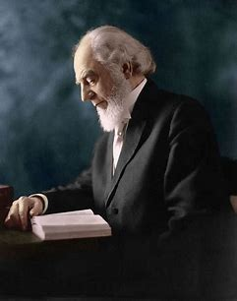
Russell to Rothschild: You Will Rule by 1915
“As you will see from my books, we find the testimony of the prophets to be, that your nation will be greatly blessed and return to divine favor between now and the year 1915, A.D.," Russell wrote. The persecutions that Jews were suffering in Russia were "a mark of divine favor rather then the reverse," the pastor suggested - and it would only get worse because the Lord's purpose was to drive the Jews "out of all lands whither he has scattered them.“ Ibid.

Slide 9
Masonic Ties?
“We must demand that the Society of Jesus be expelled from the American Empire, while earnestly praying for individual Jesuits that they would leave the Company and tell their story. Laws must be passed that no one may hold public office who has given an oath of allegiance to a foreign Monarch—especially the Pope! This would include the Knights of Malta and the Knights of Columbus. Laws must be passed that no member of a secret society can hold public office. This would include all Freemasons, as their doctrines are secret, their lodges have no windows (just like the Kingdom Halls of the Masonically-controlled Jehovah’s Witnesses who deny the deity of Jesus Christ) and their highest leaders are loyal to the Jesuit General.” Eric Jon Phelps, Vatican Assassins, 3rd Ed., p. 1693

Slide 10
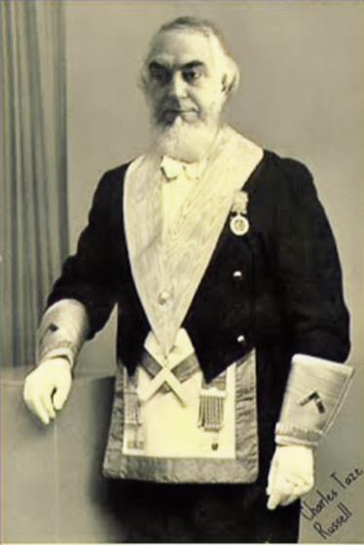
The Masonic Question….
Pieces of Evidence:
According to the book “Bloodlines of the Illuminati” by Fritz Springmeier, the “Russell” Family is one of the major families in history who are tied to the Illuminati and extremely successful. The Skull and Bones Society was started by a man named William Russell, and organized under the “Russell Trust”—it is unclear if there is any relation..
Charles T. Russell is promoting Time-Setting Armageddon theories, of which the prophecy happens to begin in 1914, which was the start of World War I, which is based on the erroneous and unbiblical teaching of the 2520
Charles T. Russell does not try to get Jews to accept the Gospel, but to reestablish a nation, which God will use to rule the earth—Zionism

Slide 11
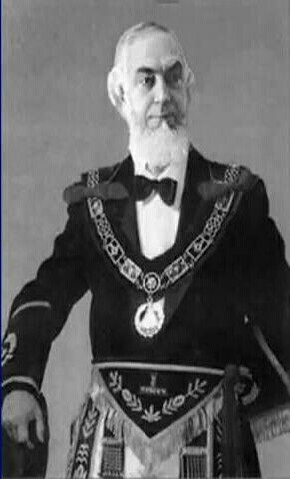
Charles Knows the Masonic Handshakes?
“Many Masons shake hands with me and give me what I know is their grip; they don't know me from a Mason. Something I do seems to be the same as Masons do, I don't know what it is; but they often give me all kinds of grips and I give them back, then I tell them I don't know anything about it except just a few grips that have come to me naturally” June, 1913, Masonic Hall in San Francisco (see Wayback Machine (archive.org), Pastor Russell’s Convention Tours, CR 362)

Slide 12
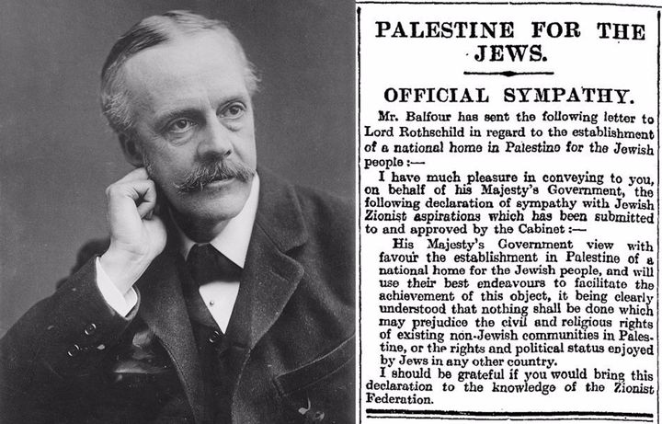
1914: World War I and then the Nation of Israel
“World War I began with the assassination of Austrian Royalty in the person of the Archduke Franz Ferdinand by the Serbian Gavrilo Princip. In a domino effect, many countries into the war in opposing factions. America entered the war in 1916 after the terrorist attack of the sinking of the Lusitania German Uboats. It is estimated that 20 million people died in the war, and over 40 million military and civilian casualties. The war ended with the signing of the Treaty of Versailles which was extremely antagonistic to Germany. After the war, the world saw the creation of the “League of Nations” which was the first attempt of a united world government alliance, which failed and would later be replaced by the United Nations. Great Britain was entrusted with the temporary rule of Palestine, which allowed for Jewish resettlement in Israel. The Balfour Declaration was given in 1917, declared the necessity of restoring the nation of Israel “On November 2, Balfour sent a letter to Lionel Walter Rothschild—scion of the Rothschild family, a prominent Zionist and a friend of Chaim Weizmann—stating that: “His Majesty’s Government view with favor the establishment in Palestine of a national home for the Jewish people”—History.com, the Balfour Declaration, August 21, 2018

Slide 13
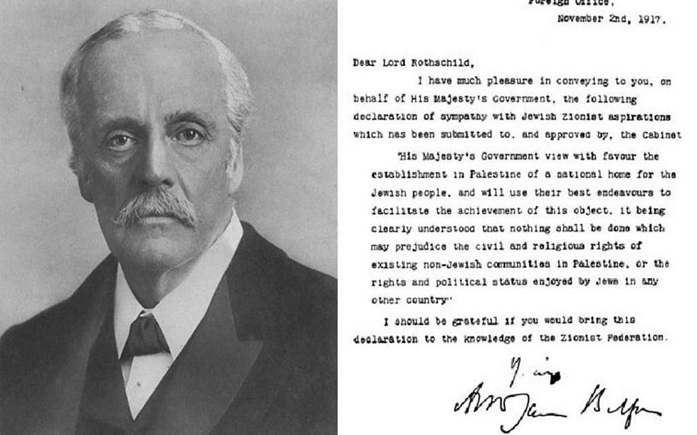

Slide 14
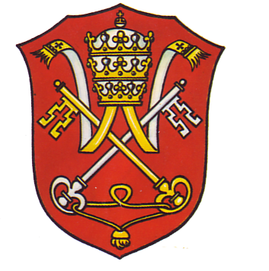
Who are the Rothschilds???
“Aware that the Rothschilds are an important Jewish family, I looked them up in Encyclopedia ]udaica and discovered that they bear the title “Guardians of the Vatican Treasury.” The Vatican Treasury, of course, holds the imperial wealth of Rome. Imperial wealth grows in proportion to its victories in war – as the Jesuit empowerment Regimini militantis ecclesiae implies, the Church-at-War is more necessary than the Church-at-Peace. According to H. Russell Robinson’ s illustrated Armour of Imperial Rome, Caesarean soldiers protected themselves in battle with shields painted red. Since the soldiery is the State’s most valuable resource (the Council of Trent admitted this in preferring the Jesuits to all other religious orders), it is easy to understand why the red shield was identified with the very life of the Church. Hence, the appropriateness of the name Rothschild, German for “red shield.” The appointment of Rothschild gave the black papacy absolute financial privacy and secrecy. Who would ever search a family of orthodox Jews for the key to the wealth of the Roman Catholic Church? I believe this appointment explains why the House of Rothschild is famous for helping nations go to war.” F. Tauper Saussy, Rulers of Evil, p. 160-161

Slide 15
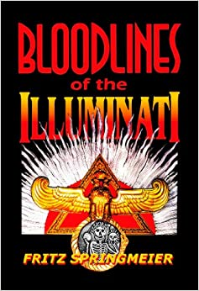
Bloodlines of the Illuminati
“It has been said all roads lead to Rome. For this book, it could be said all paths of investigation lead to the Rothschilds. Charles T. Russell, in a 1891 letter to Baron (Lord) Rothschild, mailed from Palestine, outlined possible courses of action that could be taken to establish the Jews in Palestine. Russell’s letters praised the Rothschild’s money which established Jewish colonies in Palestine. Russell writes Rothschild, “What is needed here, therefore, next to water and cleanliness, is a good government which will protect the poor from the ravenous and the wealthy. Banking institutions on sound bases, and doing business honorably, are also greatly needed" Russell continues, "May the God of Jacob direct you, my dear Sir, and all interested with you in the deliverance and prosperity of Israel, and blessed will they be who, to any extent, yield themselves as his servants in fulfilling his will as predicted.“ Fritz Springmeier, Bloodlines of the Illuminati, ch. Financial Wizards and Wealthy p. 116 (PDF)

Slide 16
Where is Russell Getting His Theology From?
“In the decades that followed it became apparent that, in order to achieve their goal of world domination, they would have to instigate a series of world wars which would result in the leveling of the old world order in preparation for the construction of the New World Order. This plan was outlined in graphic detail by Albert Pike, the Sovereign Grand Commander of the Ancient and Accepted Scottish Rite of Freemasonry, and the top Illuminist in America, in a letter to Giuseppe Mazzini dated August 15, 1871. Pike stated that the first world war was to be fomented in order to destroy Czarist Russia—and to place that vast land under the direct control of Illuminati agents. Russia was then to be used as a 'bogey man' to further the aims of the Illuminati worldwide. World War II was to be fomented through manipulation of the differences that existed between the German Nationalists and the Political Zionists. This was to result in an expansion of Russian influence and the establishment of a state of Israel in Palestine [May, 1948]. The Third World War was planned to result from the differences stirred up by Illuminati agents between the Zionists and the Arabs. The conflict was planned to spread worldwide. The Illuminati, said the letter, planned to "unleash the Nihilists and Atheists" and "provoke a formidable social cataclysm which in all its horror will show clearly to the nations the effect of absolute atheism, origin of savagery and of the most bloody turmoil. Then everywhere, the citizens, obliged to defend themselves against the world minority of revolutionaries, will exterminate those destroyers of civilization, and the multitude, disillusioned with Christianity, whose deistic spirits will from that moment be without compass [direction], anxious for an ideal, but without knowing where to render its adoration, will receive the true light through the universal manifestation of the pure doctrine of Lucifer, brought finally out in the public view, a manifestation which will result from the general reactionary movement which will follow the destruction of Christianity and atheism, both conquered and exterminated at the same time." Des Griffin, Descent Into Slavery, p. 38-39

Slide 17
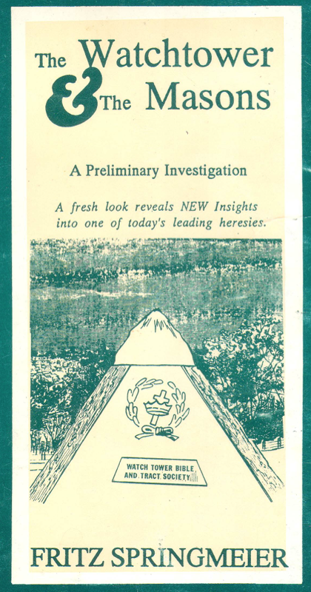
Russell Tapped Into the Illuminati Plan???
Evidence:
1. Charles T. Russell was preaching false doctrines, and using them to set prophetic times, which correlated to actual events which were controlled by Rome
2. Charles T. Russell “knew” “naturally” Masonic handshakes and used them
3. Charles T. Russell promoted the Illuminati plan to reestablish the Nation of Israel—based again on false doctrines
4. Charles T. Russell was in direct contact with the Rothschilds family (aka Rome) and planned how to reestablish Israel for the Jews
5. Charles T. Russell was obsessed with Pagan mystic practices and symbols like Pyramidology, astrology, and winged disks

Slide 18
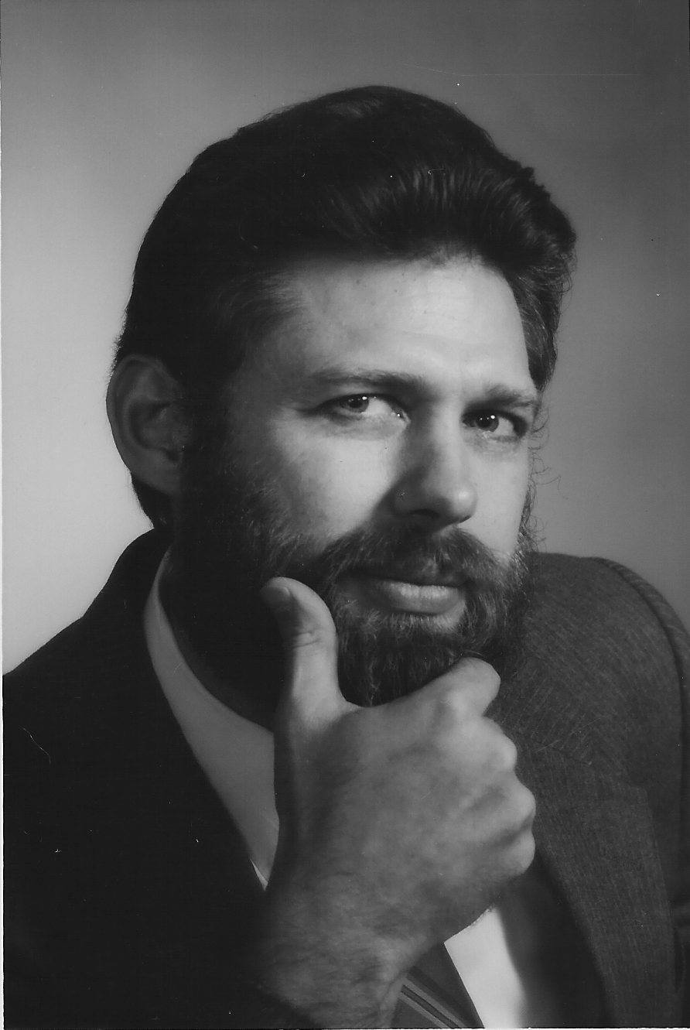
Fritz Springmeier Says Russell was a Satanist?
One of the strangest things for this Author was to continue running into evidence that seems to indicate Charles Taze Russell, the man who started the Jehovah’s Witnesses’ Watchtower Society, was secretly an important Satanist. Lest the reader devalue the evidence, permit this author to state that the evidence came in first before I came up with my theory that Russell was an important Satanist, and not vice-versa. Some of the outstanding clues are:
a.) C.T. Russell was definitely a Mason, yet he puts up some great smokescreens in his writing concerning his membership.
b.) C.T. Russell’s Bethel staff became concerned about his occultic activities and required him to take an oath forswearing any further occultic activities.
c.) In my previous book The Watchtower and the Masons, I study 35 parallel beliefs that Russell had with Masonry. I spent a page per parallel. These 35 are not in any way inclusive, Russell had many other identical ideas to what the Masonic lodges propogate.” Fritz Springmeier, Bloodlines of the Illuminati, p. 166 (PDF)

Slide 19
Satanic Assessment Continued…
d.) Various items from magic were part of Russell’s religious beliefs including healing handkerchiefs, phrenology, the Winged-Sun-Disk, Enochian Magical planes, etc.
e.) Russell’s family’s possible Illuminati links, and his wife’s possible connections with a family line of Satanists.
f.) Russell’s apparent secret Rosicrucian membership with the Quakertown, PA group of Rosicrucians, as revealed by the pyramid he ordered erected, his use of the Winged-Sun-Disk. and his cremation three days after his death.
g.) Russell owned a cemetary in Pittsburgh. Leading Satanists try to own cemetaries for several reasons. First, it facilitates the disposal of human sacrifices which are buried in pieces below the fresh holes dug for someone else’s burial. When the casket is placed in the hole, it would be rare for anyone to dig below the casket level ever again. Second, magic power is associated with cemetaries. The spiritual power of the dead is pulled up by making a circle of light over them then within the circle a naked Satanist lays. Third, specific bones are sought such as the skulls and left hands. Left hands are preserved in order to hold candles for certain ceremonies.
h.) Contacts from various places today indicate that the modern Watchtower Society is working with the New World Order. This implies that at some point the Society began cooperating with the New World Order. Russell seems to be the likeliest starting point.” Ibid.

Slide 20
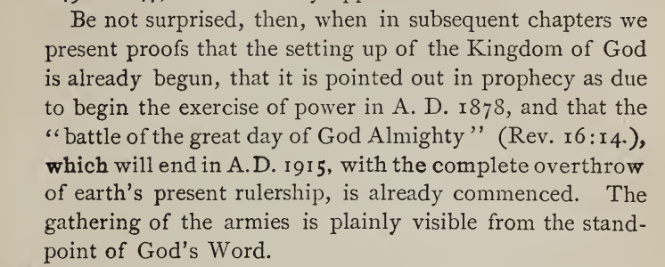
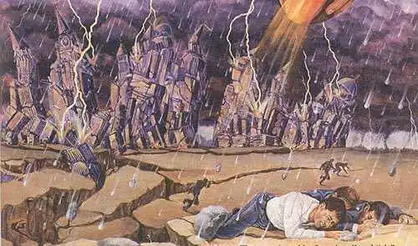
Back to The Origin Story
(Russell, The Time is at Hand, (1914 ed.) p. 101

Slide 21
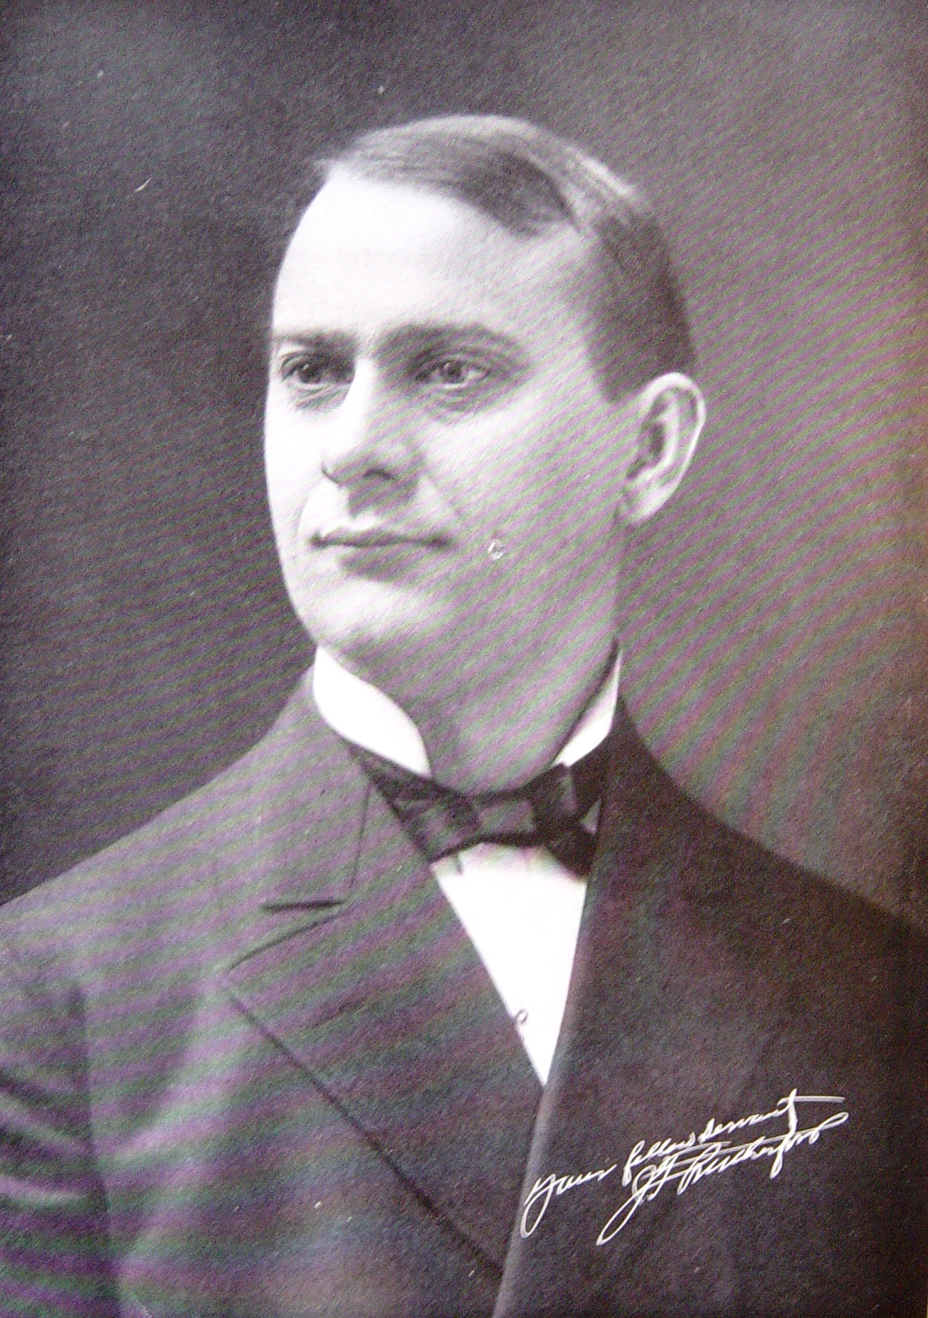
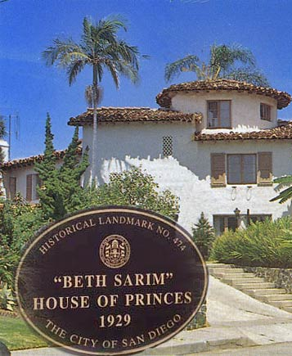
Russell to Rutherford—Old Habits!
In a concise summarization, after Russell died in 1916, Joseph F. Rutherford obtained the presidency of the WatchTower Society, he began increasing and centralizing power, which upset many congregations of Bible Students which were accustomed to Russell democratic leadership. He set times for Armageddon between 1918-1920 (The Finished Mystery, p. 258 & 404), for the resurrection of the patriarchs in 1925 (The Way to Paradise, p. 224). Rutherford had a palace built called Beth Sarim in San Diego, in the 1920s as the dwelling place for the patriarchs and prophets, which became his residence, and later quietly sold by the organization. As a result of the new control policies and unfulfilled prediction many thousands left the Watchtower Society and started other Bible Student movements. Finally, by 1931, Rutherford introduced the new name “Jehovah’s Witnesses” in 1931 to distinguish them from the other Bible Student movements. Rutherford and the Jehovah’s Witnesses went on to set other times 1941 (WWII), 1975, the generation of 1914, on to overlapping generations. They created a new translation of the Bible called the NWT complete in 1961 (the translators remain anonymous).

Slide 22
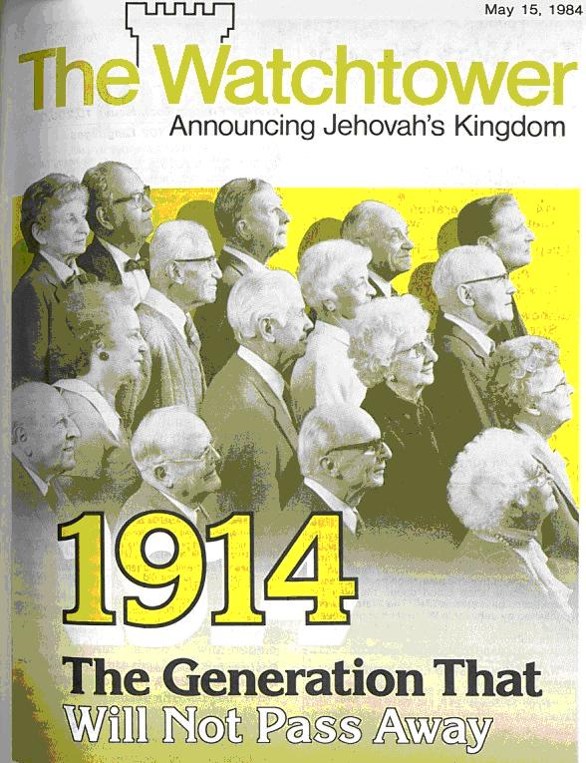
The Legacy:
Charles Taze Russell comes out of the branch of Millerism that went on to time-set and time-set and spiritualize away there false ideas—using the speculative ideas of 2520, pyramidology, and the 6,000 year cycle
Charles Taze Russell was a successful tract publisher who set multiple times for various event—all of which failed
Russell had knowledge of Masonic handshakes, planned Zionistic goals with the Rothschilds (Jesuits), and did not preach Christ to the Jews as necessary for salvation
The name “Russell” is one of the dominant family “bloodlines of the Illuminati” which rule the world in secret---Russell’s ties to Zionism and the Rothschilds makes this claim credible
After his death, Russell was replaced by a spiritual dictator Rutherford who continued to set times—all of which failed
The Jehovah’s Witnesses got their name from Rutherford in 1931, and went on to time-set more after his death and create a new Bible

Slide 23
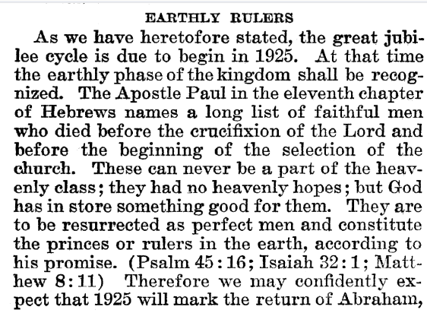
Rutherford Predicts Return of Abraham
Joseph F. Rutherford, (1920): Millions Now Living Will Never Die! p. 89-90

Slide 24
Time-setting Again! 1975
"Choosing the Best Way of Life". The Watchtower. March 15, 1980. pp. 17–18. With the appearance of the book Life Everlasting—in Freedom of the Sons of God, ... considerable expectation was aroused regarding the year 1975. ... there were other statements published that implied that such realization of hopes by that year was more of a probability than a mere possibility. It is to be regretted that these latter statements apparently overshadowed the cautionary ones and contributed to a buildup of the expectation already initiated. ... persons having to do with the publication of the information ... contributed to the buildup of hopes centered on that date.
"What will the 1970's Bring?". Awake!. Watch Tower Society. October 8, 1968. p. 14. Does this mean that the above evidence positively points to 1975 as the complete end of this system of things? Since the Bible does not specifically state this, no man can say... If the 1970s should see intervention by Jehovah God to bring an end to a corrupt world drifting toward ultimate disintegration, that should surely not surprise us.
"How Are You Using Your Life?". Our Kingdom Ministry. May 1, 1974. p. 63. Reports are heard of brothers selling their homes and property and planning to finish out the rest of their days in this old system in the pioneer service. Certainly, this is a fine way to spend the short time remaining before the wicked world's end.

Slide 25
Decline of the Watch Tower After Death
Chicago Daily Tribune October 30, 1949 pg 18: "Pastor Russell died in 1916. In the 33 years since, the methods of this sect have deviated completely from those of Pastor Russell and his manner of teaching."

Slide 26
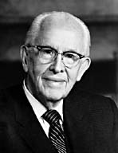
An Important Statement From an LDS Prophet
Prophet Ezra Taft: “the Book of Mormon is the keystone of our religion. This was the Prophet Joseph Smith’s statement. He testified that “the Book of Mormon was the most correct of any book on earth, and the keystone of our religion” (Introduction to the Book of Mormon). A keystone is the central stone in an arch. It holds all the other stones in place, and if removed, the arch crumbles.” (October 1986 General Conference)

