Slide 1
Kings Who Have Fallen
An Abbreviated List

Slide 2

1584
“A German nobleman by birth, William the Silent became the leader of a rebellion in the Netherlands against the king of Spain. Passionately devoted to the cause of the unity of the Netherlands, he saw the country dividing into distinct northern and southern states under the impact of military events and religious antagonisms. At various times a Lutheran, a Roman Catholic, and a Calvinist, William was most of all dedicated to Erasmian tolerance in religion;”
http://www.encyclopedia.com/topic/William_the_Silent.aspx

Slide 3
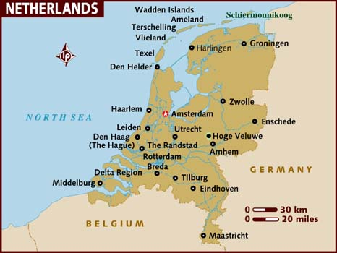
Protestant Unification
During 1584 the States of Holland and Zeeland proposed to give William the title of count with limited powers, but he was slain on July 10 by Balthasar Gérard, a Roman Catholic from Franche-Comté, at the Prinsenhof in Delft before any action was taken. The last words attributed to him, "God, have pity on me and this poor people," expressed his devotion to the cause for which he had fought so long. ” ibid.

Slide 4
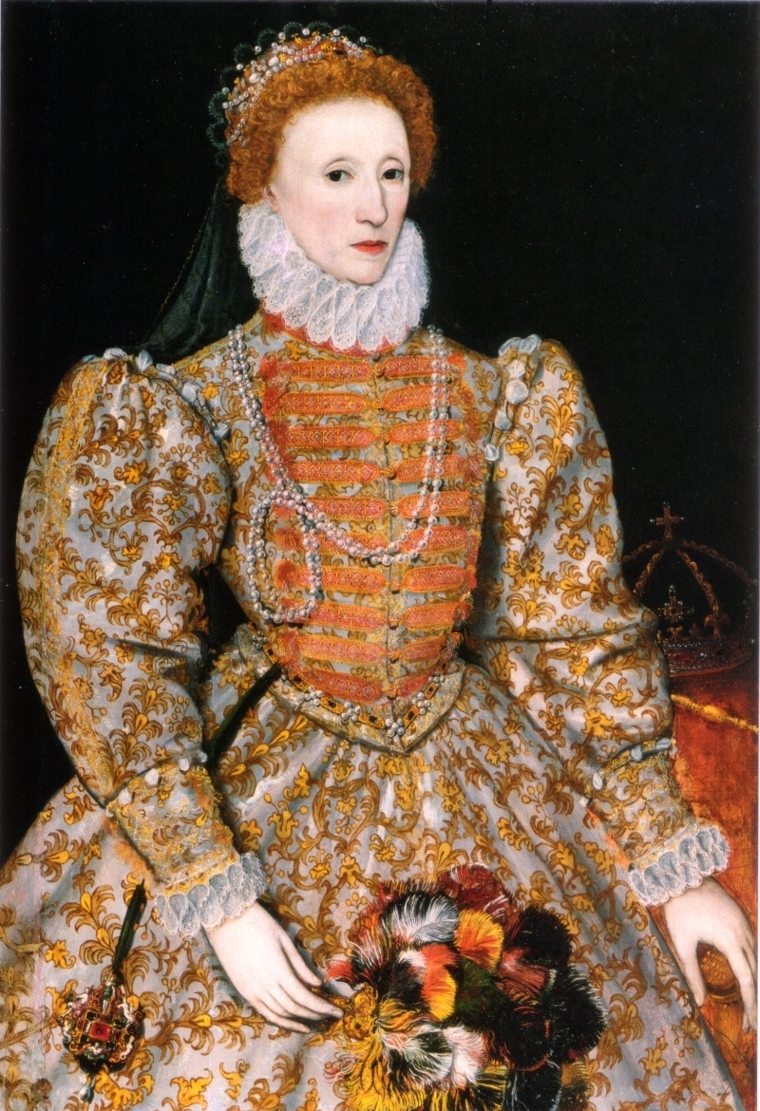
Elizabeth I
“After her accession, Elizabeth wrote to Sir Richard Crane, the English ambassador in Rome, to notify the people of her accession. But she was informed by ‘His Holiness’ that England was a fief [servant or slave] of the ‘Holy See,’ that Elizabeth had no right to assume the crown without his permission, that she was not born in lawful wedlock, and could not therefore reign over England; that her safest course was to renounce all claims to the throne, and submit herself entirely to his will; then he would treat her as tenderly as possible. But, if she refused his ‘advice,’ he would not spare her! She declined the pope’s advice, and the hatred of Pius and his successors was assured. — J.E.C. Shepherd, The Babington Plot, Wittenburg Publications, p. 46.

Slide 5
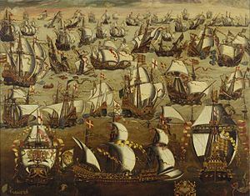
When all else fails, send Armada!
“Later on it was Pope Sixtus X who promised Philip of Spain a million scudi to assist in equipping his ‘Invincible Armada’ to destroy the throne of Elizabeth, and the only condition the pope made in bestowment of his gift: ‘he should have the nomination of the English sovereign, and that the kingdom should become a fief of the church.’ — Ibid, p. 47.
The famous Spanish Armada was sent to crush England because Elizabeth would not give her throne and kingdom to the pope.

Slide 6
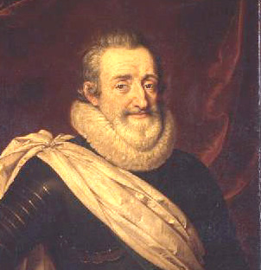
Henry of Navarre, the IV
“As a Huguenot, Henry was involved in the Wars of Religion before ascending the throne in 1589. Before his coronation as King of France at Chartres, he changed his faith from Calvinism to Catholicism and, in 1598, he enacted the Edict of Nantes, which guaranteed religious liberties to the Protestants, thereby effectively ending the civil war. One of the most popular French kings, both during and after his reign, Henry showed great care for the welfare of his subjects and displayed an unusual religious tolerance for the time. He was assassinated by a fanatical Catholic, François Ravaillac.^{[1]”}
http://en.wikipedia.org/wiki/Henry_IV_of_France

Slide 7
Edict of Nantes, 1598
“Henry IV had been a Huguenot but had agreed to conform to the Roman Catholic church in order to become king. At the time of the edict, he was a French Catholic king. The French kings were from a long line of kings who viewed their authority as a Devine right. Consequently, his Edit of Nantes was an exceptionally revolutionary document for its time. It was the first, long-lasting decree of religious toleration in modern Europe. It granted unheard of religious rights, in Catholic Europe, to French Protestants [Huguenots].
The Edict of Nantes marked the end of France’s Wars of Religion [1562 – 1598]. Over the course of these wars a series of treaties had been negotiated that provided certain privileges to the Huguenots. However, all had been broken. The Edict of Nantes integrated the various religious provisions of this series of broken treaties and provided a number of additional ones.” http://www.french-at-a-touch.com/French_History/edict_of_nantes_%5B1589%5D.htm

Slide 8
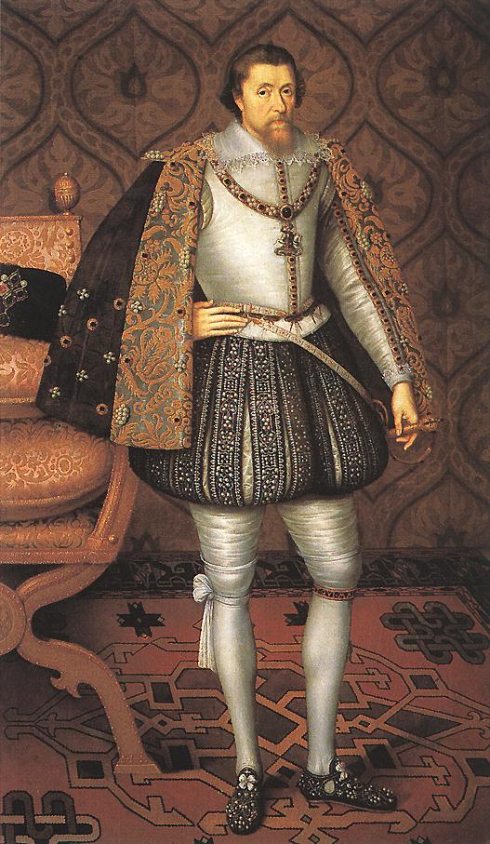
King James I
While most accounts indicate that James I was far more agreeable to and trying to be less stringent on Rome and her Jesuits, clearly Rome was not pleased with James I progress. Thus, the Gunpowder Plot was hatched. This was aimed at all of Parliament in one awful, devilish moment of annihilation! This event is identical to the Lincoln plot of 1865!!

Slide 9
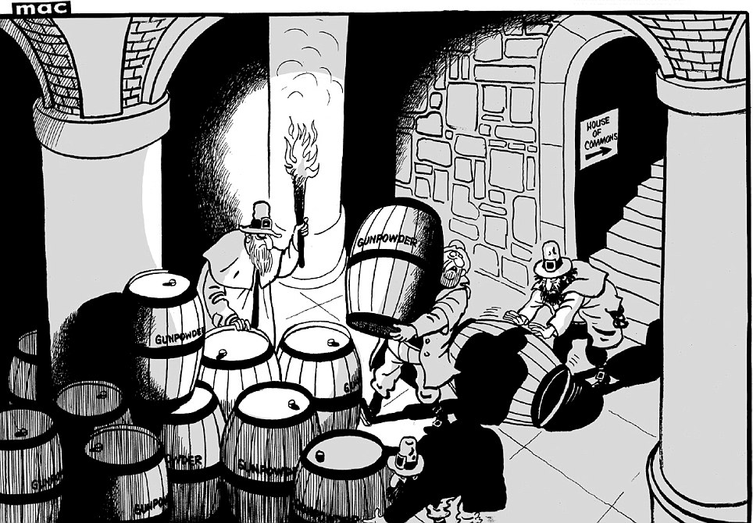
Blow Them All Up!
The Gunpowder Plot came to its culmination November 5th, 1605. The intent of the Gunpowder Plot was the wholesale attempt to assassinate King James I and all of Parliament as they begin delineating in session. If you don’t like the laws, you blow up those making them!

